Slide 1
Sub-Saharan Africa

Slide 2
Africa is a CONTINENT

Slide 3
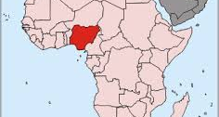
Its most populous country is Nigeria

Slide 4
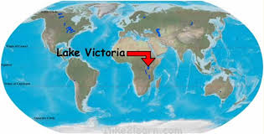
Lake Victoria
Largest lake in this region
Source of part of the Nile River
Equator runs through it

Slide 5
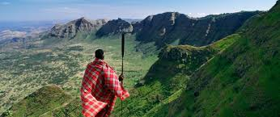
Great Rift Valley
Formed by the spreading of tectonic plates in East Africa

Slide 6
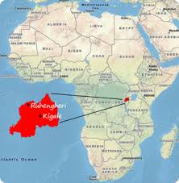
Rwanda
Had a civil war with ‘ethnic cleansing’ between the Hutus and Tutsis

Slide 7
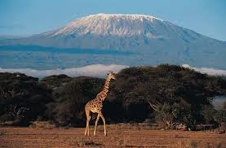
Kilimanjaro
Tallest mountain in Africa

Slide 8
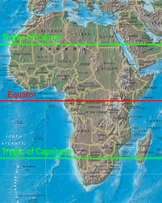
Equator
0 degress latitude
Runs through Africa

Slide 9
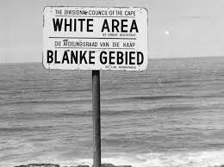
Apartheid
Racial discrimination that occurred in South Africa until the early 1990’s.

Slide 10
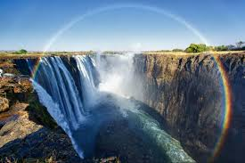
Zambezi River
Located in southern Africa
Location of Victoria Falls

Slide 11
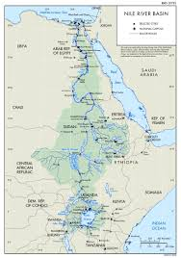
Nile
Longest river in the world
Flows south to north

Slide 12
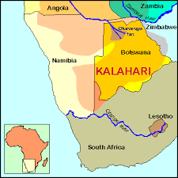
Kalahari
Desert in and around Botswana in southern Africa

Slide 13
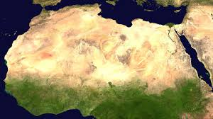
Sahara
Largest desert in the world
Is divided from Sub-Saharan Africa by the dry region known as the Sahel

Slide 14
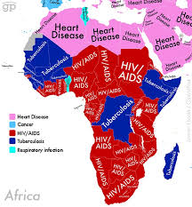
Diseases/Health Problems
Malaria
AIDS
Tuberculosis
Also Ebola

