Slide 1
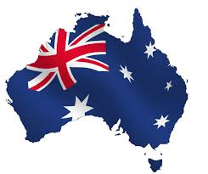
Australia

Slide 2
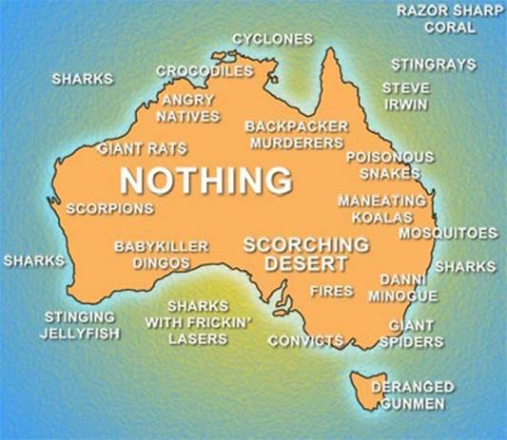
Map

Slide 3
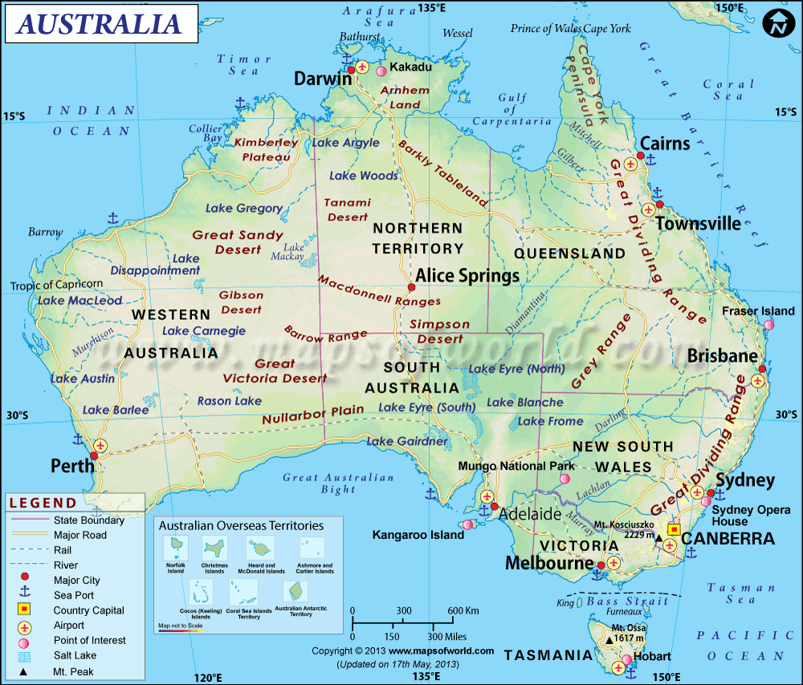

Slide 4
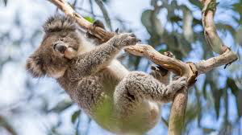
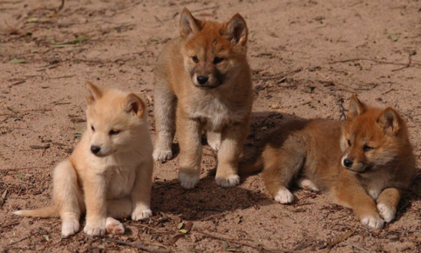
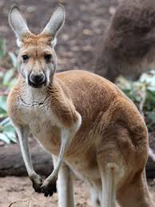
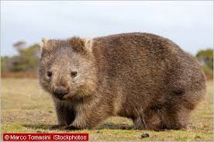
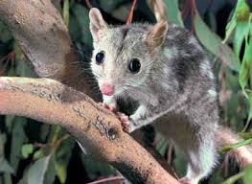

Slide 5
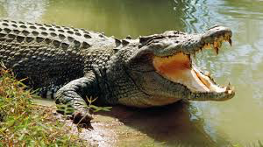
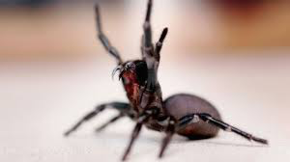
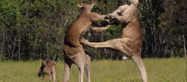
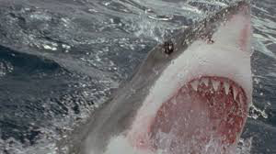
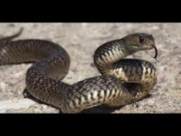

Slide 6
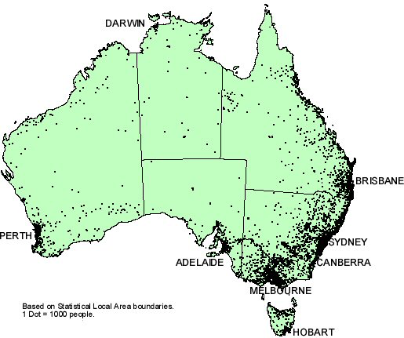
Facts
The capital of Australia is Canberra.
There are 23.13 million people. (There are more kangaroos than people)

Slide 7
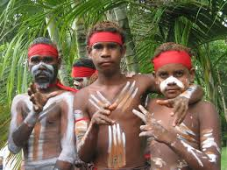
Aborigine People
The people native to Australia are known as the Aborigines. They migrated to the area around 50,000 years ago!
Aboriginal means “First People.”

Slide 8
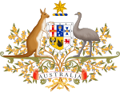
History
Inhabited by people around 50,000 years ago.
1606: Dutch navigator landed in Australia. Called the area “New Holland.”
1770- James Cook charted the East Coast of Australia.
1788- The continent became a penal colony for Britain.

Slide 9
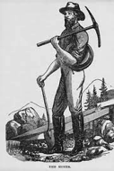
History
Six British colonies were established in Australia, but they formed a federation in 1901.
Australia fought with the Allies during both World Wars.
Gold rushes and agricultural enterprises have brought weal to the people.

Slide 10
Conflict with the Natives
Throughout Australian history, there have been frequent conflicts with the Native people, usually resulting in the Aborigines being forced off their land.
100,000 mixed race children given to white families to promote assimilation
Today, many Federal cases have given the Aborigines back their native land.

Slide 11
Culture
Most inhabitants of Australia are of European descent, but the country is currently experiencing high migration rates from countries in Asia and West Europe.
Christianity is the dominant religion.
Constitutional Monarchy
Comedy is an important part of the Australian culture.

Slide 12
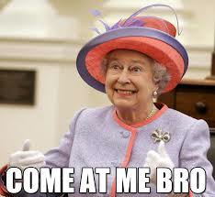
Culture
British influences
Drive on left side of road, Tea time
Christianity
English speaking

Slide 13
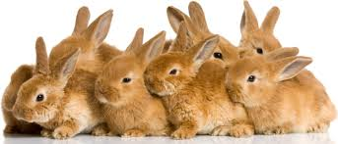
Rabbits
Invasion of the Rabbits
1859 – Thomas Austin released 24 rabbits
1 pair can have up to 184 descendants in 18 months
1900 – more than a billion rabbits
Wiped out native plans and destroyed crops
Endangered native animals, reduced land ability to feed herds of sheep

