Slide 1
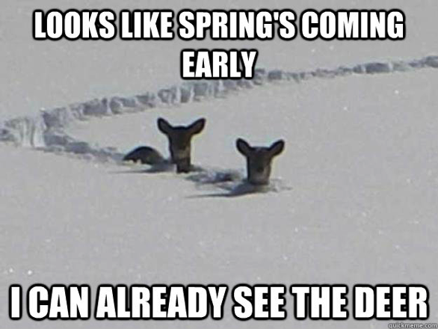
Canada
A brief guide

Slide 2
Question
Who is the Canadian Prime Minister?
Justin Timberlake
Justin Marin
Justin Trudeau

Slide 3
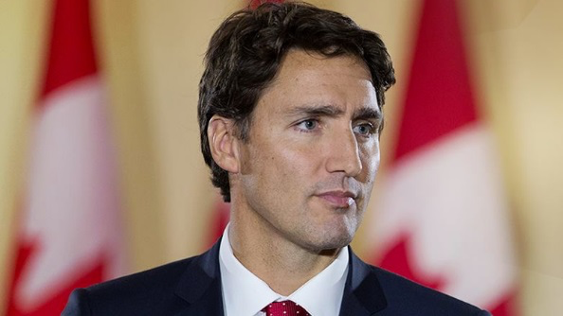
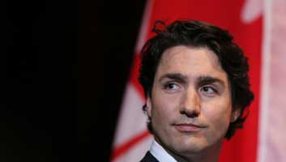
Answer
3) Justin Trudeau
Leader of the Liberal Party

Slide 4
Vocabulary
Parliamentary System: A parliamentary system is a system of democratic governance of a state where the executive branch derives its democratic legitimacy from the legislature (parliament) and is also held accountable to that legislature.
Political Party : A political party is defined as an organized group of people with at least roughly similar political aims and opinions, that seeks to influence public policy by getting its candidates elected to public office.
Hockey: a game played on a field by two opposing teams of 11 players each, who try to hit a ball into their opponents' goal using long sticks curved at the end

Slide 5
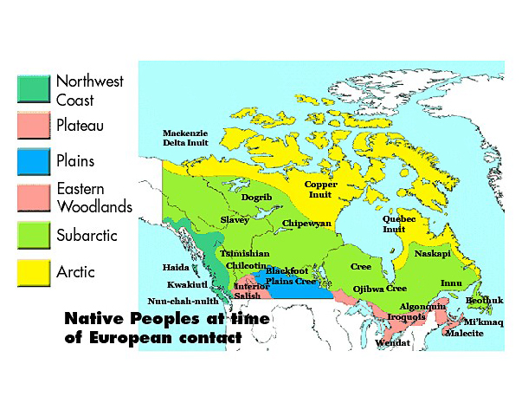
Ancient Canada
Canada was first inhabited by Native Indians, or First Nations. They arrived on the continent 10,000-30,000 years ago.

Slide 6
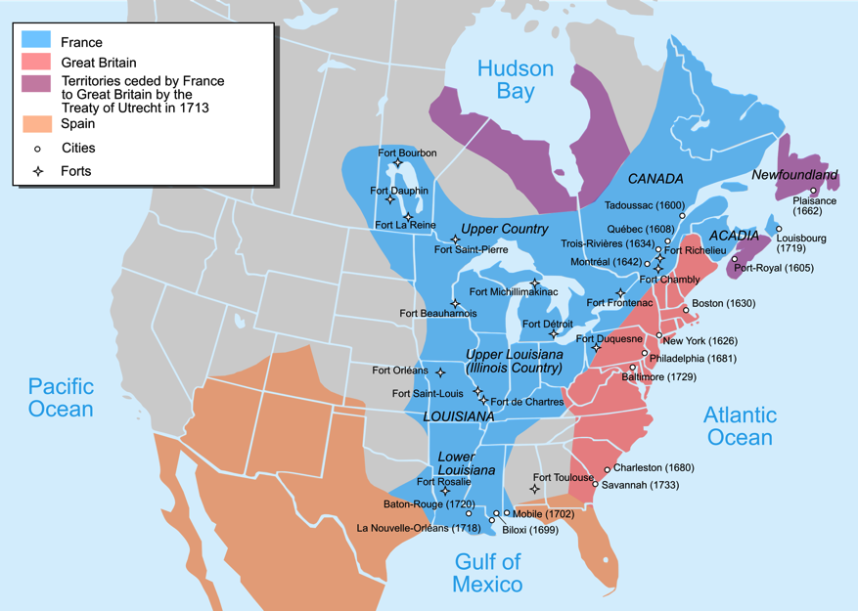
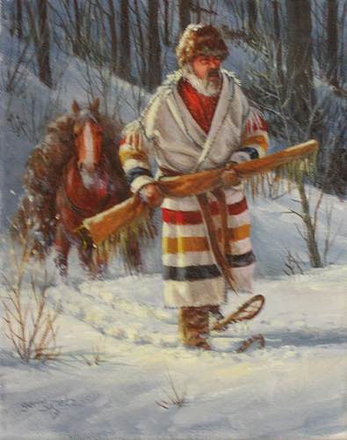
Colonization
Early Canadian colonization saw a heavy influence from France, but later England gained control of the region and became the sole colonizing force.

Slide 7
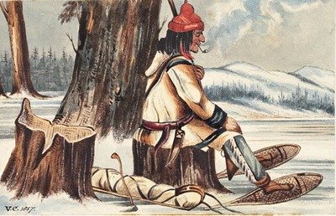
Colonization
France utilized a different approach when it came to the native people of Canada. The European power frequently traded with the tribes and encouraged those under their control to learn the native languages.

Slide 8
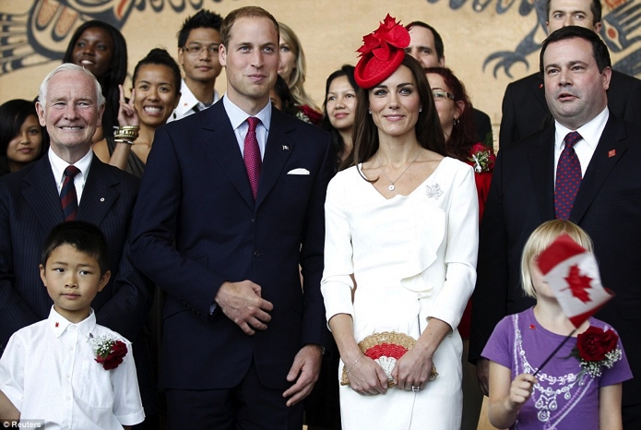
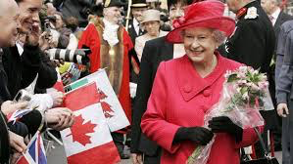
Canada Today
After being granted its independence from Great Britain in the 1980s, Canada still remains as part of the British Commonwealth.
This means citizens still pay taxes to the Queen, of officially “runs” the government. Officially, it is “Her Majesty’s government.”
Constitutional Monarchy

Slide 9
Canada Today
Canada is home to roughly 35 million people.
Canada has 10 provinces (not states), each with its own capital.
Quebec is the epicenter of French speaking Canadians. At one point in time, they tried to leave the nation.
Canada has a Parliamentary system.
Legislative – Parliament, House of Commons and Senate
Executive – Queen and Prime Minister
Judicial – Courts, highest being the Supreme Court

Slide 10
Political Process
In a parliament based government, the people do not vote directly for a candidate; rather, they vote for the party
Typically each party has a front runner, who would eventually become Prime Minister, if the party wins.
Because Canada operates on a different system than the US, it can support numerous political parties.

Slide 11
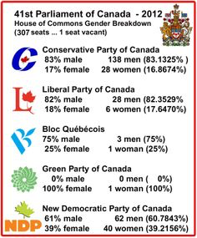
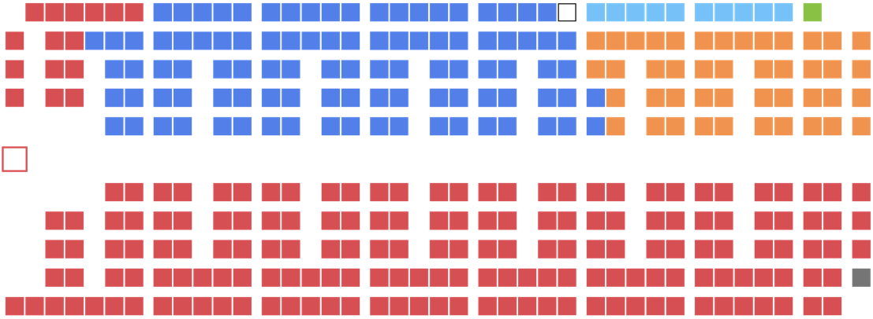
Division

Slide 12
Canadian Politics
The party that wins the majority vote during the elections is the power with most seats in Parliament.
The party with the second most votes gets the second most seats in Parliament and is known as the “Official Opposition.”
Seats of Parliament are distributed based on percentages. If a political party, even a small one, receives 1% of the vote, than it will receive 1% of the seats in Parliament.
This allows for numerous parties to be involved in the political process.

Slide 13
Canada Landforms
Rocky Mountains
Hudson Bay
Appalachian Mountains
Canadian Shield
Great Lakes
Arctic Lowlands

Slide 14
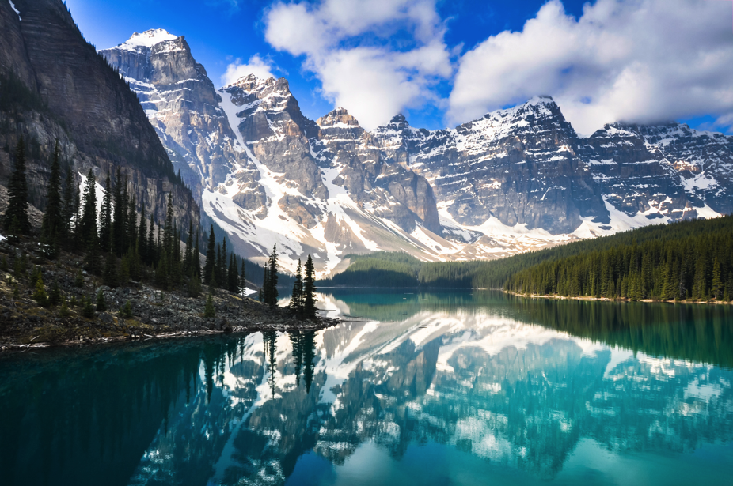
Rocky Mountains
The Rocky Mountains are tall and jagged, due to the tremendous forces exerted on it from plate tectonics.

Slide 15
Hudson Bay

Slide 16
Appalachian Mountains

Slide 17
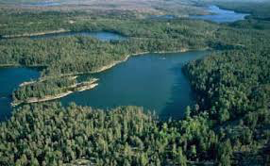
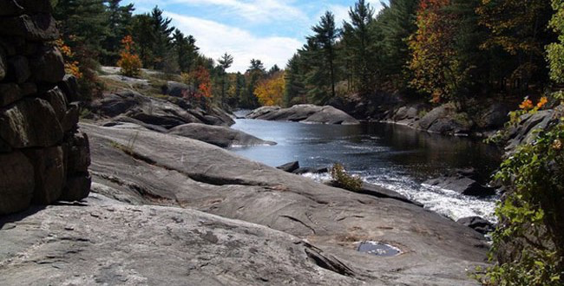
Canadian Shield

Slide 18
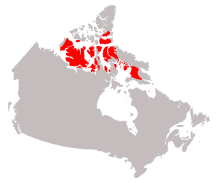
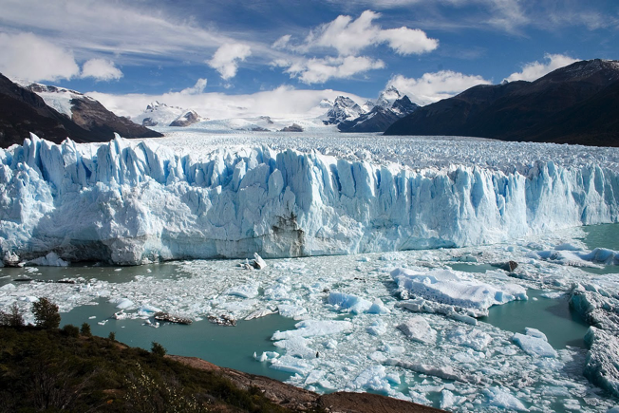
Arctic Lowlands

Slide 19
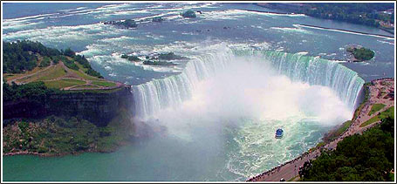
Great Lakes

Slide 20
Hockey

