Slide 1
Colonization of Africa
Write the words that are RED

Slide 2
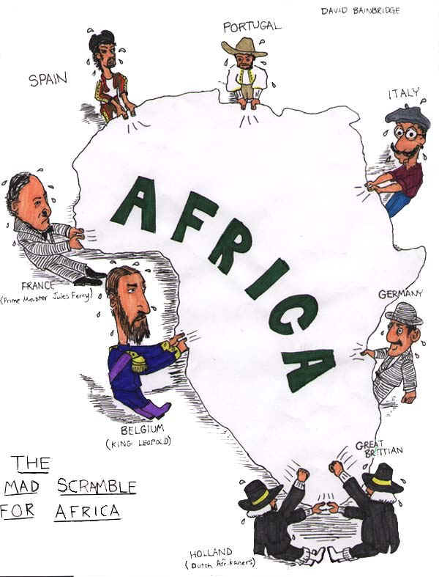
Berlin Conference 1884-85
Europeans wanted resources of Africa but didn’t want to fight over them. Europeans divided up as long as a nation could establish control over the region. No African leaders were invited. Ethiopia and Liberia were the only nations to maintain their independence.

Slide 3
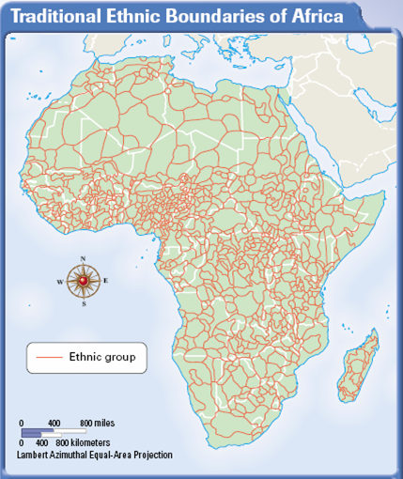
Major Problems Caused by Colonization
Berlin Conference divided Africa without concern for ethnic differences. Europeans would prefer one ethnic group over another. African’s have little experience running governments. White minorities unwilling to give up wealth and power. No infrastructure- built only to remove resources. Groups wanted revenge.

Slide 4
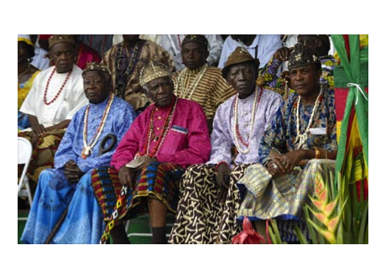
Stateless Society
Government based on lineage and ancestry (tribal (family))

Slide 5
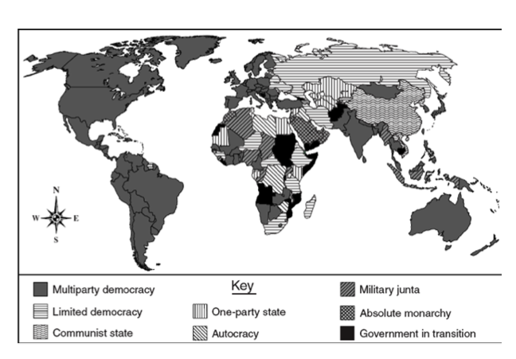
Africans have little experience with Democracy
Most African nations have been unable to maintain stable multiparty democracies.
Many governments remain transitional
Military rule in many areas
Stability is difficult to maintain

Slide 6
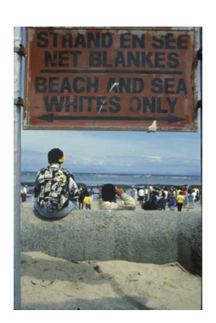
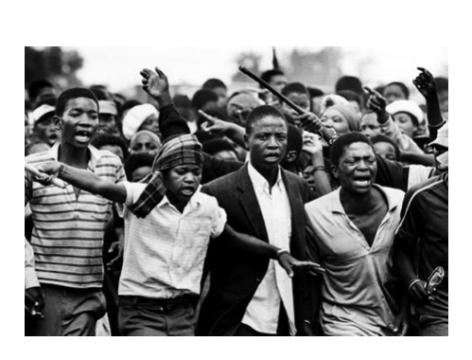
South Africa struggles due to British colonization
False belief that Whites genetically superior to people of color. Unwilling to give up power and influence. Descendants of Europeans are the minority in all of Africa. Black African’s denied
* Education
*Access to resources
* Access to jobs

Slide 7
Apartheid in South Africa
Blacks and Whites separated by law. Blacks forced to live in “homelands.” White Minority kept all power.

Slide 8
Europeans Exploited Africa
Did not invest in building infrastructure. Only cared to use natural resources to build wealth. Were not interested in developing the economy of Africa.
Effects- Cash crops: African’s grow crops for sale in other countries and not to eat. Lack of food is a problem

