Slide 1
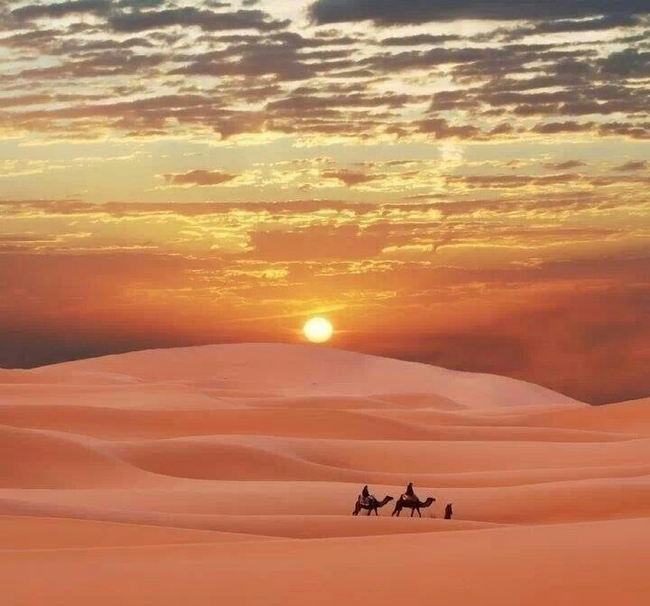
Desertification: The Expansion of the Sahara

Slide 2
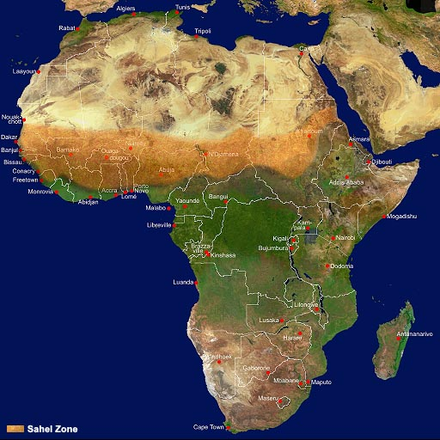
Desertification
Think About: Many countries in Africa are affected in some capacity by the Sahara Desert. It’s the world’s biggest desert…and it’s getting bigger.

Slide 3
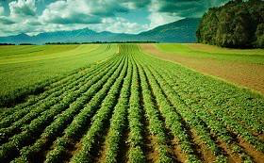
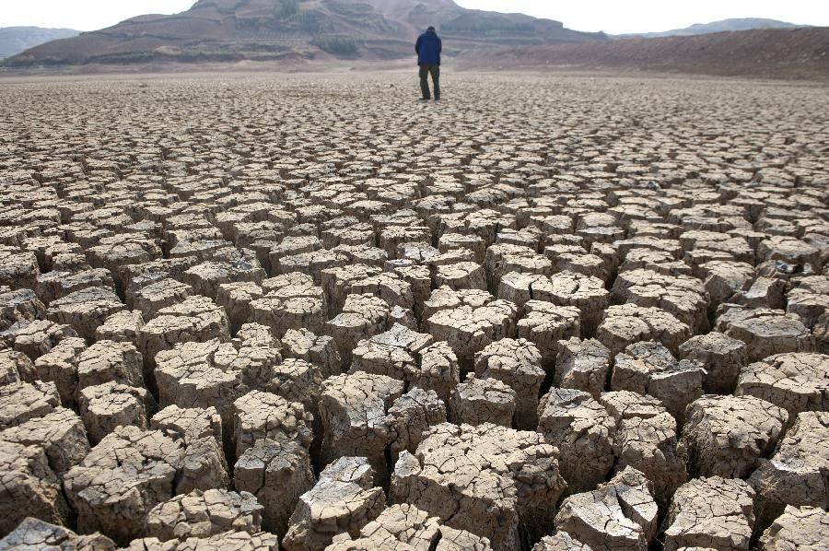
Desertification
Desertification – is the change of fertile (good farm land) land that is too dry or damaged to support life.

Slide 4
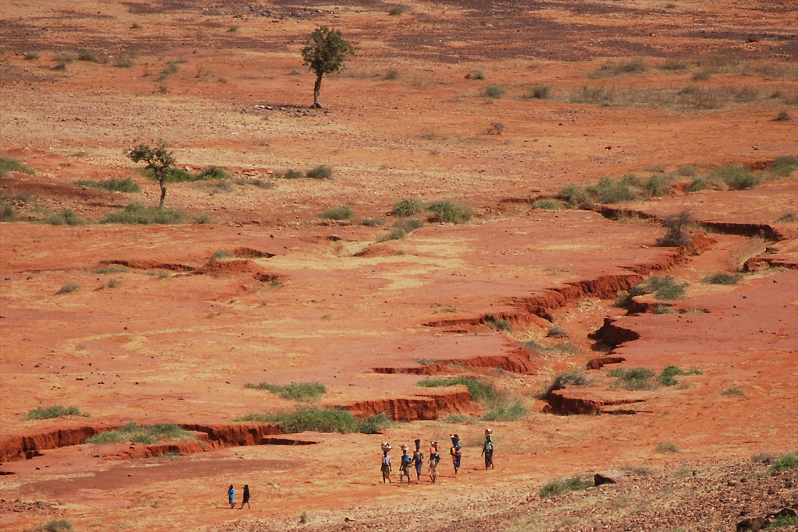
Desertification
Desertification – Link

Slide 5
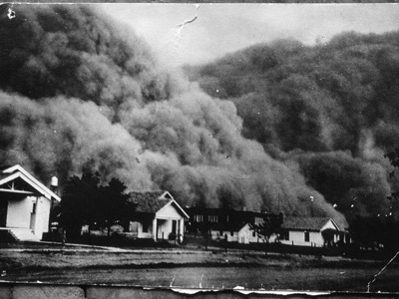
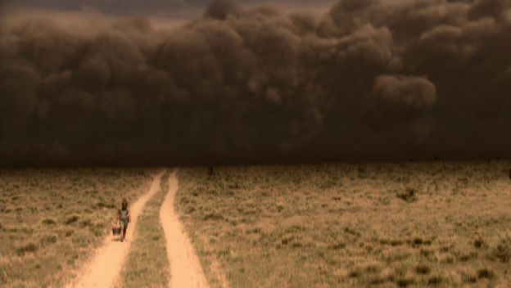
Desertification
Dust Bowl – Link
The Dust Bowl, also known as the Dirty Thirties, was a period of severe dust storms that greatly damaged the ecology and agriculture of the US and Canadian prairies during the 1930s

Slide 6
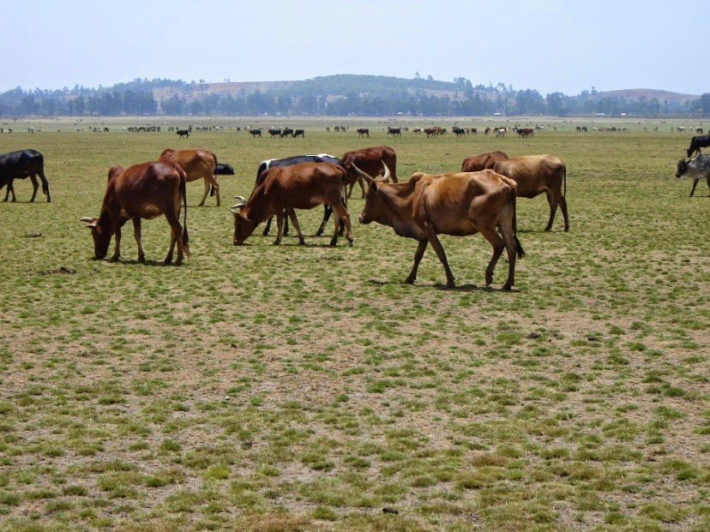
Desertification
Main Causes
Overgrazing- animals eat to much
Over farming- farmers over use the soil
Drought- there is nothing to hold down the good soil since all of the plants are dried up

Slide 7
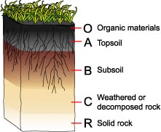
Desertification
Topsoil is the top layer of ground that has the nutrients/food to help plants grow.

Slide 8
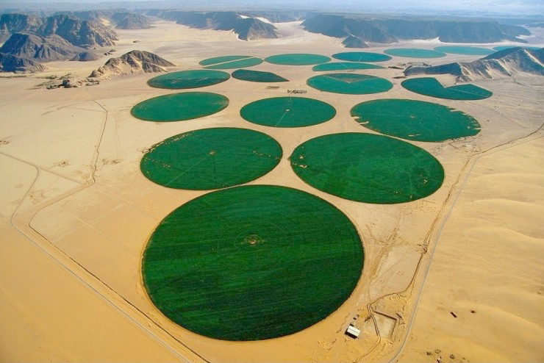
Desertification
Desertification is threatening the way of life of many North African farmers.
Solutions – Need to repair topsoil
1. Stop overgrazing or over farming fertile land.
2. New irrigation projects.

Slide 9
Make a poster…
Poster warning against desertification
1. Must warn against the three causes (over drought, overgrazing, and over farming)
2. Show how desertification works.
3. Possible solutions.

Slide 10
The word Sahel means “shore” in Arabic.
Why is this an appropriate word to describe the Sahel?
Why would it be bad if the Sahara Desert is expanding?

Slide 11
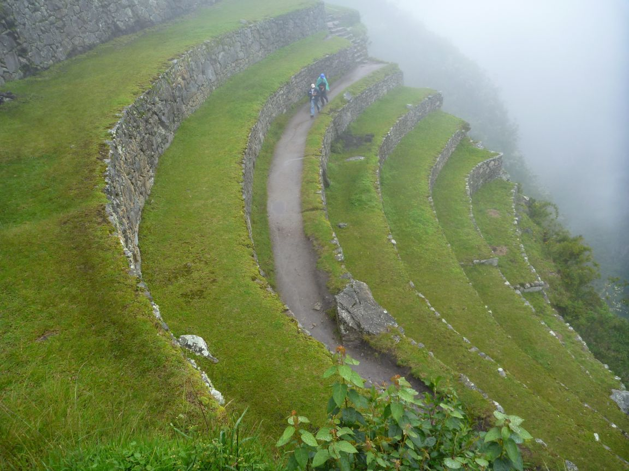
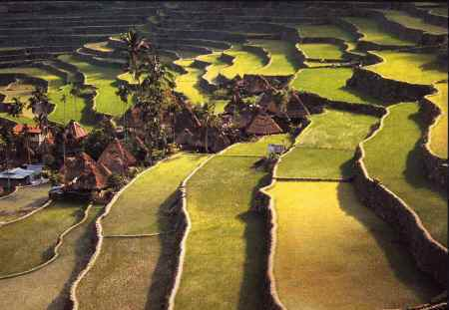
Desertification- Terrace
Terrace- flat platforms of earth that cuts into a slope of a hill. This protects topsoil from being washed or blown away.

Slide 12
Water in Sub-Sahara Africa?
Why is water important to life?

