Slide 1
Economic Development
Africa

Slide 2
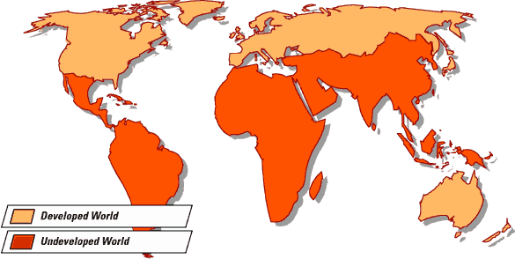
Economic Development in Sub-Saharan Africa
Objective: you will understand how decisions about infrastructure influence economic development.

Slide 3
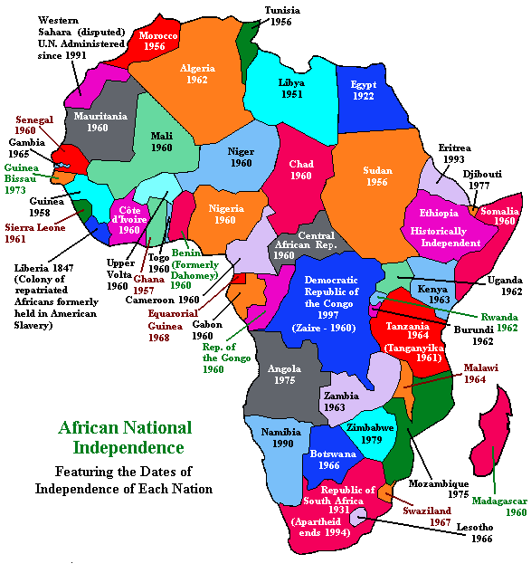
The Legacy of European Colonialism
European colonialism had a
lasting impact on Africa, socially and
economically.
The artificial boundaries created
by colonial rulers brought many different
ethnic groups together with major
consequences.

Slide 4
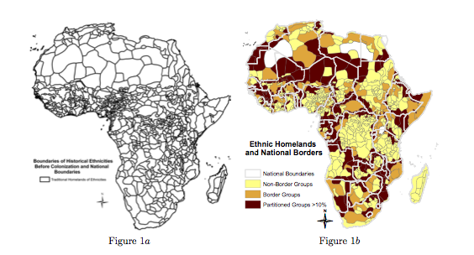
The Legacy of Colonialism
Since the colonial period, Africa had numerous influential outside powers (foreign countries that controlled certain areas). After the Cold War, the outsiders left, leaving a power vacuum.
Conflict arose over disputed boundaries, economic development, and increased militarization.

Slide 5
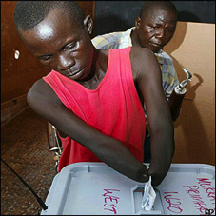
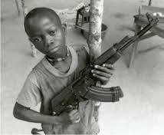
Photos of Conflict

Slide 6
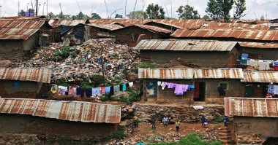
Level of Development
40% of people living in sub-Saharan Africa live in absolute poverty. (a condition characterized by severe lack of basic human needs, including food, safe drinking water, sanitation facilities, health, shelter, education and information. It depends not only on income but also on access to services.
Sub Saharan Africa is less developed with the exception of South Africa (Newly Industrialized)

Slide 7
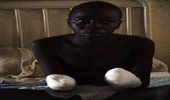
Challenges to Development
Each African country has a unique history, and today faces unique challenges.
Political corruption, lack of respect for rule of law, human rights violations and war
Ex: Sierra Leone; the government’s election slogan in Sierra Leone in ’99 was ‘The future is in your hands,’ so the RUF rebels amputated people’s hands to intimidate them into not voting
Stable government and democracy, which are critical to eliminating poverty. It takes many decades for stable government, economic stability and the rule of law to establish.

Slide 8
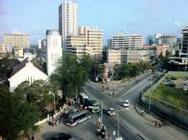
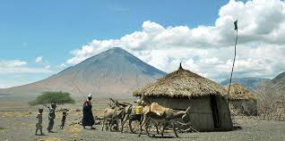
Challenges to Development
Unequal International Trade
Limited rights to land (descendants of the colonizers held most of the wealth and power)
“I was in Washington last year. At the World Bank and the first question they asked me was “how did you fail?” I responded that we took over a country with 85% of its adult population illiterate. The British ruled us for 43 years. When they left, there were 2 trained engineers and 12 doctors. This is the country we inherited. When I stepped down there was 91% literacy and nearly every child was in school. We trained thousands of engineers, doctors and teachers.” – Tanzania President, Julius Nyerere

Slide 9
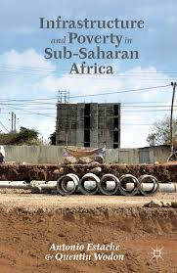
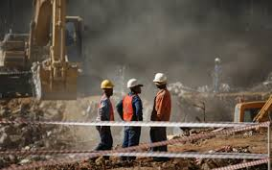
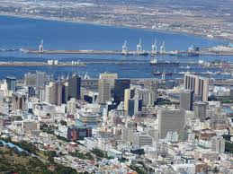
Lack of Infrastructure
Colonizers built little infrastructure (only to get resources)
Years of civil war destroyed infrastructure
Large numbers of the population uneducated
Limited experience with multiparty democracies
Brain Drain – emigration of knowledgeable, well-educated and skilled professionals from their home country to another country.

Slide 10
Question – Think About
How has the lack of infrastructure had an impact on the spread of disease in Sub-Sahara Africa?

Slide 11
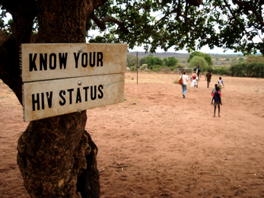
HIV/AIDS
HIV/AIDS is an autoimmune deficiency disease that weakens the immune system and makes a person susceptible to many illnesses.
HIV is spread when the virus comes into contact with mucus membranes (nose, genitalia, mouth, eyes). Mothers can give the virus to their babies during birth.
There is currently no cure for HIV/AIDS.
Some places in Africa experience 4/10 cases.

Slide 12
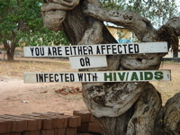
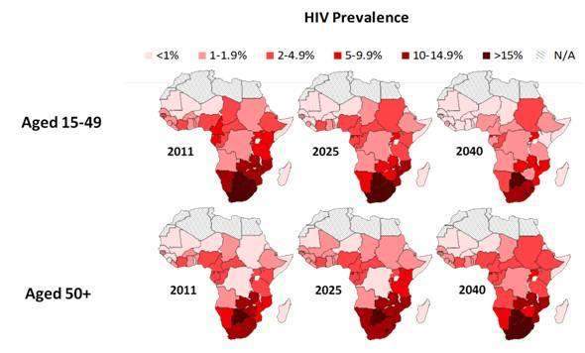
HIV/AIDS

Slide 13
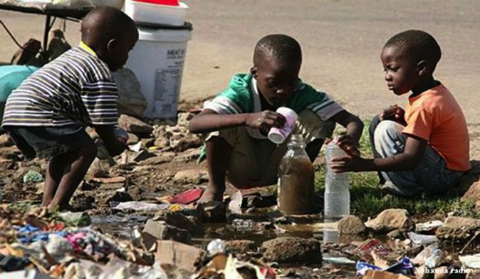
Cholera
Cholera is an infection of the intestines that is caused by poor sanitation and dirty, contaminated water. Up to 80% of cases can be successfully treated with oral rehydration salts.
Cholera is not a common disease in most industrialized countries. Why?

Slide 14
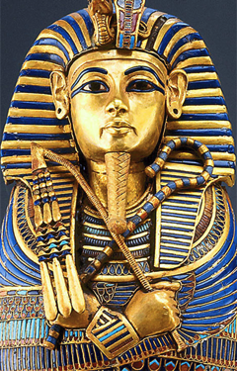
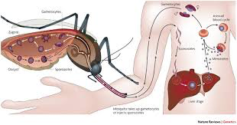
Malaria
Malaria is a parasitic infection that is transferred by mosquitos. With proper medical care, the disease is treatable. Vaccines also prevent children and adults from contracting the virus.
King Tut was allegedly killed by Malaria.

Slide 15
Interesting

Slide 16
Question - Answer
How has the lack of infrastructure had an impact on the spread of disease in Sub-Sahara Africa?
Answer in at least 3 sentences.
PAP: Formulate a thesis and three arguments that defend your thesis.

