Slide 1
Economic Geography

Slide 2
Economy
What is an economy?
How do economies change?
How does the role of government change in economies around the world?

Slide 3
Types of Economic Systems
Traditional economy
Command/Communism economy
Market/free enterprise/capitalism economy
Mixed/socialism economy

Slide 4
Traditional economy
Subsistence farming
Little Income Earned
Subsistence agriculture is self-sufficiency farming.
The farmers focus on growing enough food to feed themselves and their families. The typical subsistence farm has a range of crops and animals needed by the family to feed and clothe themselves during the year.

Slide 5
Command/Communism economy
Total government control; Communism Government
Communism is a political theory derived from Karl Marx, advocating class war and leading to a society in which all property is publicly owned and each person works and is paid according to their abilities and needs.

Slide 6
Market/free enterprise/capitalism economy
Consumers control; Democracy government
Capitalism is an economic and political system in which a country's trade and industry are controlled by private owners for profit, rather than by the state.

Slide 7
Mixed Economy
Consumer demand with limitations on what can be made and sold (laws prohibit people from engaging in behaviors that are considered harmful, such as drugs and child labor).

Slide 8
Socialism
Socialist: the government collects a larger percent of taxes in order to supply citizens with services, such as education, medicine, and roads.

Slide 9
Elements of an economy

Slide 10
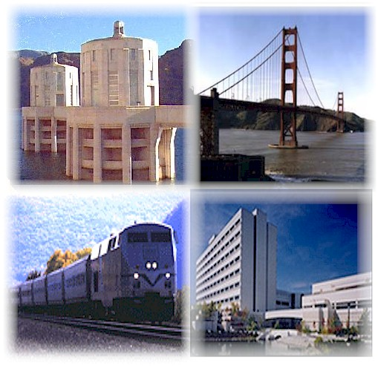
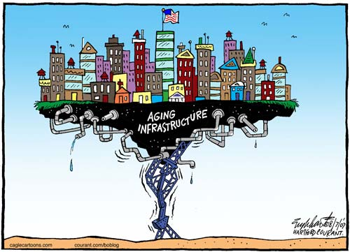
Infrastructure – Basic support systems needed to keep an economy going and economic growth.
Transportation
Communication
Technology

Slide 11
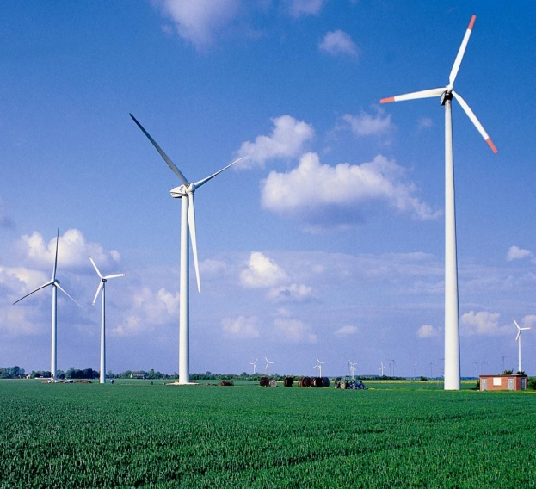
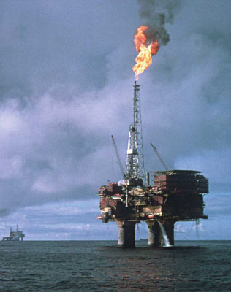
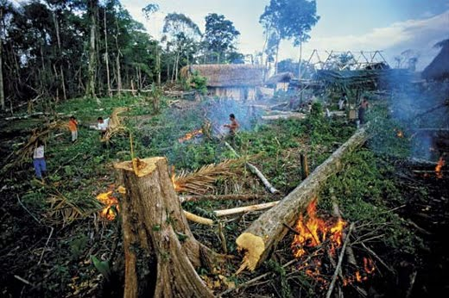
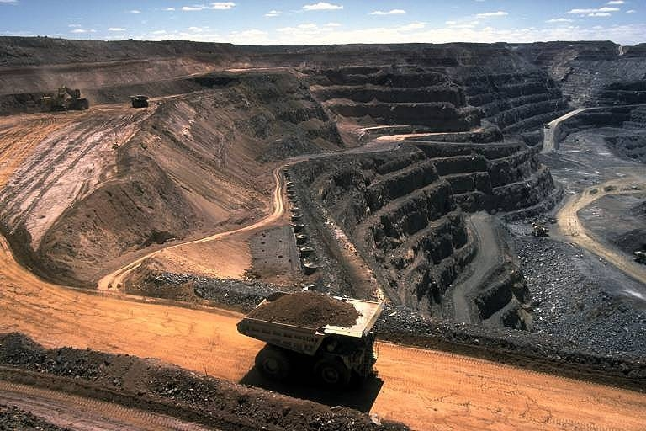
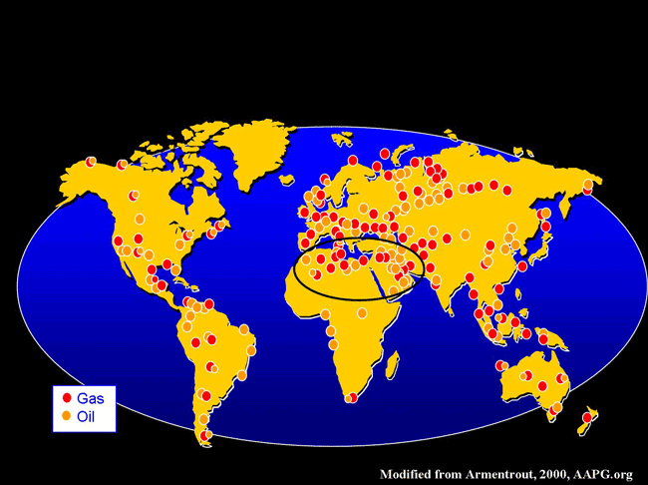
Natural Resources
Non-renewable resource: cannot be replaced
Ex: oil
Renewable resource:
can be replaced
Ex: timber

Slide 12
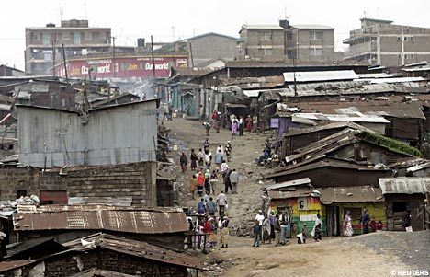
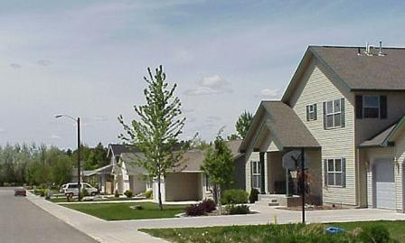
Standard of Living
Level of wealth, comfort & material goods.

Slide 13
Levels of Economic Activity
Quaternary
Tertiary
Secondary
Primary

Slide 14
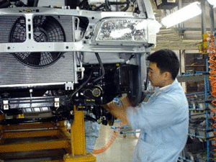
Levels of Economic Activity
Primary activity – collecting raw goods, growing, harvesting (farmers, mining)
Secondary activity – creating (manufacturing, automobile production, construction)

Slide 15
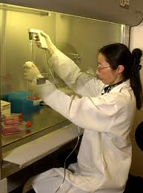
Levels of Economic Activity
Tertiary activity – professionals
(teachers, lawyers, salesperson)
Quaternary activity – information, research, management services
(principal, medical research, professors)

Slide 16
Strong Economies
Have stable infrastructure.
Transform resources into goods (industry).
Have a high per capita income.
Have many different types of professions (varied economy).

Slide 17
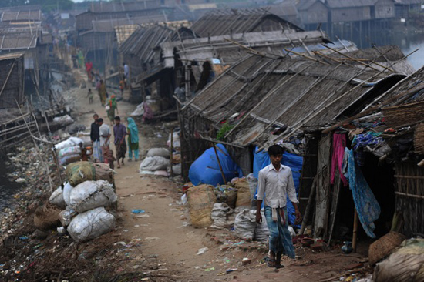
Levels of Economic Development
There are 3 levels of economic development.
Countries are categorized depending on infrastructure & economic activity.
(Ask yourself)
How would you rank
or rate this country?

Slide 18
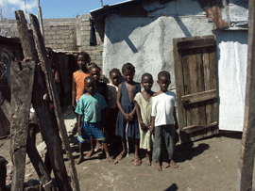
Less Developed Nations
Lower levels of prosperity
Lack of adequate industries – few jobs available.
Lack of education
Lack modern technology
Most families grow their own food (subsistence farming)
Poor Infrastructure – little access to modern transportations and few developed road systems.

Slide 19
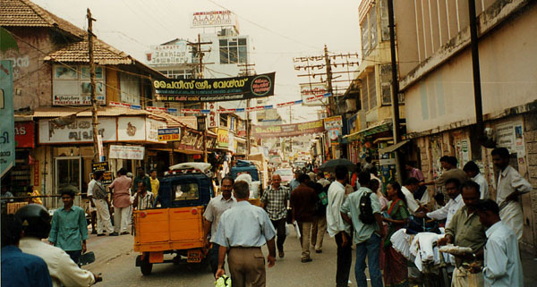
Newly Industrialized Nations
Mid-standard of living
Gaining higher levels of education
Gaining higher levels of health care
Transportation – more types and access
Communication facilities
More food available
More manufacturing and service jobs

Slide 20
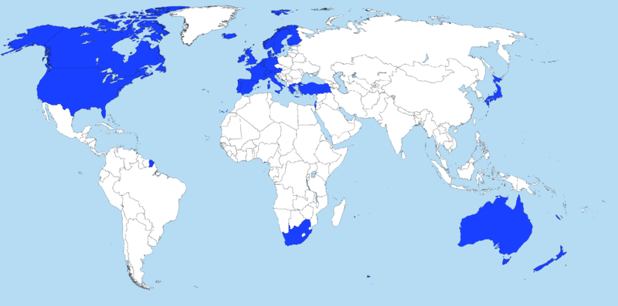
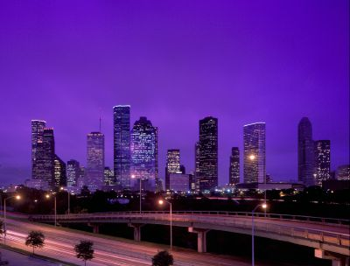
More Developed Nations
High standard of living
High levels of education
High levels of health care
Transportation – many types and a lot of availability
Good Infrastructure
Consume more food
Live longer

Slide 21
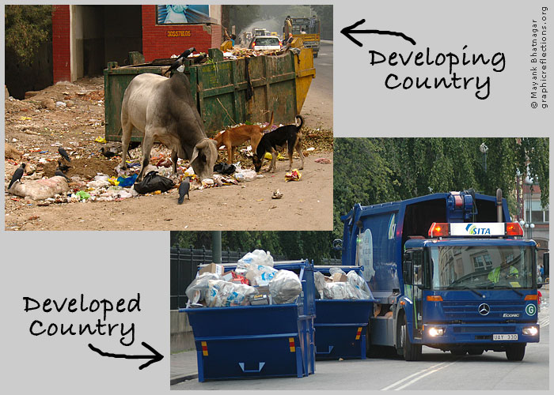
Less Developed or
Newly Industrialized Nation
More
Developed Nation

Slide 22
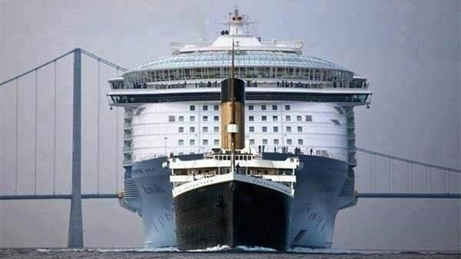
Globalization
The idea the the world is becoming more connected through trade, technology, and transportation.

