Slide 1
Economic Systems

Slide 2
Spectrum
Like colors on a spectrum, economies blend and meld with one another; therefore, there is never a TRUE capitalist or a TRUE communist country.
<----------------------------------------+------------------------------------------>
Least Freedom Most Freedom

Slide 3
Capitalism
Consumer demand determines what goods and services are produced and sold (citizens are allowed to own/buy whatever item they please or create any business they like).
The marketplace will regulate itself – if no one buys cigarettes, no one would make them (not profitable).

Slide 4
Communism
The government determines what goods and services are produced (citizens do not have private property; everything belongs to the state). Citizens are not allowed to own businesses.
In a true communist country, people have little ability to decide what is being made, bought, and sold; however, everyone is considered economically equal. No extreme poverty or extreme wealth, in theory.

Slide 5
Mixed
Consumer demand with limitations on what can be made and sold. Laws prohibit people from engaging in behaviors that are considered harmful, such as drugs and child labor.
For the most part, people are allowed to own businesses and buy whatever they want, as long as its within the legal structure of the country.

Slide 6
socialist
The government collects a larger percent of taxes in order to supply citizens with services, such as education, medicine, and roads.
Citizens may pay between 40-60% in taxes, but the government supplies many services, such as healthcare, education, etc.

Slide 7
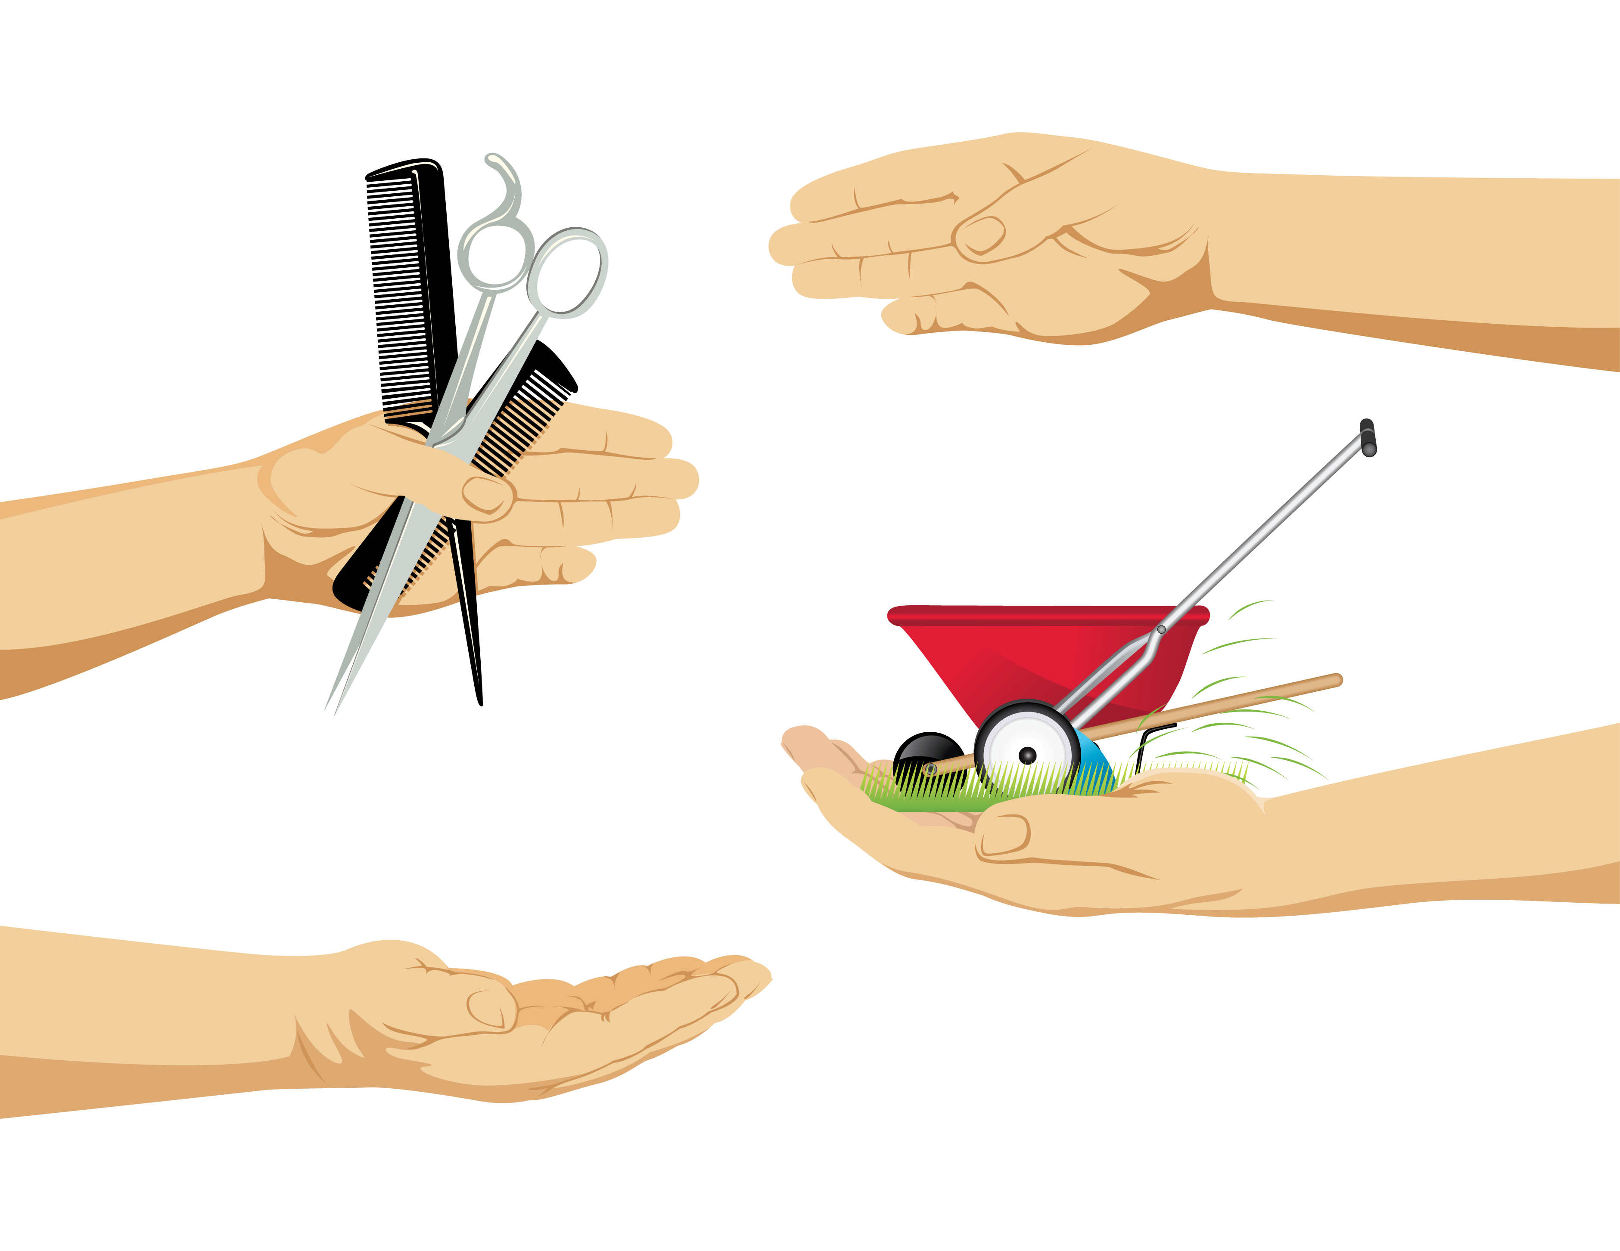
Traditional
Basic economic system in which people exchange one good or service for another.
Subsistence Farming: Farmers grow enough food to feed themselves. Self-sufficiency farming.
Historical Example: French trappers traded with Native Americans. Animal pelts for guns, blankets, beads, etc.
Modern Example: People in less developed areas of the world, such as indigenous tribes in the Amazon, utilize subsistence farming, along with simple barter and trade.

