Slide 1
Modern europe
Cooperation and population

Slide 2
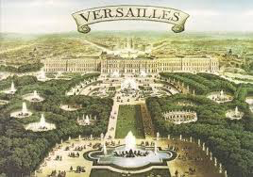
Essential questions
What are the benefits and disadvantages of countries cooperating with on another?
How does an aging population affect government policy?

Slide 3
Key terms and objectives
Regional Cooperation: countries, which are closely related geographically, working together for a common purpose
Supranational Cooperation: Independent countries give up certain powers in order to work together toward a common goal.
Demography: The student of how population changes.
Unstable Government = Unstable Economy

Slide 4
Question
Do more people live in Europe or in the United States?

Slide 5
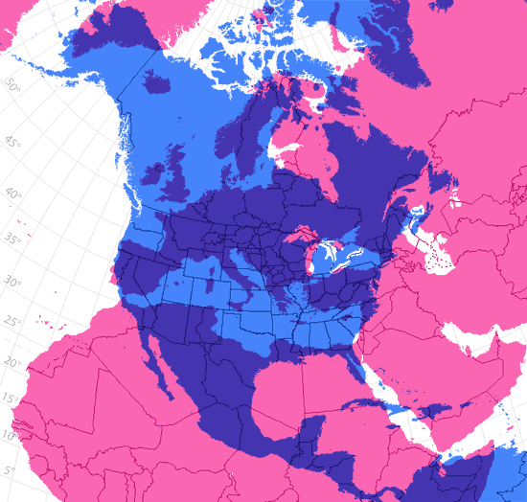
Answer
More people live in Europe. About 742.5 million people inhabit the continent.

Slide 6
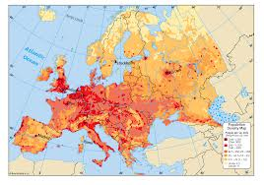
population
Europe is densely populated.

Slide 7
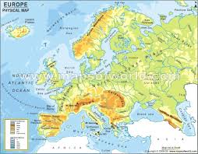
population
The dense population is due to the following factors:
Abundance of natural resources
Ample water sources (oceans, rivers, lakes)
Early Industrialization (focus on machinery and efficiency)

Slide 8
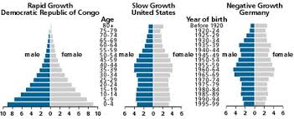
Population
However, within the last few decades, many countries in Europe have begun to experience negative growth.
Negative growth occurs when the birth rate is lower than the death rate.

Slide 9
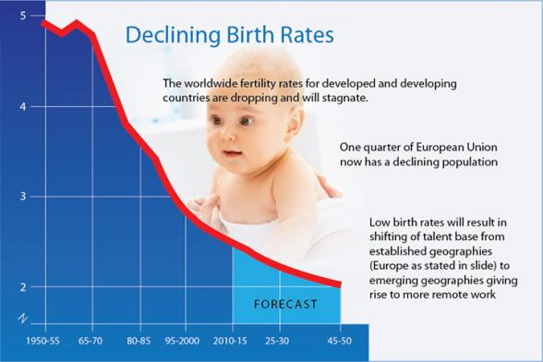
Population
WHY?
Many developed countries experience low birth rates.
This means that the replacement rate is less than 2. (Most couples have only one child, which does not replace them when they die)

Slide 10
Population: Fun Fact

Slide 11
Population
To combat this, countries that are affected by negative growth have implemented many policies in the hopes of encouraging couples to have children.
“Cash for Babies” – financial aid to any family that has children.
Raising Retirement Ages – forcing people to stay in the work place longer
Family-friendly workplace policies
STRIKE →

Slide 12
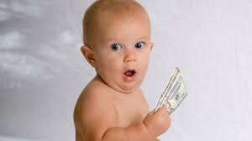
Population
Also, many countries encourage foreigners to come seek employment within their borders.
NEGATIVE GROWTH = THE SLOW LOSS OF WORKERS
Individuals retire and there are not enough adults to take their jobs, which could potentially slow the economy.
← Sad Baby

Slide 13
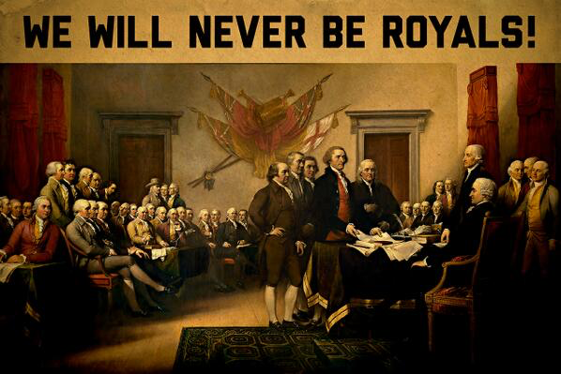
question
What was the first constitution of the US called?

Slide 14
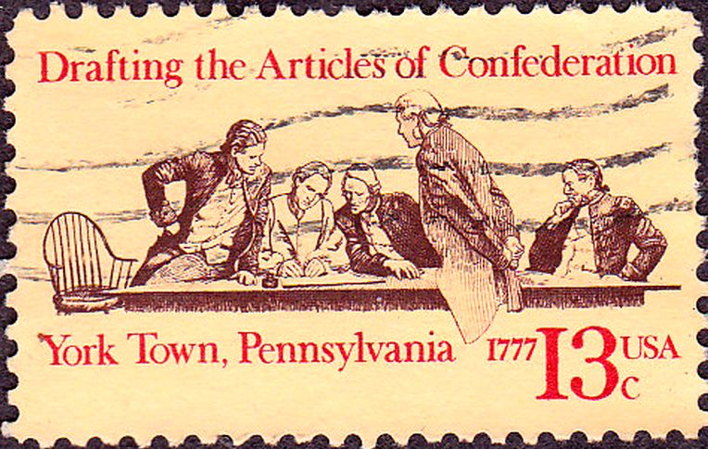
Answer
The Articles of Confederation.
Fun Fact: Thomas Jefferson HATED the present constitution, because he believed it made the national government too powerful. However, his opinions did not stop him from become the third President…

Slide 15
Cooperation
European countries were once the economic powerhouses of the world, but now struggle to compete with the U.S. and Asian countries.
The European Union was created in 1993 to promote trade between countries.
The EU (European Union) is a modern-day confederacy. Confederacy: a union of political units, or independent states, for common action in relation to other units.

Slide 16
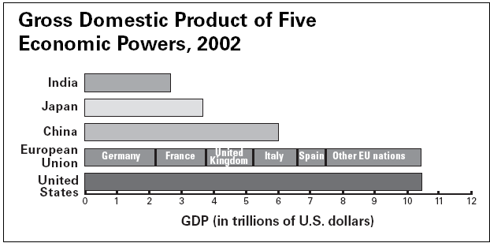
Cooperation
The European Union, however, has as much economic power as U.S.
Began with a Common Market
Promotes cooperation by reducing trade barriers.
Creation of a common Currency, The Euro.

Slide 17
cooperation

Slide 18
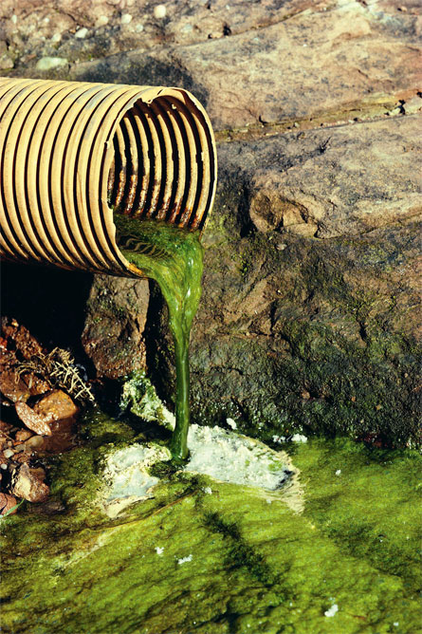
Cooperation
Along with boosting the economies of Europe, a clean environment is also the focus of the EU.
Europe is densely populated with many shared natural resources, especially rivers.
Pollution, therefore, usually crosses national boundaries.
Regional Cooperation is necessary to prevent and clean up pollution.

Slide 19
Cooperation
In order for a country to participate in the EU, they must meet certain economic standards.
In other words, they must be able to provide some capital (or money) to the confederacy.
Because of this, many disadvantaged Eastern European countries (those that evolved out of the USSR) are not permitted into the EU.

Slide 20
cooperation
However, some countries, like England, have threatened to leave the EU.
SO STAY TUNED!

