Slide 1
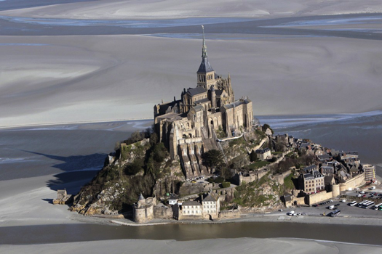
Europe and Russia, an Introduction
Mont St. Michel, France
c. 1523

Slide 2
B. Smith Photography

Slide 3
B. Smith Photography

Slide 4
B. Smith Photography

Slide 5
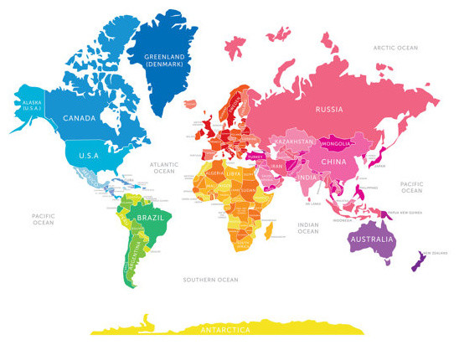
Europe

Slide 6
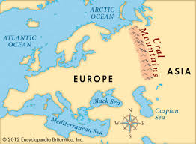
Modern Europe
Basic Geography
Europe and Russia are melded (joined) together because they share a common history and culture.
The Ural Mountain separate Europe from Asia.

Slide 7
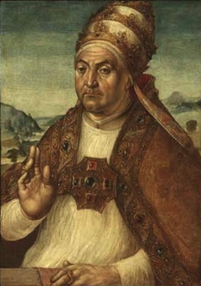
Modern Europe
Civilization has been around for thousands of years in Europe, and the continent is often accredited as being the epicenter of modern history, with a focus on culture, religion, and democracy.
Culture: The Renaissance
Religion: The Catholic Church
Democracy: Ancient Greene
Pope Sixtus IV, 1471-1481

Slide 8
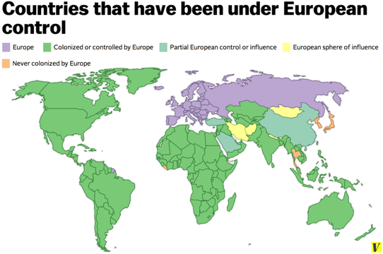
Modern Europe
Because European countries were so imperialistic, they spread their ideas, goods, and languages all over the world.
Imperialism: extending a country’s power and influence through diplomacy or military force.

Slide 9
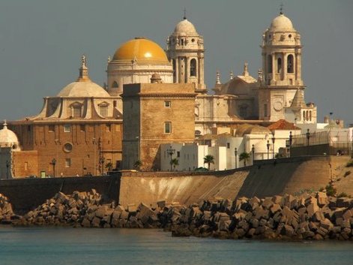
European Culture
Religions:
Roman Catholic
Protestantism
Eastern Orthodox
Muslim

Slide 10
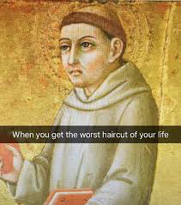
European Culture
Art and Architecture:
Gothic
Renaissance
Baroque
Impressionist
Russian Art

Slide 11
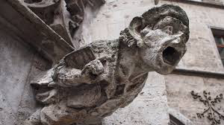
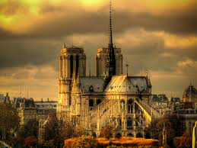
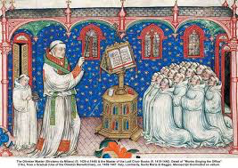
European Culture
Art and Architecture
Gothic, 1200-1400AD

Slide 12
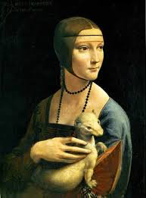
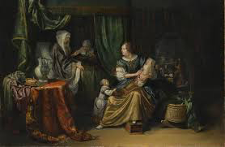
European Culture
Art and Architecture:
Renaissance Movement, 1500-1650AD

Slide 13
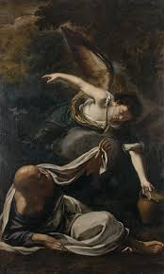
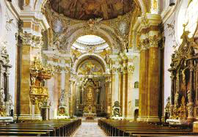
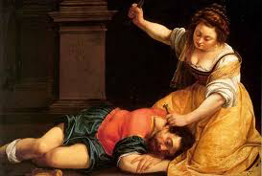
European Culture
Art and Architecture:
Baroque, 1650-1800AD

Slide 14
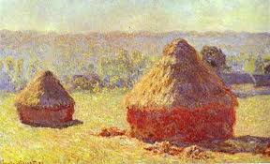
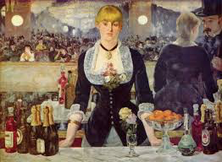
European Culture
Art and Architecture
Impressionism, 1870-1910AD

Slide 15
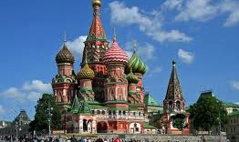
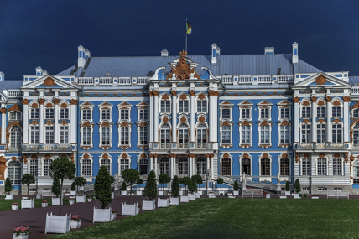
European Culture
Art and Architecture:
Russian Art

Slide 16
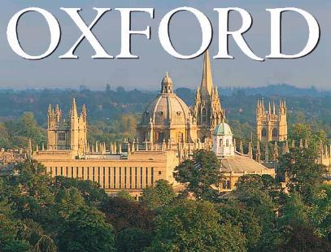
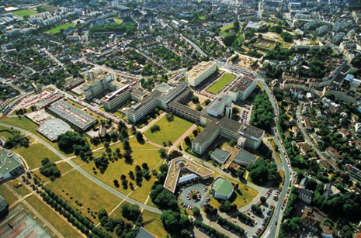
European Culture
Education:
Quality depends on economy (best in the West)
Some of the world’s finest universities
Oxford, University of Vienna, Cambridge, Sorbonne

Slide 17
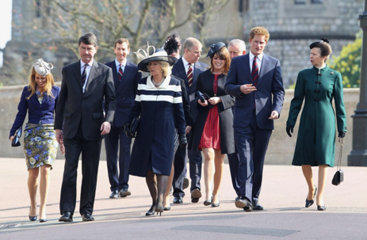
European Culture
Home Life:
Life centers around extended family
42% of workforce is women
Most families take at least one vacation

Slide 18
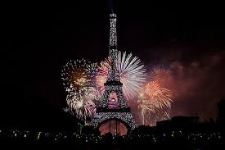
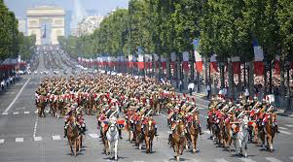
European Culture
European countries have distinct histories and festivals.
Bastille Day, France
Running of the Bull, Spain
Boxing Day, England

Slide 19
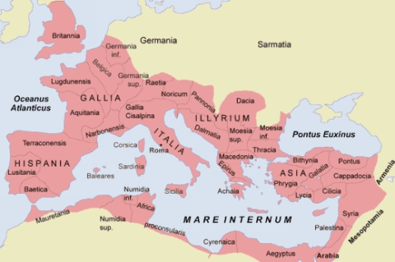
Birth of Modern Europe
What era (time period) does this map represent?

Slide 20
Birth of Modern Europe
This map depicts the Roman empire at its height, roughly AD100.
From the Roman Empire, modern Europe was born.

Slide 21
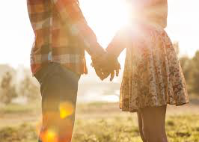
Birth of Modern Europe
After the fall of the Roman Empire, the multiple dialects of Latin, the language of Rome, evolved into the Romance Languages.
Roma = Latin for Rome
Romance Languages = Languages evolved from Latin

Slide 22
Birth of Modern Europe
Is English a Romance language?
A) Yes!
B) No…

Slide 23
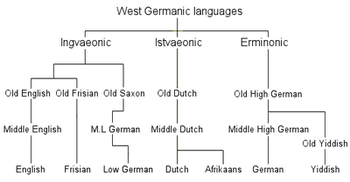
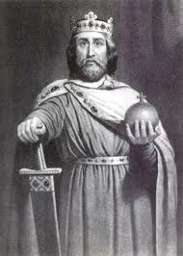
Birth of Modern Europe
No, English is not a Romance language.
Although it is highly influence by French, courtesy of William the Conqueror, English is a Germanic language.

Slide 24
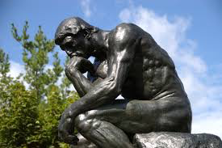
Birth of Modern Europe
What are the Romance languages?
Le Penseur
“The Thinker”

Slide 25
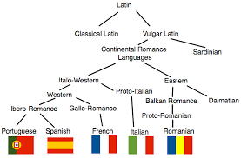
Birth of Modern Europe
Romance Languages
Spanish
French
Italian
Portuguese
Romanian

Slide 26
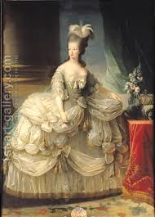
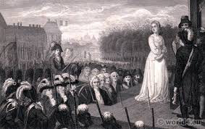
Birth of Modern Europe
After lots, and lots, and lots, and lots, AND LOTS of wars over several hundred years, a pattern emerged: Many Europe, frequently controlled by absolute monarchies, shifted to forms of democratic governments.

Slide 27
Birth of Modern Europe
What is the newest country in Europe?
A) Netherlands
B) Liberland
C) Lichtenstein

Slide 28
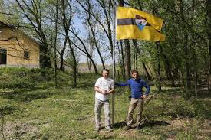
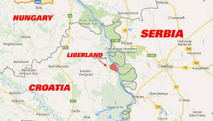
Birth of Modern Europe
Answer: B
“Officially” a country April, 2015

Slide 29
Birth of Modern Europe
Due to the outcome of recent wars (wars that happened within the last century), the political landscape of Europe has changed quiet drastically.
In other words, there have been many new countries created in Europe within the last 100 years.
WHY?

Slide 30
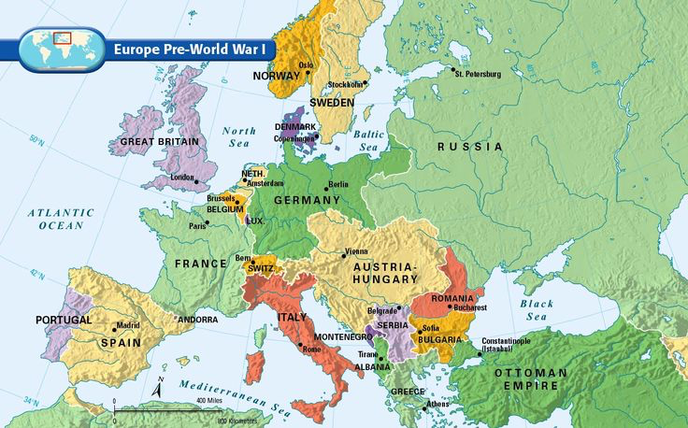
Birth of Modern Europe - Before World War I

Slide 31
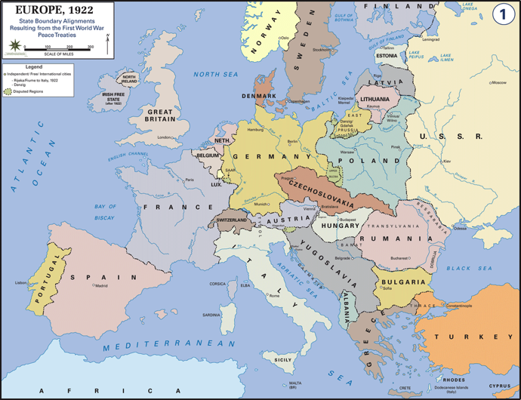
Birth of Modern Europe – After World War I

Slide 32
Birth of Modern Europe – Before WWII

Slide 33
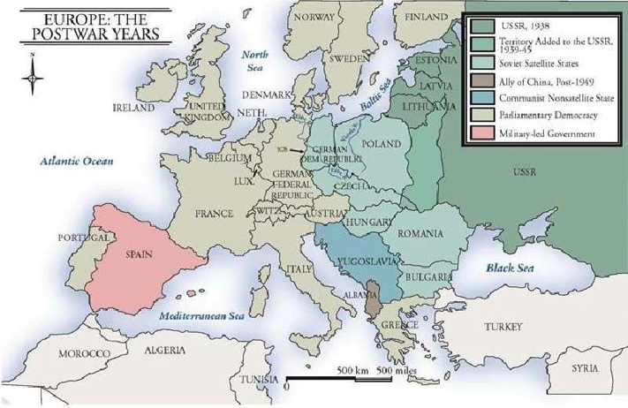
Birth of Modern Europe – After WWII

Slide 34
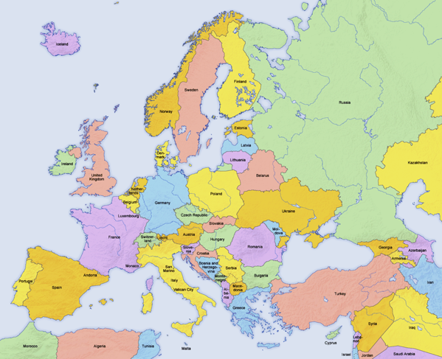
Birth of Modern Europe – Modern Europe

Slide 35
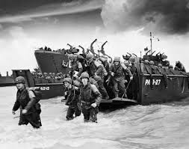
Birth of Modern Europe
What year did WWII end?
A) 1965
B) 1889
C) 1945

Slide 36
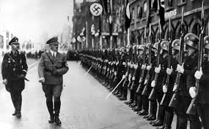
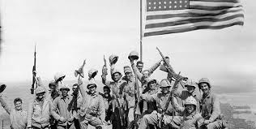
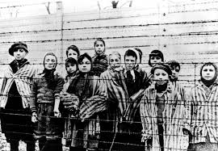
Birth of Modern Europe
Answer: C

Slide 37
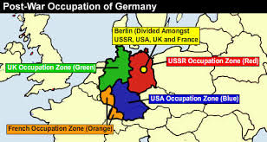
Birth of Modern Europe
After World War II, Europe was split between the Democratic West (America and England), and the Communist East.

Slide 38
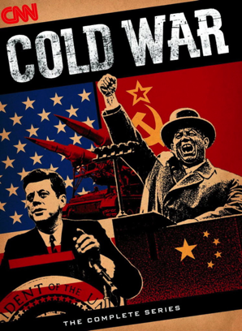
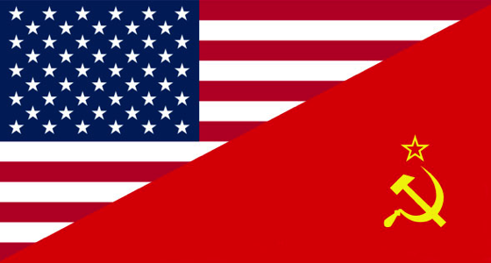
Birth of Modern Europe
Tensions between the USSR (Soviet Russia) and the United States led to the Cold War.
Democracy vs Communism

Slide 39
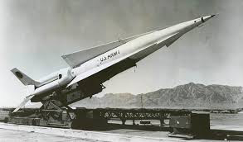
Birth of Modern Europe
The current political landscape of Europe was created from the outcome of the Cold War.

