Slide 1
https://www.youtube.com/watch?v=7KDz6dGQ5RE
Extreme Weather
Extreme Weather

Slide 2
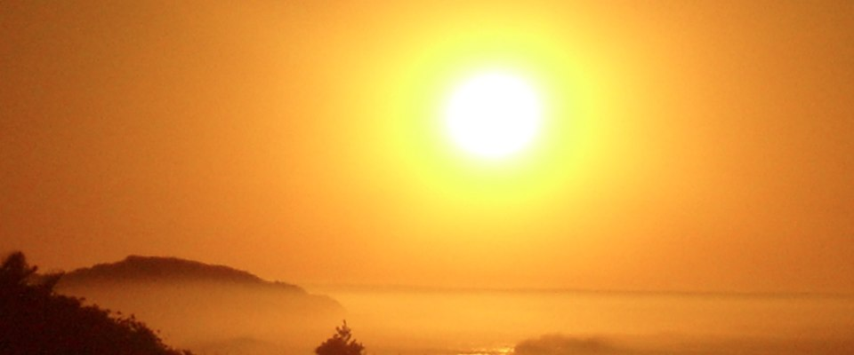
Weather
Weather is the day to day conditions of a particular place.
Ex Ex Example:
Sunny Weather

Slide 3
climate
Climate is the weather conditions prevailing in an area in general or over a long period.
Areas usually have one of the following climates:
Tropical Wet Humid Continental
Semiarid Subartic
Arid Ice Cao
Mediterranean Tundra

Slide 4
Four seasons
Spring Summer Autumn Winter

Slide 5
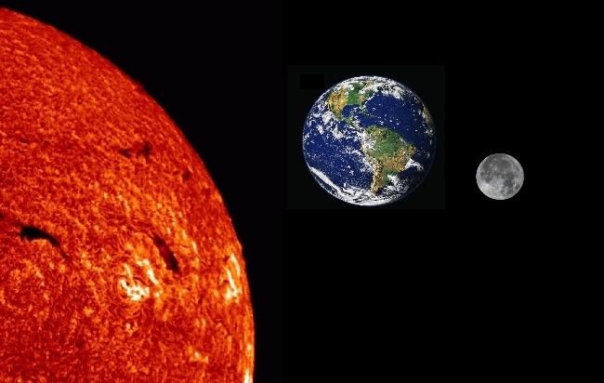
Why do we have seasons?
There are two reasons the Earth experiences seasons:
The tilt of the Earth on it’s axis
https://www.youtube.com/watch?v=vDgUmTq4a2Q
2) Earth’s rotation around the Sun
https://www.youtube.com/watch?v=9n04SEzuvXo

Slide 6
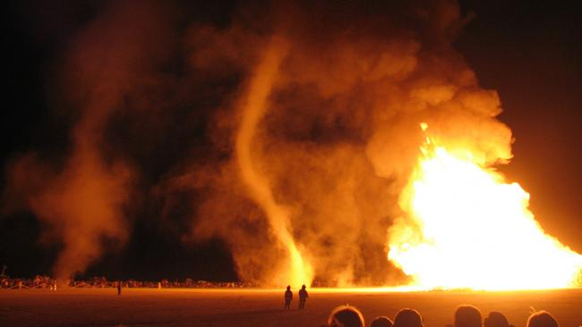
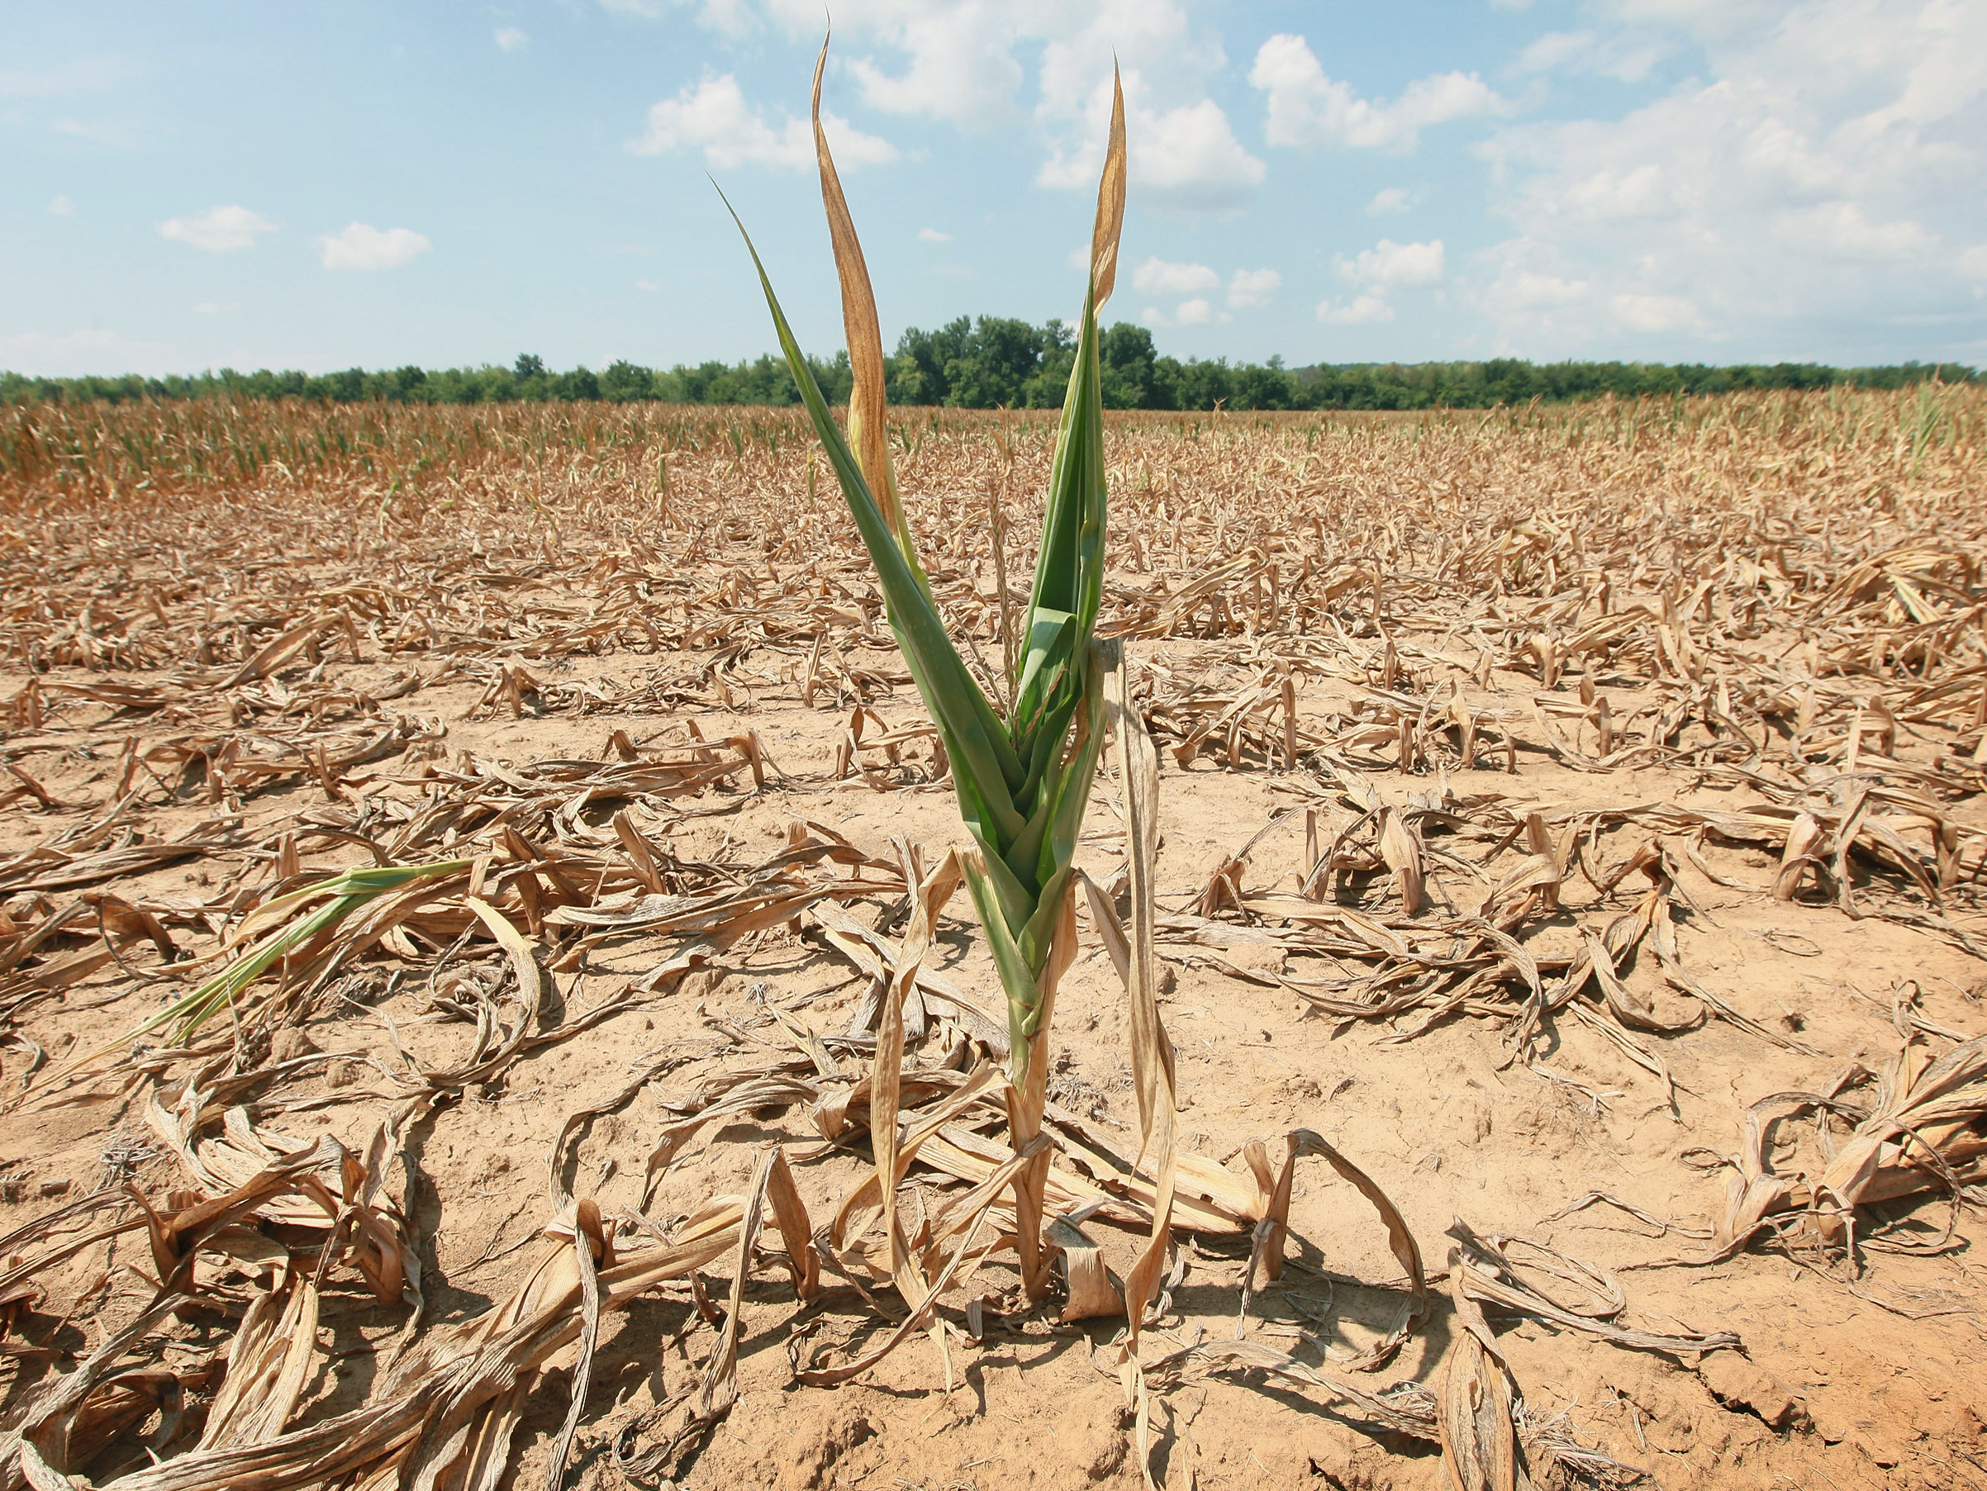
Extreme Weather
Extreme weather is when a weather event is significantly different from the average or usual weather pattern.
Example:
Hurricanes
Tornadoes
Droughts
http://youtu.be/tpdWfaNACgE

Slide 7
Hurricanes
A hurricane storm with a violent wind, in particular a tropical cyclone in the Caribbean.
Wind speed is the determining factor in the scale, as storm surge values are highly dependent on the slope of the continental shelf in the landfall region. Wind speeds are measured using a 1-minute average. Note:The Saffir-Simpson Hurricane Wind Scale (SSHWS) was updated in 2012 to accomodate number rounding issues.
http://youtu.be/ooGsvj5SeHE

Slide 8
Tornado
A tornado is a violent rotating column of air extending from a thunderstorm to the ground. The most violent tornadoes are capable of tremendous destruction with wind speeds of up to 300 mph. They can destroy large buildings, uproot trees and hurl vehicles hundreds of yards.
https://www.youtube.com/watch?v=zHxYuUAGbKk
https://www.youtube.com/watch?v=tB3sZKRlk9I

Slide 9
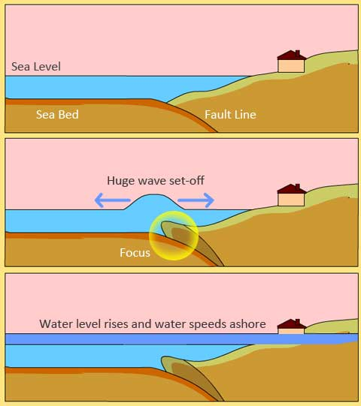
Tsunami
A tsunami is a long high sea wave caused by an earthquake, submarine landslide, or other disturbance.
https://www.youtube.com/watch?v=k8IAgUNr6x4

Slide 10
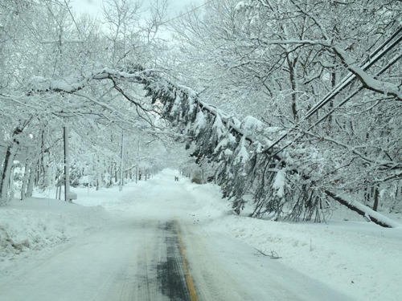
Blizzards
A blizzard is a severe snowstorm with high winds and low visibility.

Slide 11
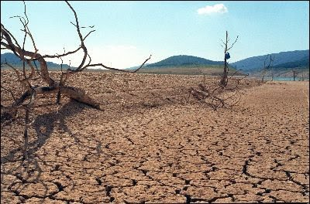
drought
A drought is a prolonged period of abnormally low rainfall; a shortage of water resulting from this.

Slide 12
Volcanoes
A volcano is an opening in Earth’s crust from which lava, ash, and hot glasses flow.
There are three main types of volcanoes, varying in size and strength:
Stratovolcano
Cinder Cone Volcano
Shield Volcano
The largest volcano in the solar system, Olympus Mons, is a Shield Volcano

Slide 13
Earthquakes
Earthquakes are a sudden and violent shaking of the ground, sometimes causing great destruction, as a result of movements within the earth's crust or volcanic action.
Earthquakes are a result of tectonic plates releasing energy along fault lines.
Earthquakes can result in the follow:
Volcanoes
Tsunamis
Destruction

Slide 14
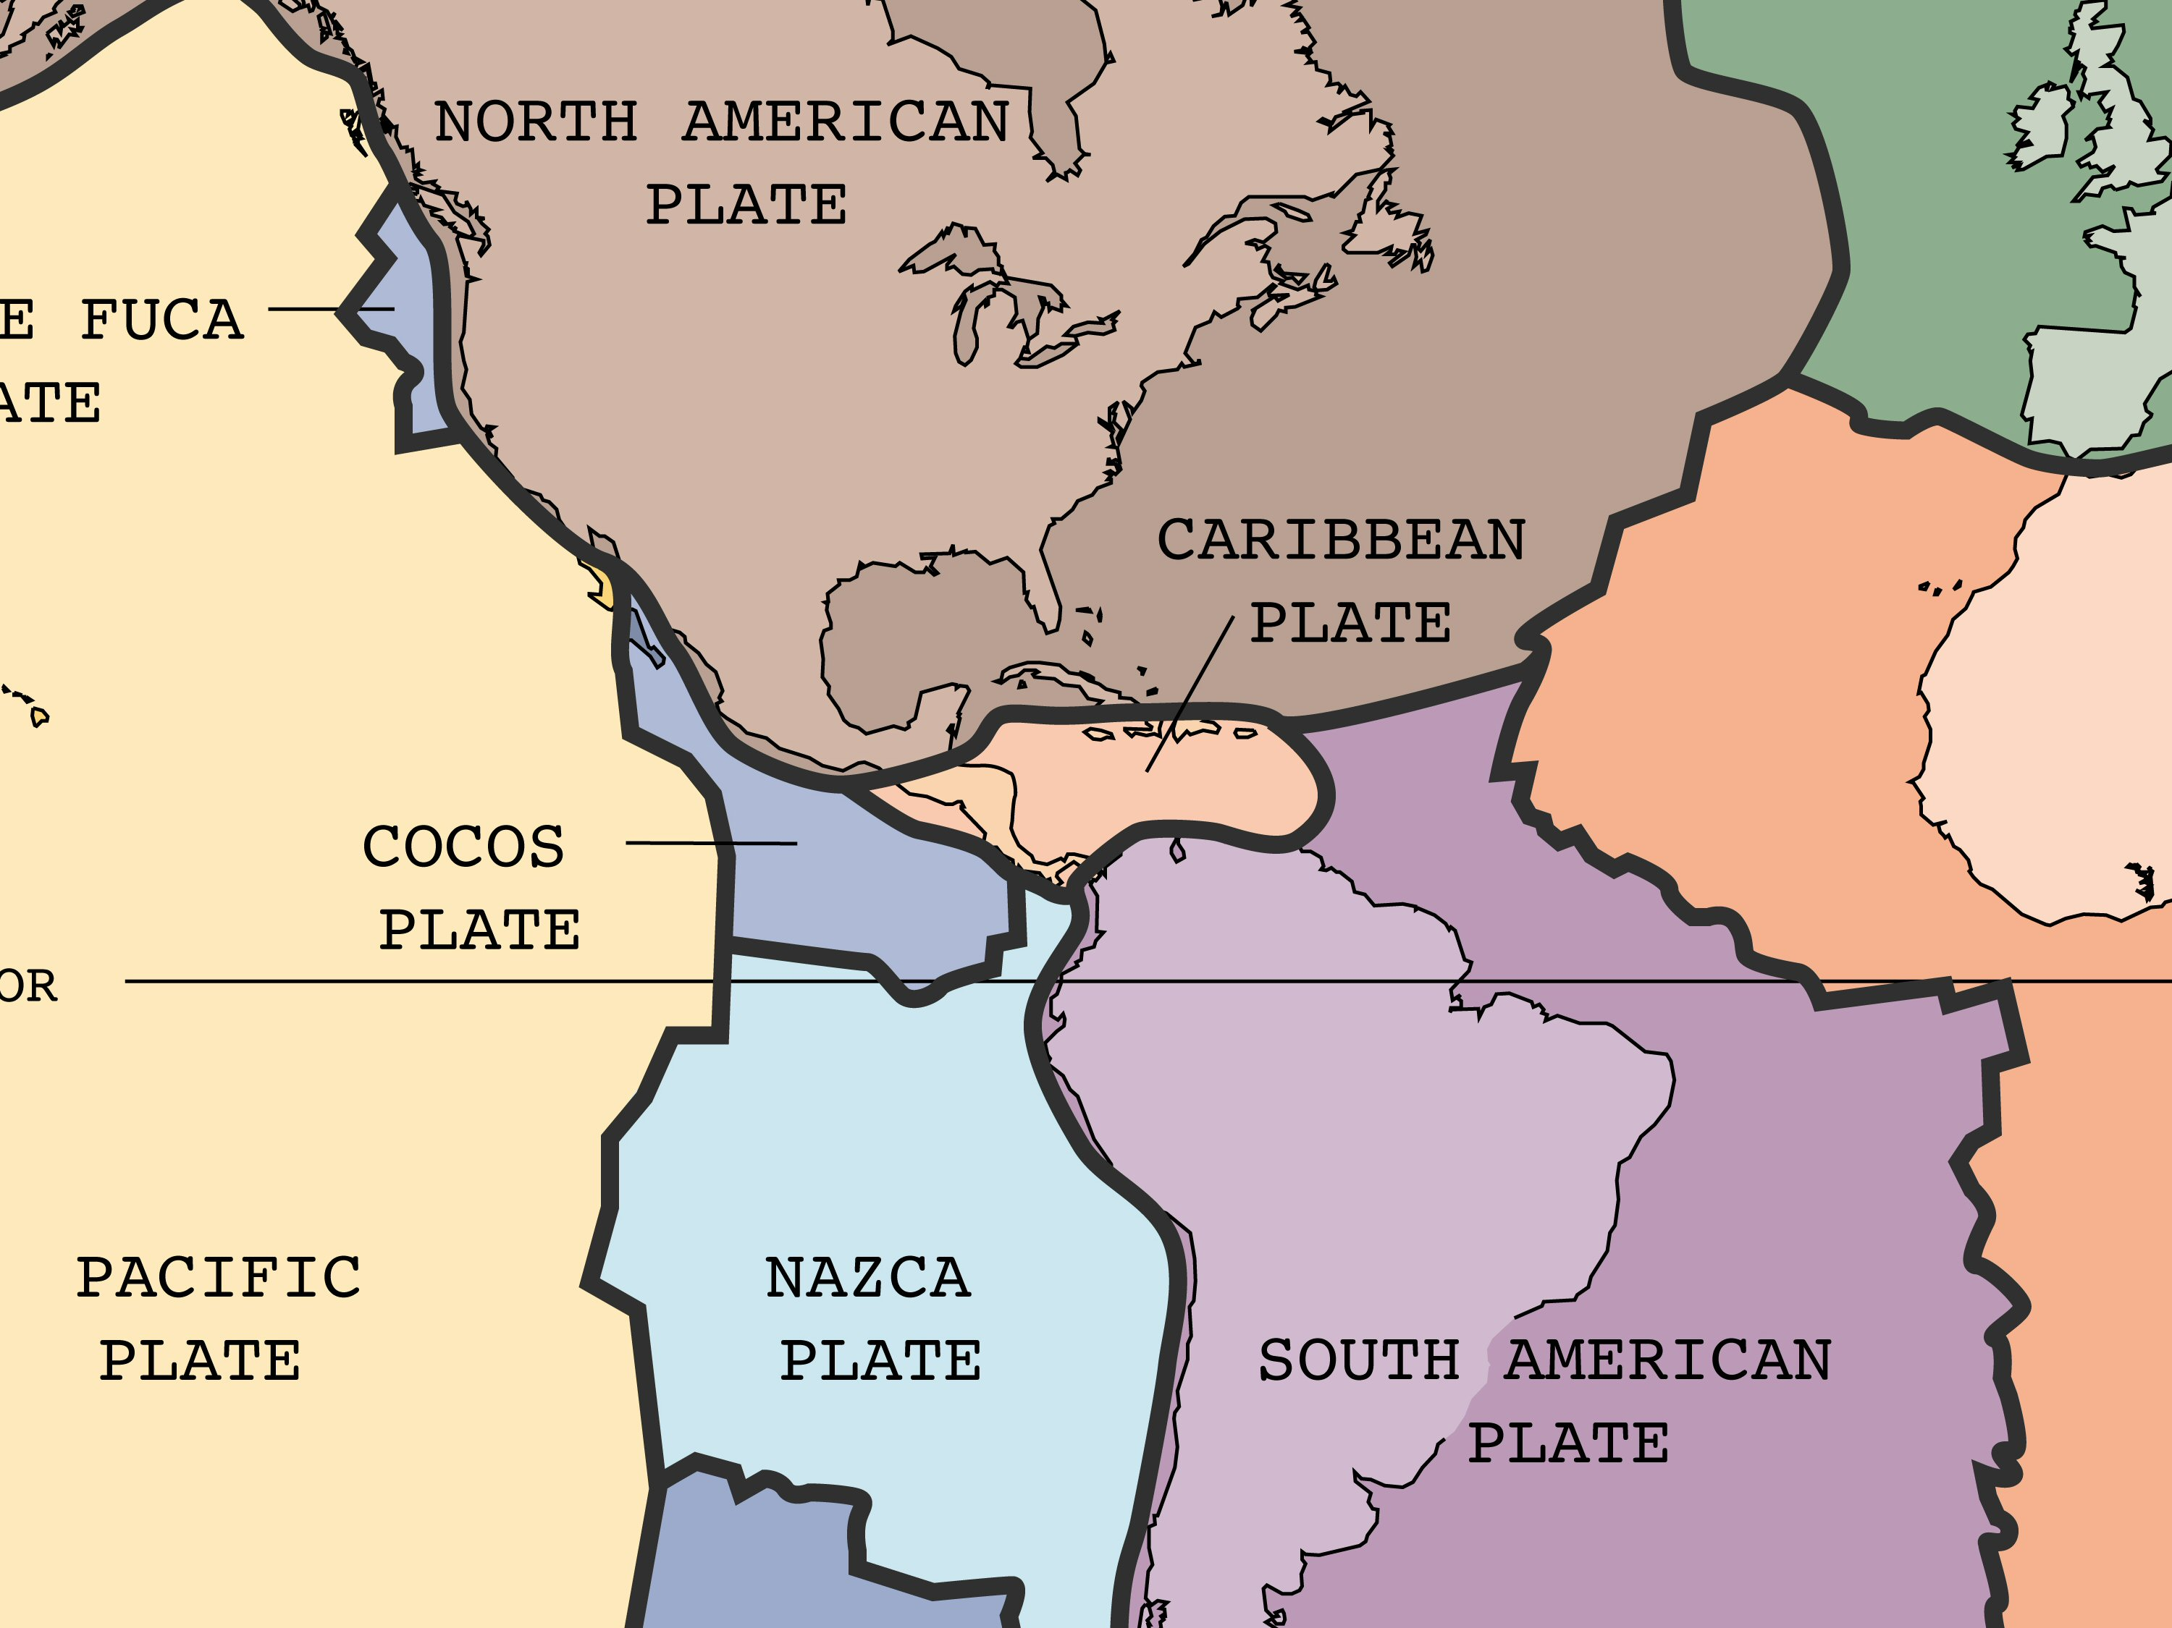
Tectonic Plates
Tectonic plates are pieces of the Earth's crust and uppermost mantle, together referred to as the lithosphere.
https://www.youtube.com/watch?v=ryrXAGY1dmE

