Slide 1
Gender

Slide 2
Gender roles and equality vary across the globe. How is your role determined in society?

Slide 3
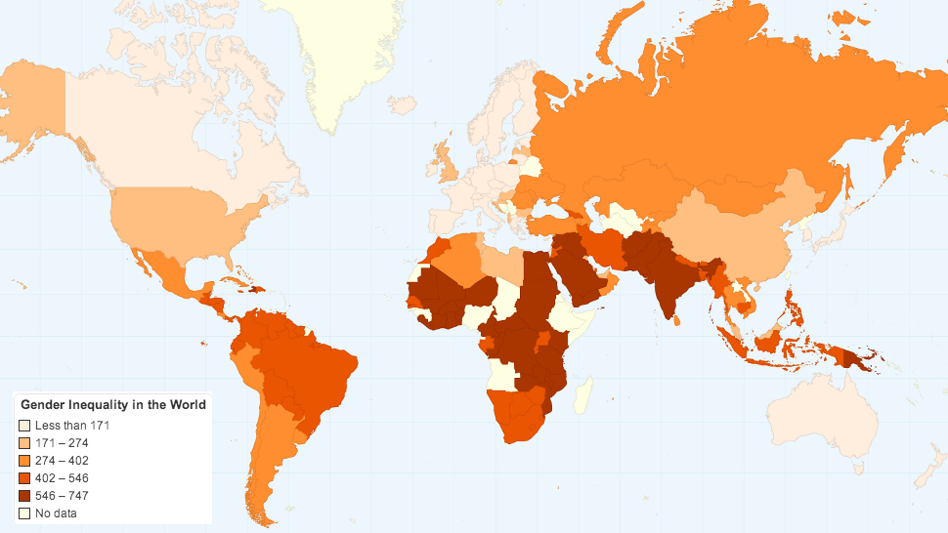
The GII measures gender inequalities in three important aspects of human development—reproductive health measured by maternal mortality ratio and adolescent birth rates; empowerment, measured by proportion of parliamentary seats occupied by females and proportion of adult females and males aged 25 years and older with at least some secondary education; and economic status expressed as labor market participation and measured by labor force participation rate of female and male populations aged 15 years and older.

Slide 4
Explore the stations around the room to determine how gender expectations affect the lives of women in the Middle East.

