Slide 1
Human Geography
An Overview

Slide 2
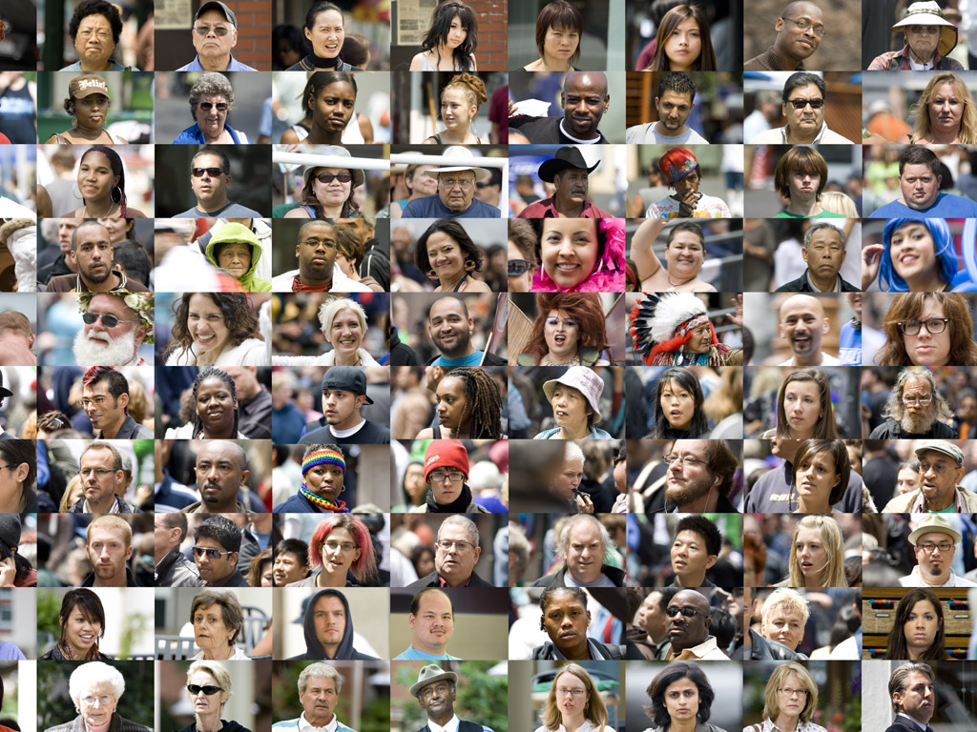
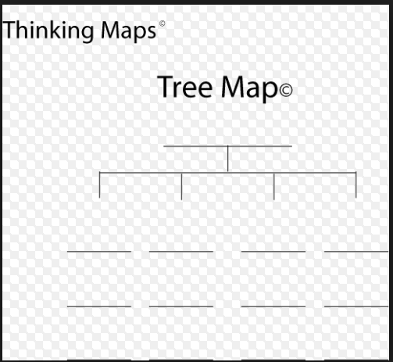
What is human geography?
The study of the world, its people & their communities.
It has a greater focus on studying human activities instead of physical features of the earth.
Parts of Human Geo.-
Create a tree map for the categories
Culture
Population
Government
Economics
Urban

Slide 3
Culture
The total of knowledge, attitudes, and behaviors shared by and passed on by members of a group.
Diffusion- Spreading Culture
Acculturation- Accepting a different culture
Innovation- Creating something new to meet a need.
Parts include:
Language (Dialect)
Religion
Ethnic Group- shared heritage
Food

Slide 4
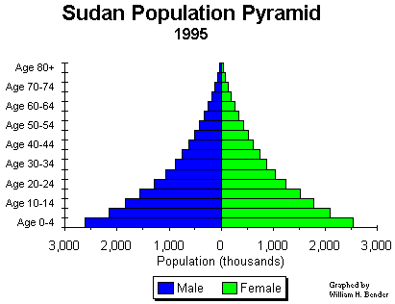
Population Geography
The study of the distribution of people in the world.
Population Pyramids show a countries population at a specific moment, divided by gender and age.
Most civilizations developed around water.
Push Factors- Reasons to leave a country.
Pull Factors- Reasons to come to a country.
Population Density- The number of people in an area.
Life Expectancy- People are living longer.

Slide 5
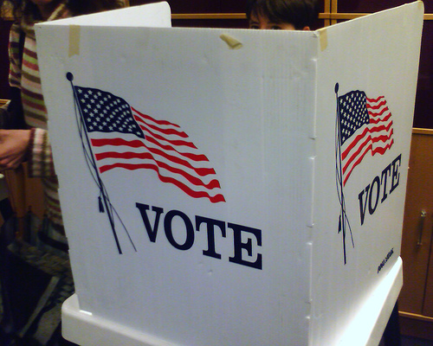
Political Geography
The study of different forms of government.
Democracy- People have the power through elected officials.
Totalitarian- Government has all the power.
Theocracy- Religious leaders have all the power.
Communist- Appointed Committee has power (economic element).

Slide 6
Economic Geography
The study of how people make money.
Types of Economies
Traditional: goods and services are traded(barter)
Mixed/Socialism: a combo of market and command
Market/Free Enterprise/Capitalism: consumer demand determines what goods and services are produced
Command/Communism: the govt. plans what goods and services are produced

Slide 7
Economic Geography (Cont.)
What is necessary for a healthy economy?
Infrastructure- basic systems for economy
Communication
Transportation
Sanitation
Education
Natural Resources
Not Evenly Distributed
Some resources are non-renewable.
Standard of Living
More Developed/
Developed
Newly Industrialized/
Developing
Less Developed/
Underdeveloped
Levels of Economic Activity
Primary
Secondary
Tertiary
Quaternary

Slide 8
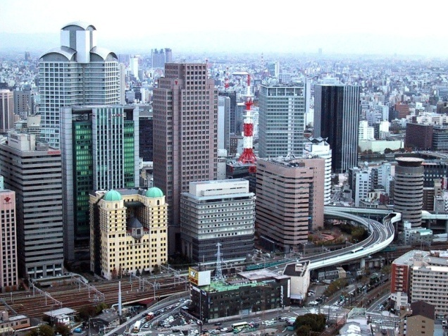
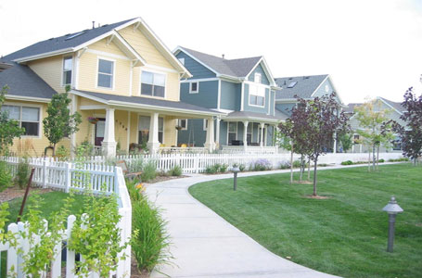
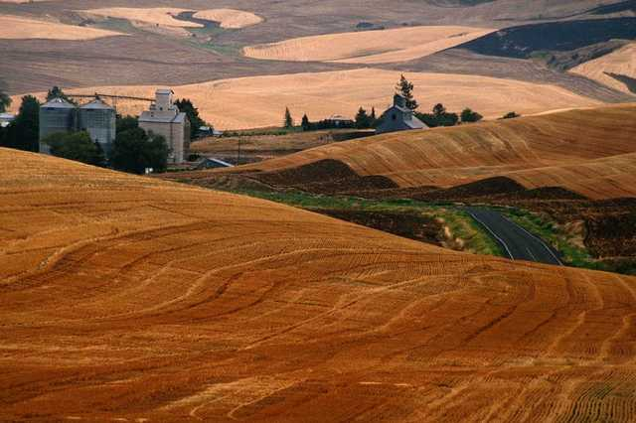
Urban Geography
The study of how people use space in cities.
Urbanization- Dramatic Rise in the number of cities and changes in lifestyle that come from that change.
Types of Areas
Urban-The Big City (Dallas, Tx)
Suburban- Middle sized town (Lewisville, Tx)
Rural- Little population, country (Happy, Tx)

