Slide 1
INDIA

Slide 2
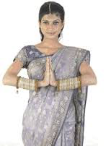
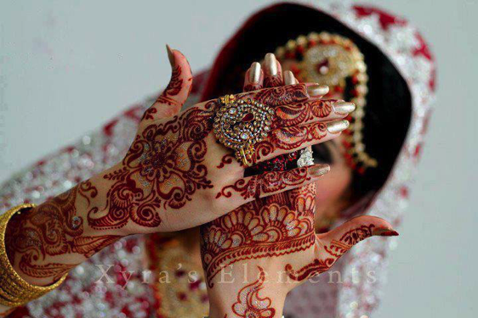

Slide 3
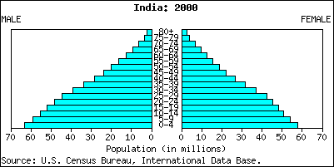
Population
India is home to 1.252 billion people.
That’s roughly 324 person/sq kilometer!
933 females to 1000 males
65% literacy rate

Slide 4
Language
Hindi is the official language of India.
258-422 million people speak Hindi.
There are numerous dialects of Hindi.
There are 461 living languages in India, though.
13 of those are dying.

Slide 5
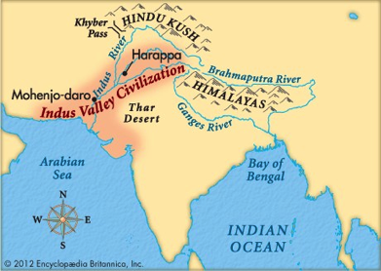
History
Civilization sprung up around the Indus River Valley around 7000 BC. The remains of that society are now referred to as the Indus River Valley Civilization.
Famous cities include Mohenjo-daro and Harappa
Fell around 19000 BC. Ancient Egypt was in the Middle Kingdom during this time.
The downfall is attributed to a wandering tribe known as the Aryans, whose traditions would later have a large impact on Indian society.

Slide 6
Religion
Evolving from the beliefs of the invading Aryans, Hinduism evolved into being, and now it is the most common religion in India.
The holy texts of Hinduism are the Vedas.
Brahman is the title given to priests.
Hinduism a polytheistic religion.
Karma: the belief that one’s actions have unavoidable and automatic effects on one’s condition or rebirth.
REINCARNATION: rebirth

Slide 7
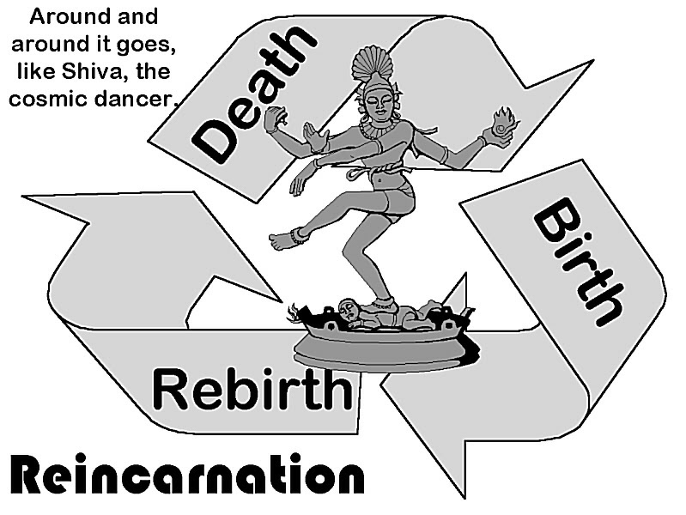

Slide 8
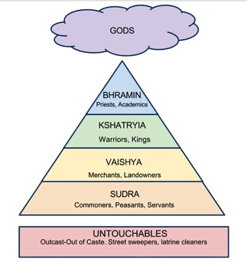
Religion and Society
Religion shaped the inner workings of society, establishing a rigid caste system (class structure that is determined by birth) that lasted for thousands of years.
A person’s caste can still determine
his or her fate today.
A person may change castes only by
Reincarnation.

Slide 9
Sikhism
During the later half of the 15th Century, a new religion, Sikhism, developed on India. “Sikh” means strong and able discipline.
Beliefs:
Adherence to religious authority.
One true God.
Karma and Reincarnation
Theocracy

Slide 10
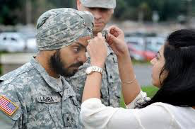
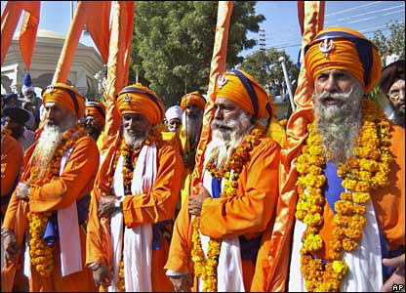

Slide 11
Geography
The Himalayas dominate the Indian subcontinent.
Mt. Everest is the largest mountain in the world.
The Ganges River is a sacred body of water.
It is a place of healing and cleansing for followers of the Hindu faith.
Provides water for farming.
Provides transportation.

Slide 12
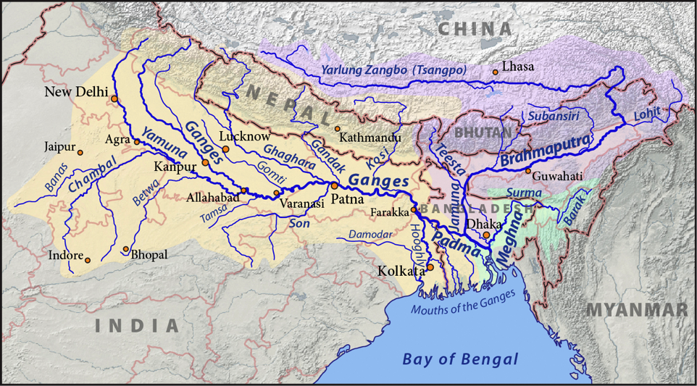

Slide 13
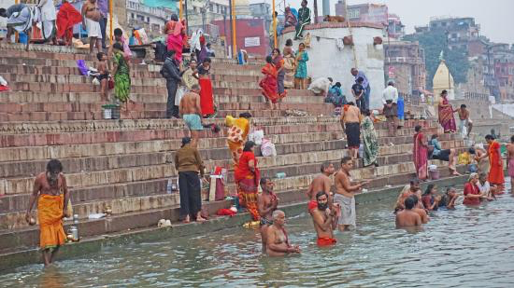

Slide 14
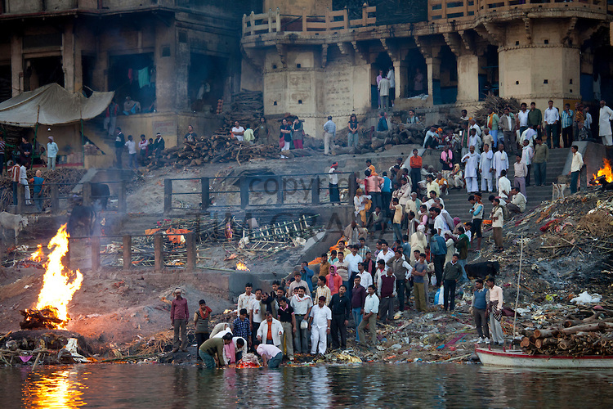

Slide 15
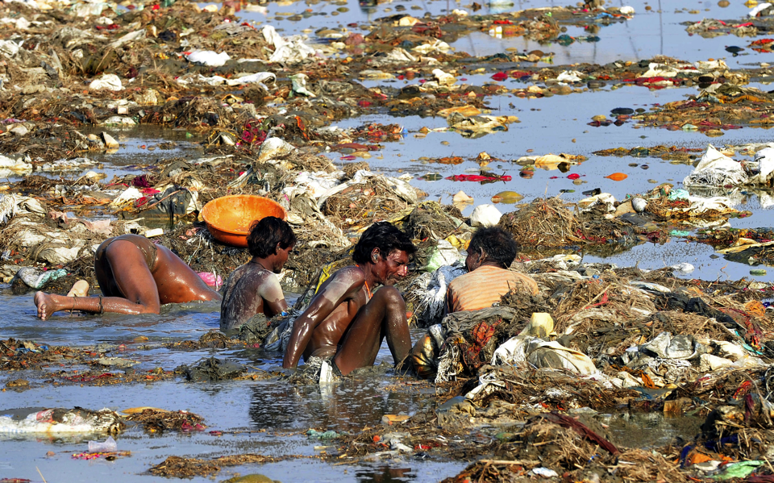

Slide 16
Political
India is a Federal Republic (people vote for the elected officials in the different tiers of government).
The powers of the government come from a constitution, making it a Constiutional Republic.
Conflict over the state of Kashmir, based on political and religious reasons, has erupted numerous times in the last 60 years. When Pakistan split from India, it separated Muslim Indians from Hindu Muslims.

Slide 17
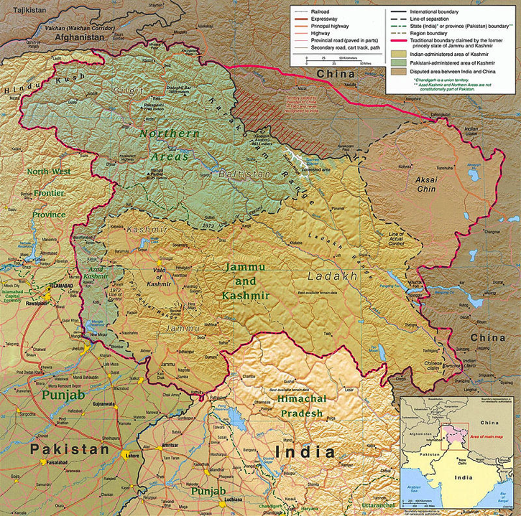

Slide 18
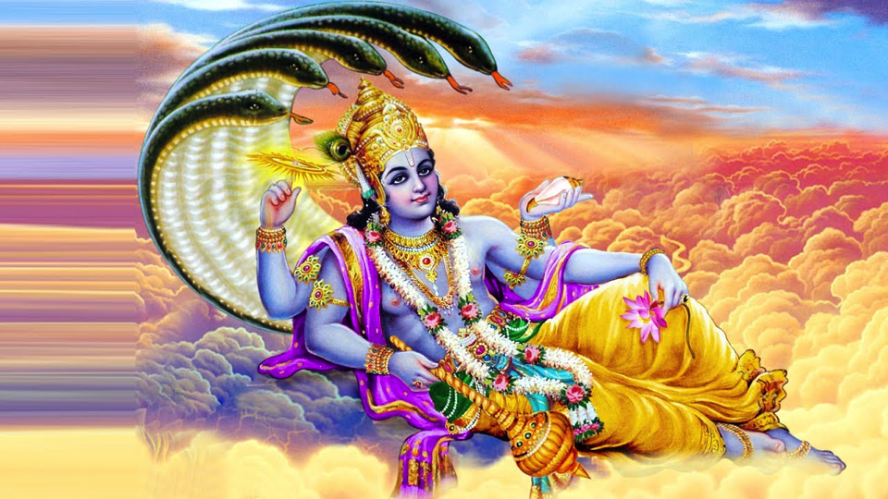
Let’s play a game!

Slide 19
Rules and Roles
1) Brahman (Priests)- Pass out/take away Karma points to other classes and help with reincarnation ceremony
2) Kshatriy (King/Queen/Warlord) a- pass out and collect papers.
3) Vaishya (Noble person)- read when called upon,
4) Sudras (Servants)- give compliments to members of higher classes on sticky notes.
5) Untouchables- pick up trash and clean up messes that the other classes make. (They’re still people, so be nice!)

