Slide 1
Directions:
Please find the group cluster that corresponds with the location you were given. (FIND YOUR CONTINENT)
Ex: If you were given Scotland, you would go to Europe – The continent that your location is in.
There is ONE group that has MULTIPLE continents. If one group cluster is full, try and find that group.

Slide 2
World Geography
Fall 2015

Slide 3
Class Objective
In World Geography, we will explore the many exciting regions of Earth, discovering what makes each area unique and special.
Religion, Government, Culture, Location, Weather, etc.

Slide 4
Class Expectations
“A person’s a person, no matter how small” -- Dr. Seuss
Respect your classmates and the teacher.
Listen and follow directions.
Be an active learner and participate in activities.

Slide 5
No. 1 Rule
No cellphones!
This rule extends to all technology – inappropriate use of iPads (or any other form of technology) will result in the item being taken away and a detention.

Slide 6
Advice from a Professor
A student should be able to:
Self Advocate – if you are confused, speak up! We’re all here to learn, not to be afraid.
Communicate Well – when interacting with others, language and style should be appropriate for the situation. Remember, this is a professional environment.
Be Responsible – YOU are held accountable for completing assignments and participating in class; you will be expected to read, write, and present.
READ, READ, READ! – The best place to learn is between the covers of a book.
Participate in Teamwork – teamwork makes the dream work.

Slide 7
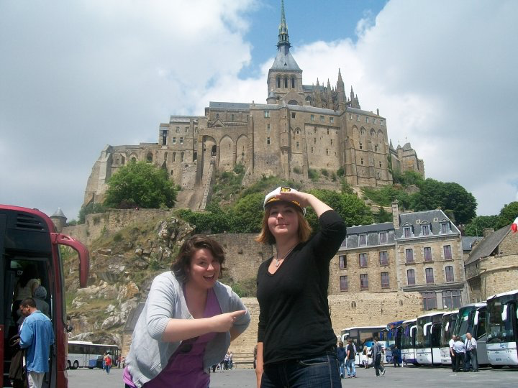
The Teacher
Ms. Smith has been described as “awesome” and “super cool” by those who know her (mostly her cats…and maybe her dog).
Graduated from the University of North Texas with a double major in History and French.
Enjoys sad books, scary movies, and funny TV shows.

Slide 8
Who are you?
Quietly and thoughtfully, please complete the Student Information form.
When you are done, think about a funny joke you can share with the class.
You have 15 minutes.

Slide 9
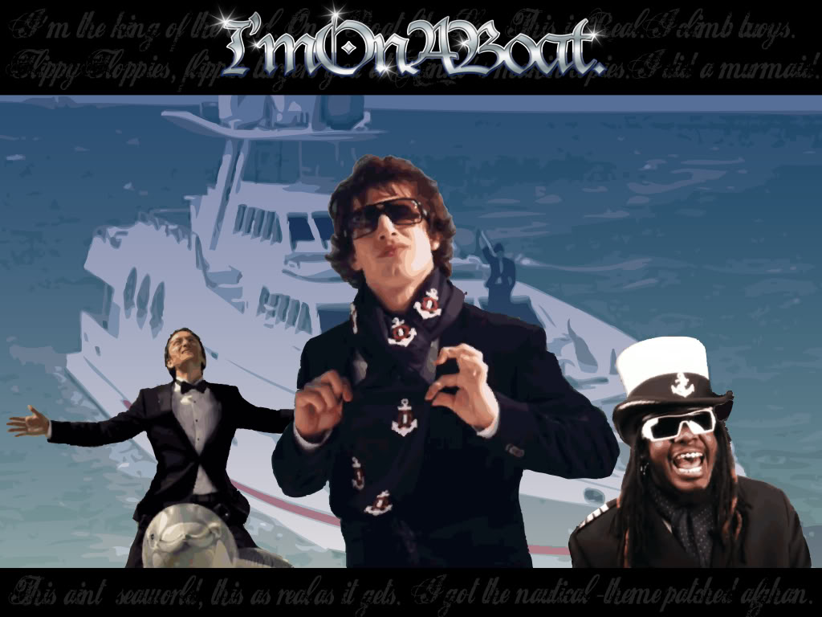
The Lonely Island
You and your group mates have been exiled to a deserted island for a year. In addition to the essentials, together you may take the following:
One piece of music
One book
One luxury item (you can carry with you, i.e. not a boat to leave the island)
What would you take and why?

Slide 10
Class Norms
What are some important rules that you think are necessary for a well functioning classroom?
Take 2 minute to quietly deliberate and write down your ideas.
Round Robin with your table (go around in a circle until all ideas have been discussed).
Within your group, pick two ideas.

Slide 11
Pop Quiz
Quietly complete all the questions.
When you are done, begin to read through the syllabus.

