Slide 1
Japan

Slide 2
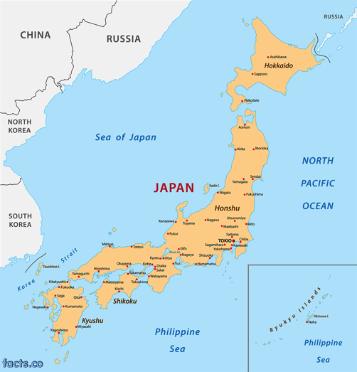
Japan
Japan is a series of islands located in the Pacific Ocean, on the east side of China. It’s capital city is Tokyo.
There are 127 million people that live in Japan, but it has a negative growth rate. Within 1,000 years, there may be no Japanese alive.

Slide 3
Physical Geography of Japan
Japan is made up of a series of islands (known as an archipelago), and over 80% of the Japanese countryside is hilly or mountainous terrain.
Mountains were sacred to ancient people dwelling on the islands.
Due to the large population and limited area, Japan has limited land for building.

Slide 5
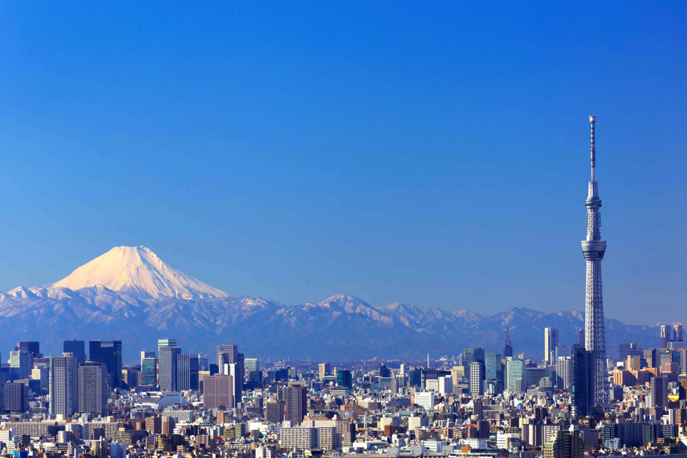

Slide 6
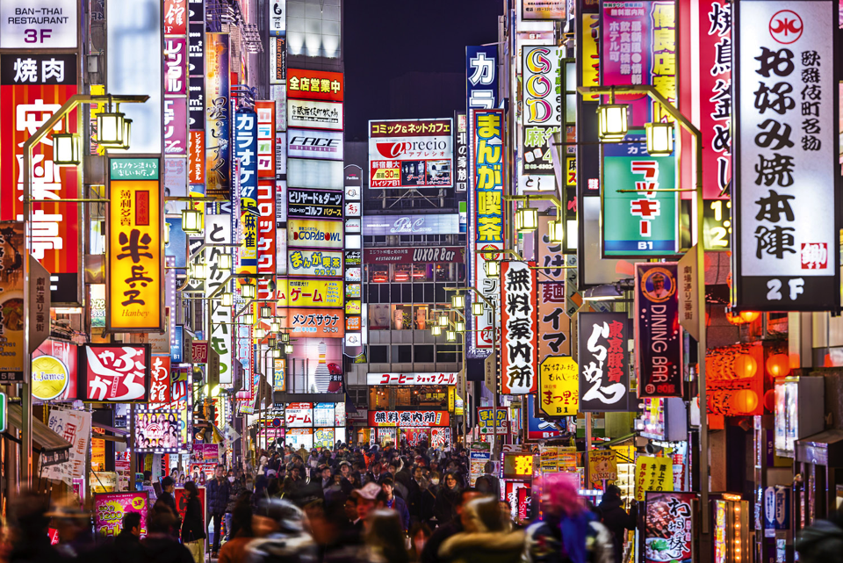

Slide 7
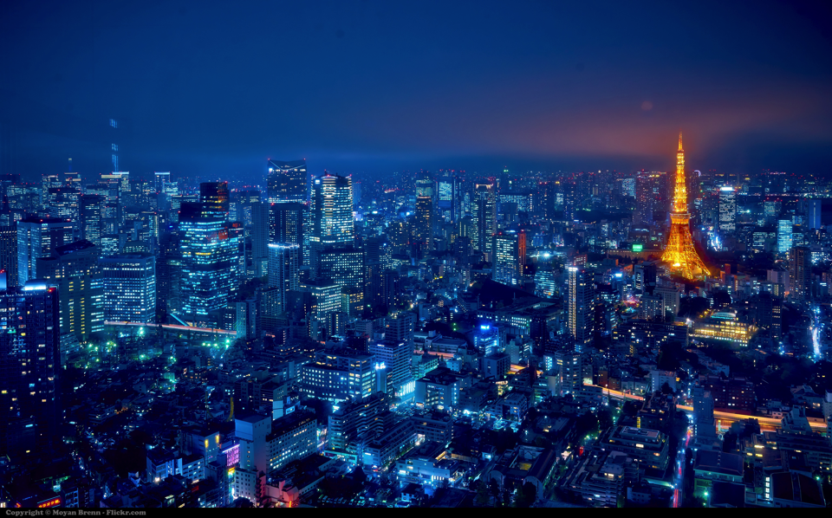

Slide 8
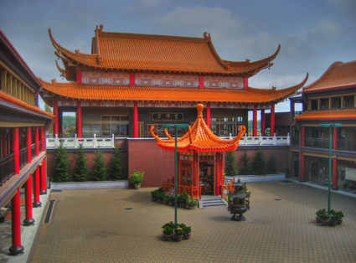
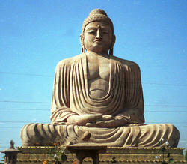
Religion
A prominent religion in East Asia and Japan is Buddhism. Buddhism originated in India and migrated northeast. Siddhartha Gautama is considered the founder.

Slide 9
Religion
Shintoism is another popular religion in Japan.
The essence of Shinto is the Japanese devotion to invisible spiritual beings and powers called kami, to shrines, and to various rituals.
Shinto is not a way of explaining the world. What matters are rituals that enable human beings to communicate with kami
Kami are not God or gods. They are spirits that are concerned with human beings - they appreciate our interest in them and want us to be happy - and if they are treated properly they will intervene in our lives to bring benefits like health, business success, and good exam results.
They co-exist with Buddhists.

Slide 10
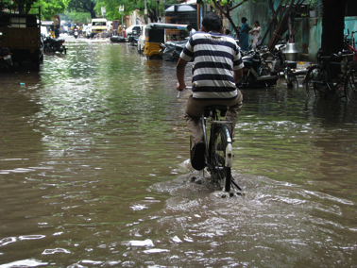
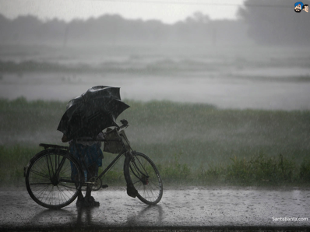
Weather
Japan is susceptible to Monsoons, which are seasonal winds and rains that can cause massive flooding.

Slide 11
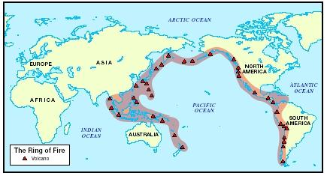
Extreme Weather
Japan is located along the Ring of Fire, leaving it prone to tectonic activity, like….
Volcanoes
Earthquakes
Tsunamis

Slide 12
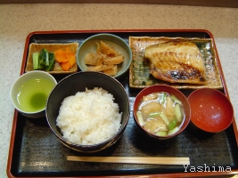
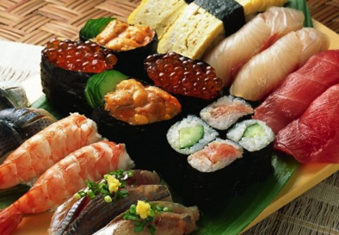
Food
Staple dishes in Japan are fish and rice.
Traditionally, women were not allowed to make sushi, because it was feared their “hot hands” would cook the raw meat.

Slide 13
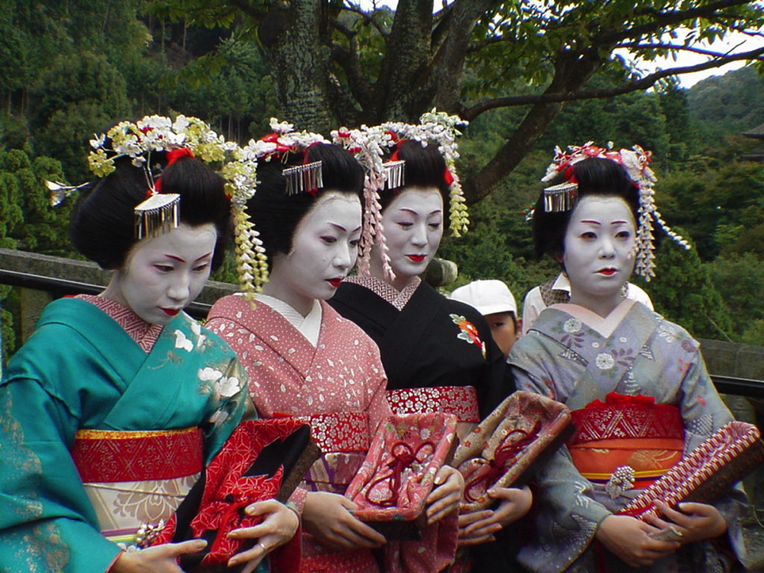

Slide 14
