Slide 1
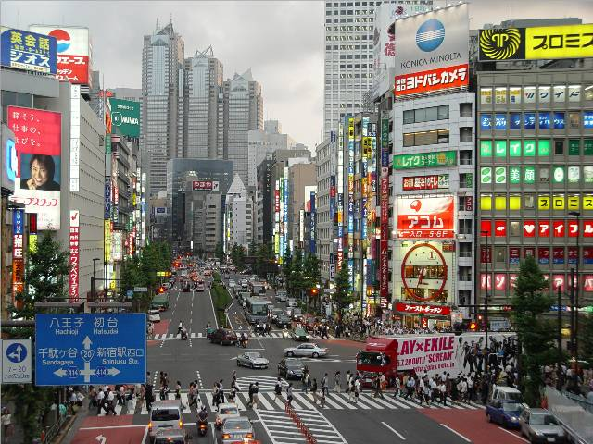
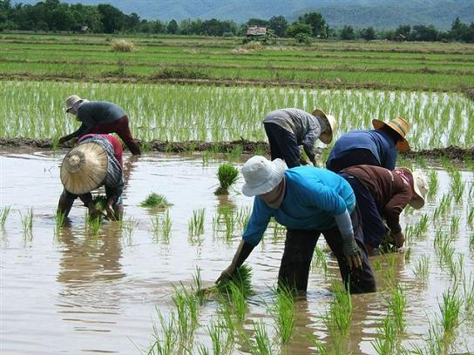
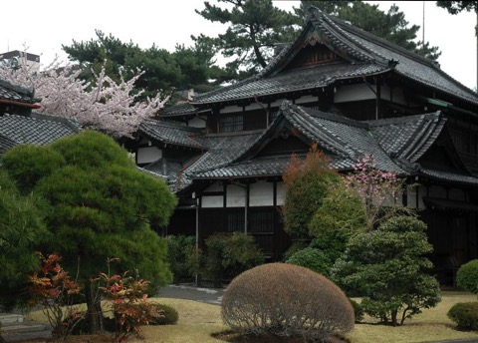
Population and Land Use in
Monsoon Asia

Slide 2
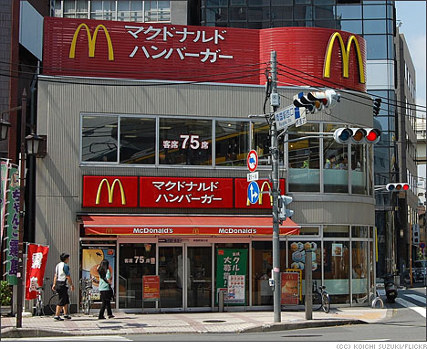
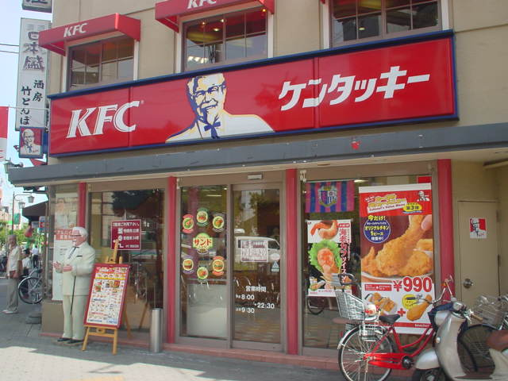
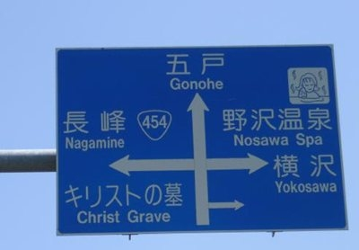
One reason for growth is due to Globalization
Cultural diffusion- spreading of culture, such as food, clothes and languages to other regions of the world.

Slide 3
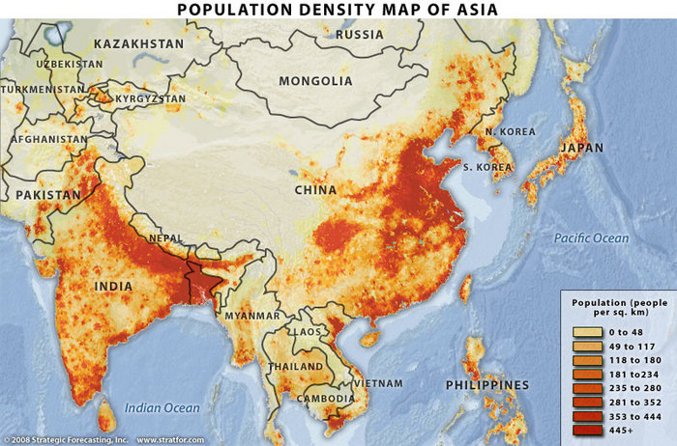
Very densely populated- especially around bodies of water

Slide 4
China’s population!
***Watch how China’s population is growing right now!

Slide 5
Cartogram of the World Population

Slide 6
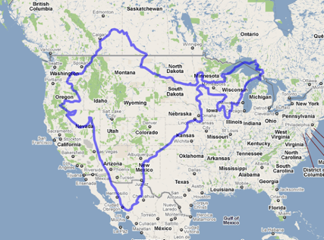
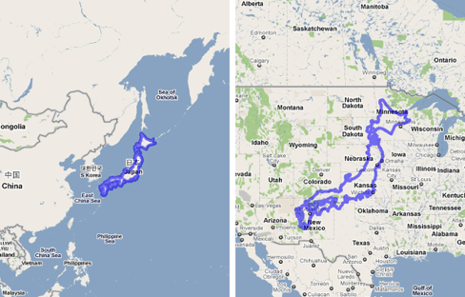
So many people!! Not enough land!!
People have to adapt to their environment.

Slide 7
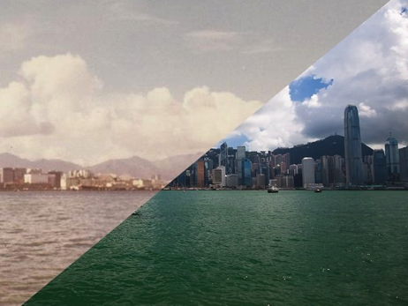
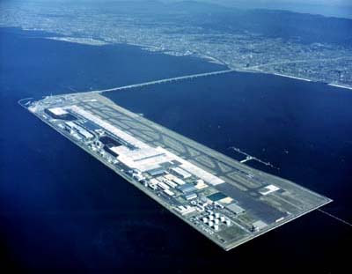
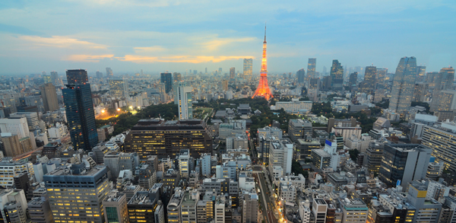

Slide 8
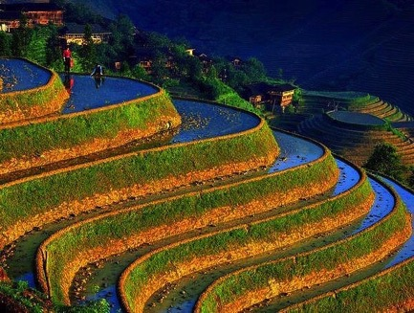
Terraced farming/agriculture
The mountainous terrain of East Asia makes it difficult to farm on flat land.
The terraced farming technique allows people to farm along the hillside.

Slide 9
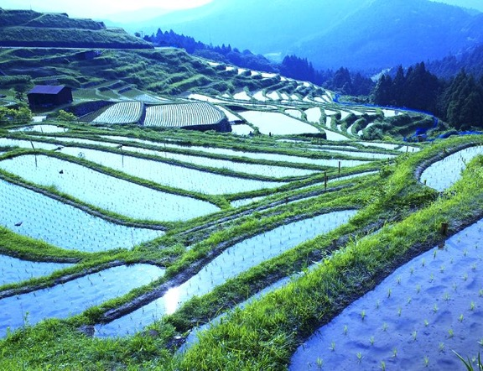
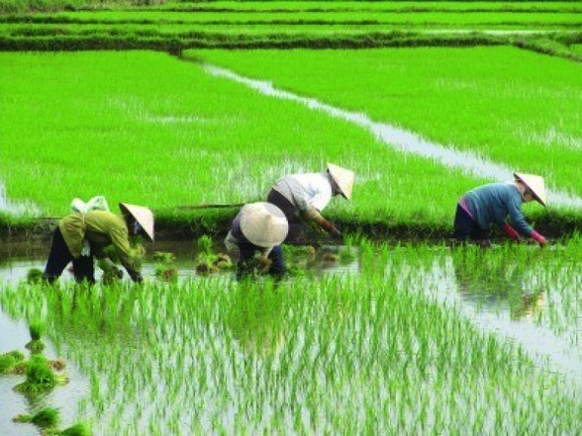
Rice Paddy
Rice is the main agricultural product grown in East Asia.

Slide 10
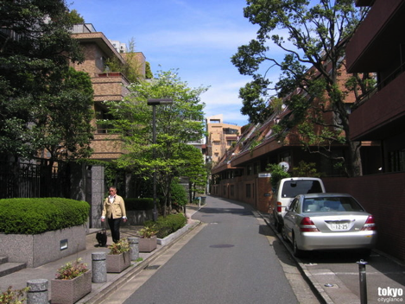
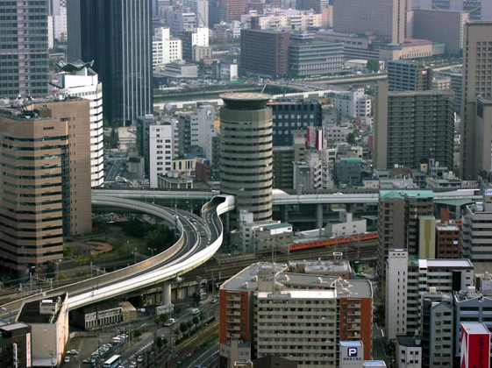
Urbanized
The cities/urban areas are extremely crowded and the land is limited for buildings & big road systems.

Slide 11
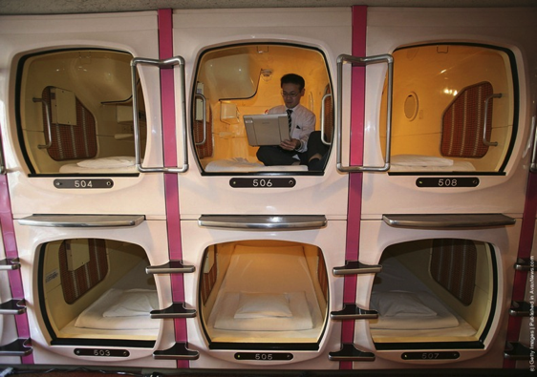
Capsule Hotels in Japan
http://www.youtube.com/watch?v=J1TbiOI7RGs

Slide 12
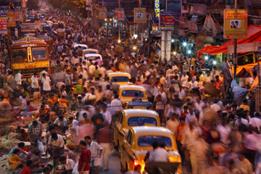
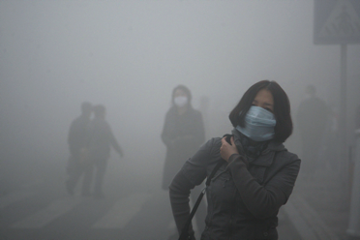
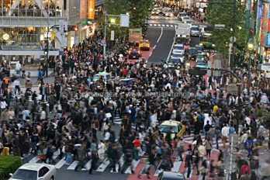
Consequences of high population
Lack of natural resources
Higher crime rates
Overcrowded cities
Poor sanitation
Government lacks services

Slide 13
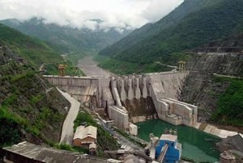
Sustaining population growth
Preserving the natural resources
Working to distribute resources equally

Slide 14
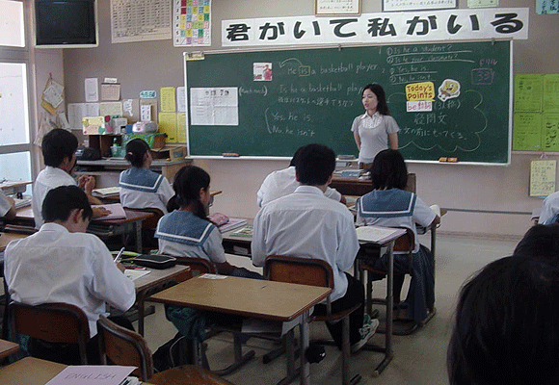
Solution for high population growth
Education- family planning, higher wages for jobs

