Slide 1
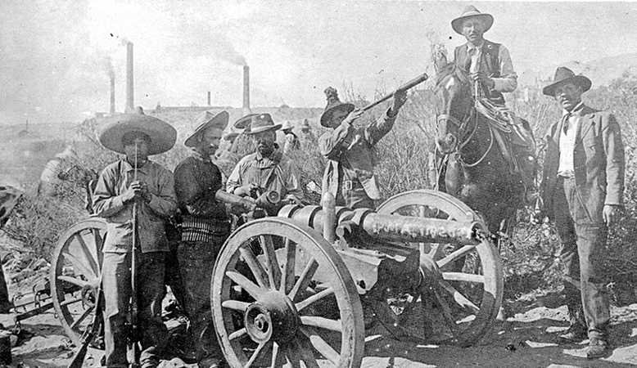
Latin America’s Challenges to Democracy

Slide 2
Trivia
What is the median income in Latin America?
5,000
9,000
50,000

Slide 3
Trivia
Correct Answer: B
The median income is actually $8,990 in Latin America. The poorest country in Latin America is Haiti.
WHY??

Slide 4
What is this?

Slide 5
Democracy
Democracy is like a spectrum, which is a chart that shows two extremes. Some countries are very democratic (which means that citizens have many rights), while others are false democracies (the people do not really vote).

Slide 6
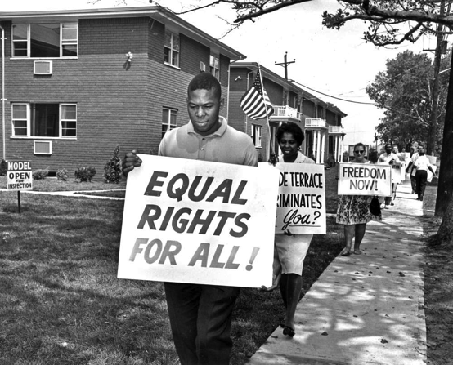
Democracy
Definitions
Personal Liberties: the freedom of the individual to do as he pleases, limited only by the government to secure public health, safety, and morals.
Civil Rights: laws that protect the individual against the government. Usually worded “The government shall make no law…” etc.

Slide 7
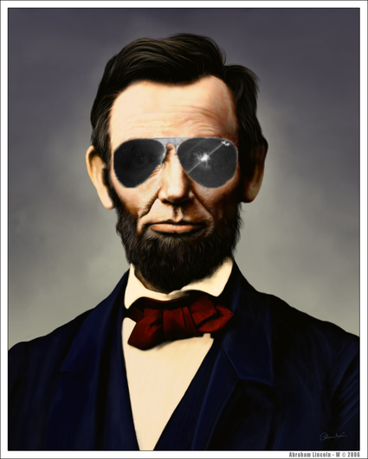
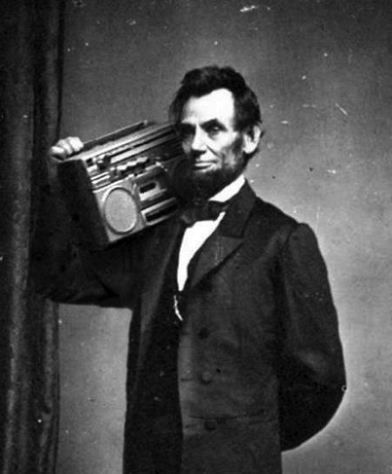
Democracy
True democracies are about the people and their wishes.
Government of the people, by the people.
- Abraham Lincoln

Slide 8
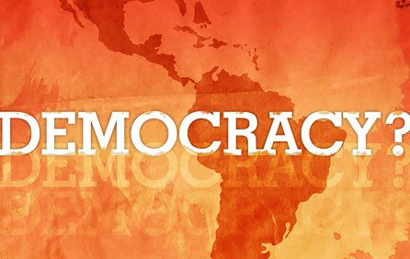
Democracy
When did Mexico become a democratic country?
A) 1917
B) 1780
C) 1889

Slide 9
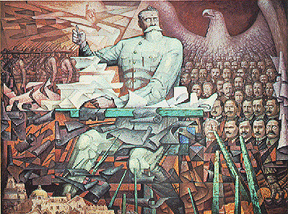
Democracy
Answer: A
After several wars, Mexico became a democracy permanently in 1917 with the adoption of the Constitution of Mexico.

Slide 10
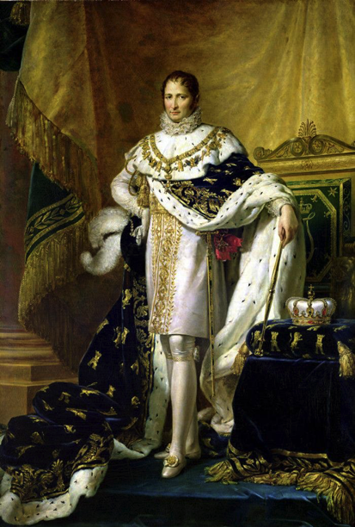
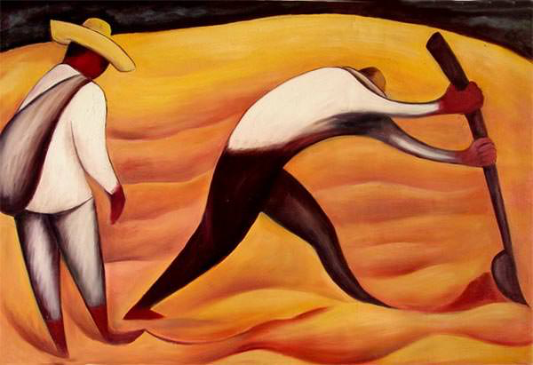
Road to Democracy
In most Latin American countries, when European countries were forced to leave, new kings were set up in the place of the old king.
The social order never changed. The minority rich ruled, and the majority poor had no say in the government.

Slide 11
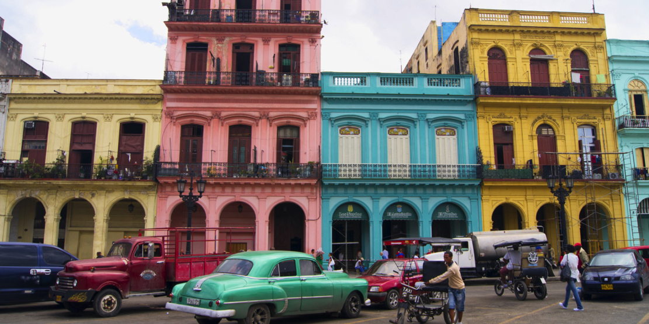
The Road to Democracy
Latin American countries have had a revolving door of dictatorships and democracy from the 1800s until the 1990s.
Today every country in Latin America (except Cuba) is ruled by a democratically elected government, although some are more democratic than others.

Slide 12
Road to Democracy
What percentage of Cubans have access to the uncensored Internet (not regulated by the government)?
A) 1%
B)5%
C) 23%

Slide 13
Inherited Political Traditions
Colonial rule
Europeans rule
Huge class differences (rich and poor)
Wars for Independence
Class distinction
Freed different colonies at different times
Lack of Infrastructure
Mostly agricultural society
Lack of transportation and communication

Slide 14
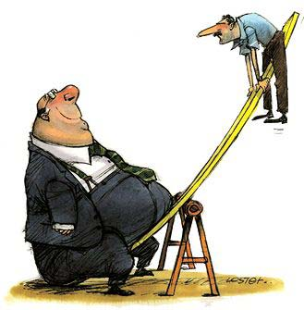
Who is controlling this situation?

Slide 15
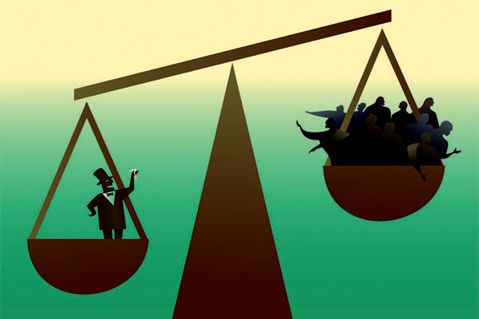
Inherited Political Traditions
Those with all the wealth and resources were the ones who made all the political decisions.

Slide 16
Inherited Political Traditions
European (Spanish and Portuguese) colonist and their descendants prevented democracy in Latin America even after independence.

Slide 17
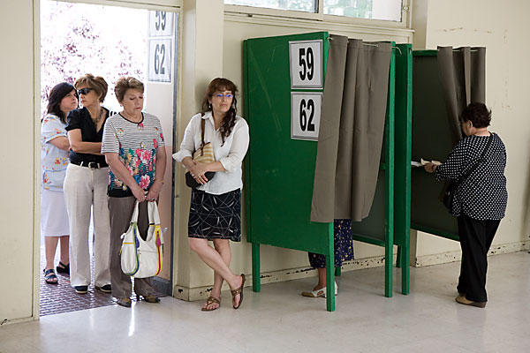
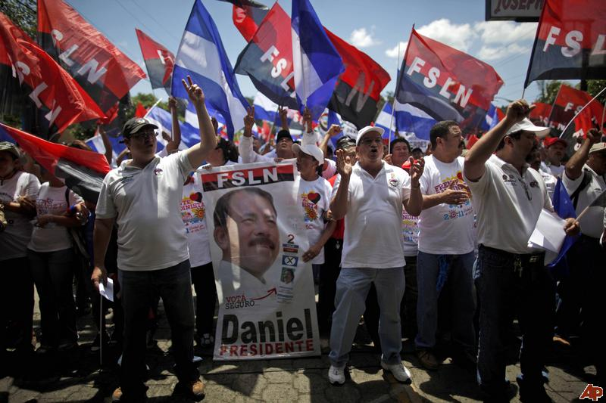
Inherited Political Traditions
The Poor People Wanted Democracy!

Slide 18
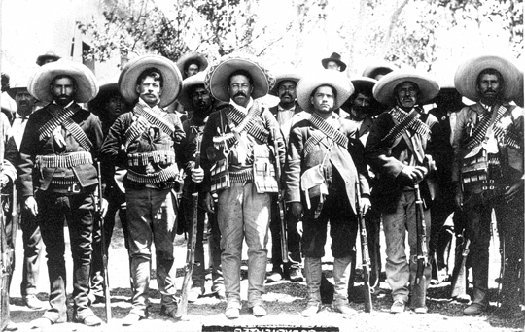
Inherited Political Traditions
All throughout Latin America, numerous battles and wars were fought to give each country their own democracy, respectively.

Slide 19
Inherited Political Traditions
This lead to political instability in Latin America.

Slide 20
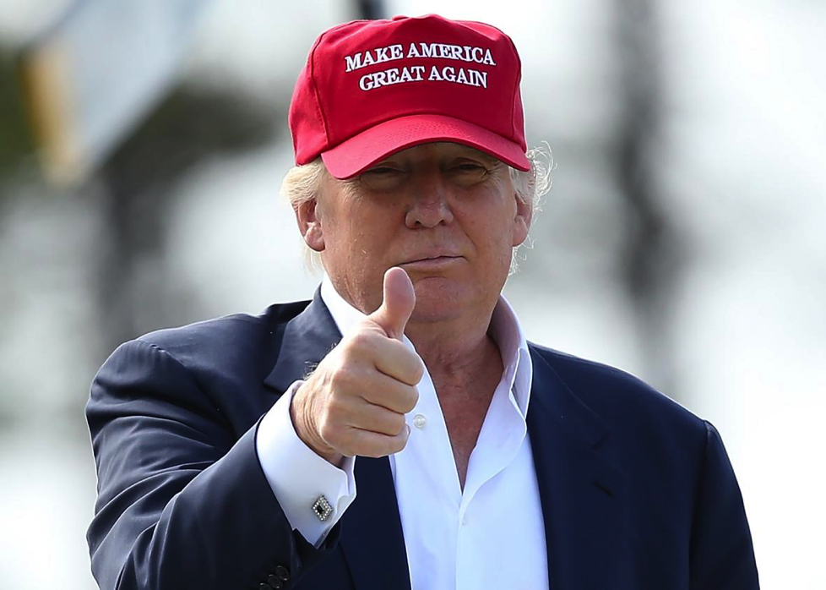
Inherited Political Traditions
If Donald Trump won the presidency, what would happen in the United States?

Slide 21
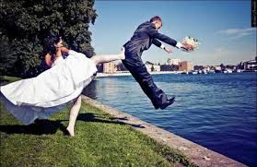
Economics
Political instability = Economic instability
Government (politics) and the economy are married. If one is doing well, so is the other. If one is doing poorly, the other one is, too.

Slide 22
Economics
Ms. Smith’s sister, Lucinda-Sue Smith, is $5,000 in debt. She needs to borrow $250 to pay off a late credit card bill. Lucinda-Sue does not have a job and does not know when she can pay back the money.
Good Idea
Bad Idea
Ms. Smith should spend the money on herself

Slide 23
Economic
As a result of years of political instability most Latin American countries economic growth has been hindered (slowed down).
A lack of investment capital (money $) from foreign countries who are doubtful of political stability. (High debt, Slow growth)

Slide 24
Conclusion: In The Past 20 to 30 years Democracy has Succeeded in most Latin American countries except Cuba.

Slide 25
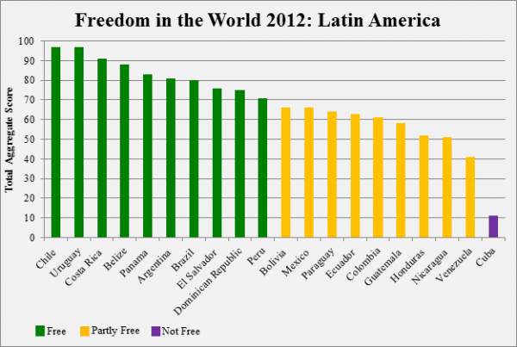
Conclusion

Slide 26
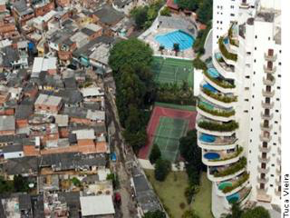
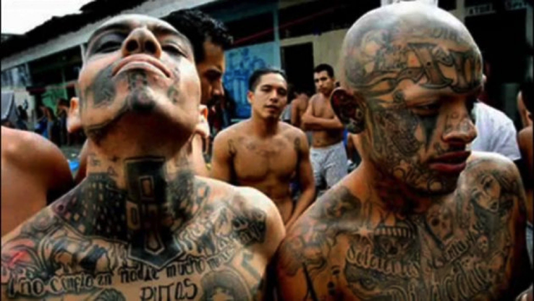
Conclusion
The income gap is large in Latin America. Leads to….
Informal Economy thrives because people need jobs. Leads to…
Spatial Inequality: is the unequal amounts of qualities or resources and services depending on the area or location, such as medical or welfare.

