Slide 1
Middle East
Antiquity,Modern History and Conflict

Slide 2
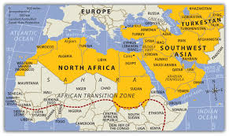

Slide 3
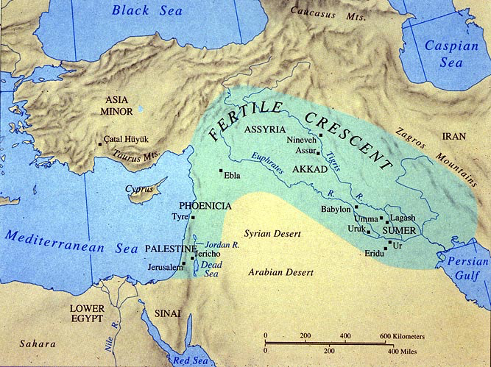
Ancient Mesopotamia
The Cradle of Civilization

Slide 4
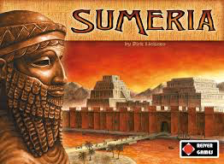
Ancient Sumeria, 4000-3000BC

Slide 5
Sumerian empire

Slide 6
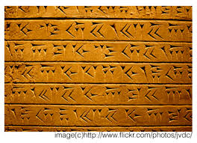
Ancient sumeria
The Sumerians were polytheistic.
Main Gods: Annunaki
Anu: god of heaven, the firmament.
Enlil: god of the air (from Lil = Air); patron deity of Nippur.
Enki: god of freshwater, male fertility, and knowledge; patron deity of Eridu.
Ereshkigal: goddess of the underworld, Kigal or Irkalla.
Writing: Sumerians used cuneiform to write, which is the earliest form of writing (started around 3000BC).

Slide 7
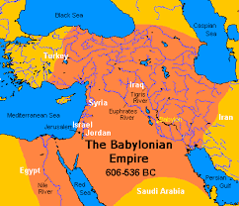
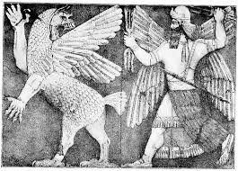
Babylonians, 2112-2004BC

Slide 8
Babylonian empire

Slide 9
The Babylonians
The Babylonians were polytheistic.
Main Gods: Inspired by Sumer
Marduk - Marduk was the primary god of the Babylonians and had Babylon as his main city. ...
Nergal - God of the underworld, Nergal was an evil god who brought war and famine on the people. ...
Tiamat - Goddess of the sea, Tiamat is drawn as a huge dragon. ...
Shamash - The Babylonian version of Utu.
Writing: Cuneiform

Slide 10
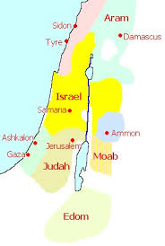
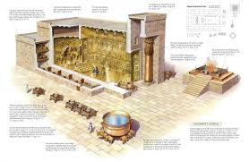
Israel, 1050-930BC

Slide 11
Kingdom of Israel

Slide 12
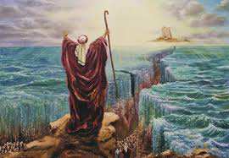
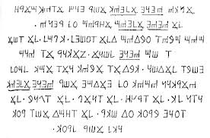
Israel
Isralites were monotheistic. They believed in Yaweh, the God of Abraham. Judaism.
Writing; Hebrew
What is the Holy Book of Judaism?

Slide 13
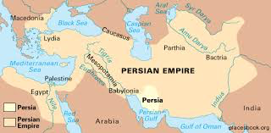
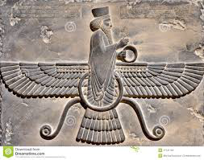
Persians, 550BC-330BC

Slide 14
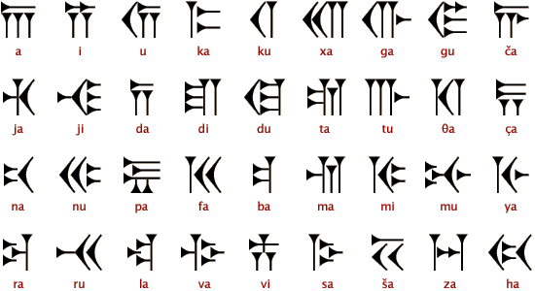
The Persians
Religion: The ancient Persians believed in a religion called Zoroastrianism (still around today). The Three Wiremen the Christian Bible were thought to be Zorastrists.
Writing: Persian Cuneiform

Slide 15
The Persian empire

Slide 16
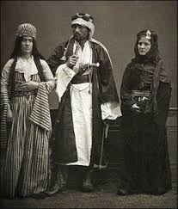
The Bedouins
The Bedouins were nomadic tribes (moved around a lot) that migrated to the Arabian peninsula. There are still Bedouin tribes today.

Slide 17
The Bedouins

Slide 18
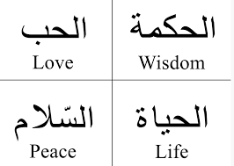
The Bedouins
Religion: From Bedouin tribes the early form of Islam emerged. Islam is monotheistic and has ties with Christianity and Judaism.
Writing: Arabic
What is the Holy Book of Islam?

Slide 19
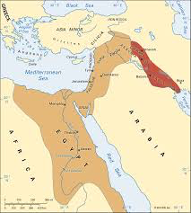
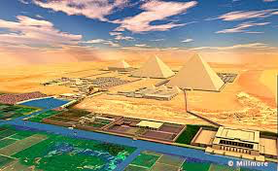
Egyptians, 3000BC-70BC

Slide 20
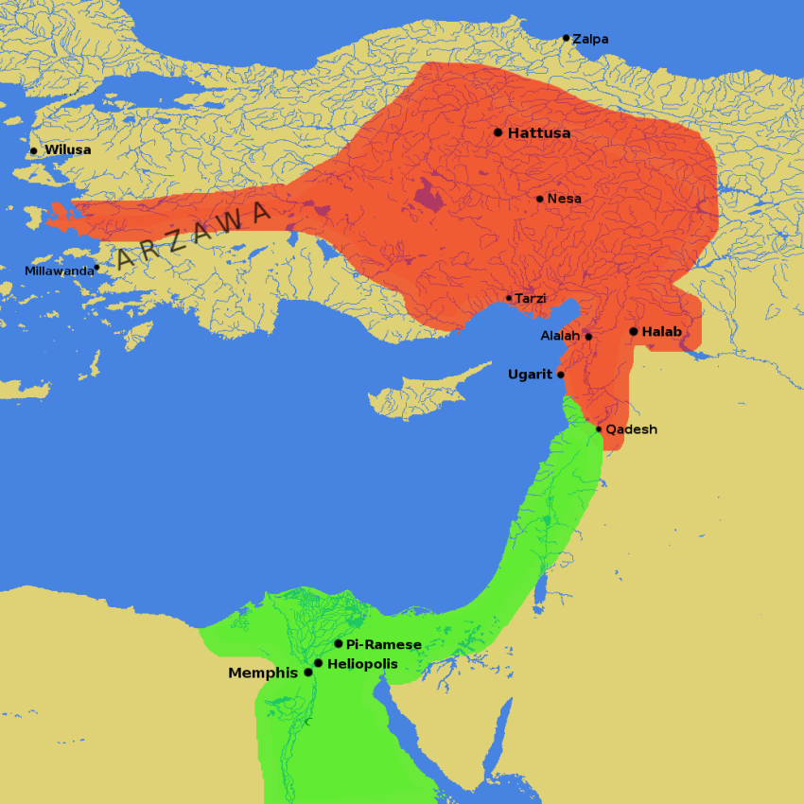
The Egyptian empire 1250bc

Slide 21
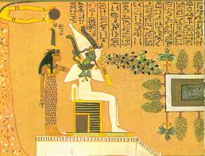
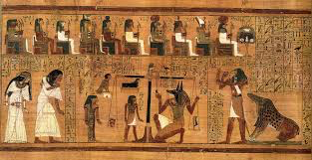
The Egyptians
Religion: The Egyptians were polytheistic and had over a thousand gods. Their religion was unique unto them, until Greek and Roman religions seeped in.
Writing: Egyptian Hieroglyphs (not Hieroglyphics)

Slide 22
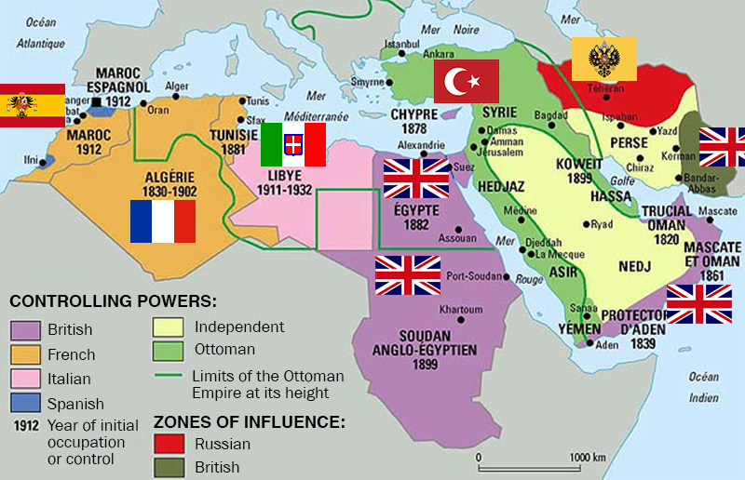
Early 1900’s
Much of the Middle East is under European control.

Slide 23
Early 1900s
There was a movement during the late 1800s and early 1900s known as Zionism.
Zionism is the political movement to re-establish the Jewish nation of Israel, or give the Holy Land back to the Jews, who are sometimes referred to as the People of Zion (which is another name for Jerusalem).

Slide 24
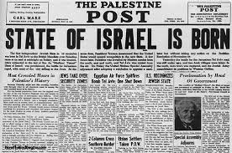
1948
The state of Israel is created by the United Nations.

Slide 26
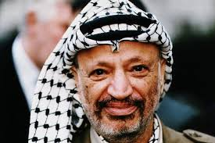
1960’s
PLO (Palestinian Liberation Organization) becomes active. Yasser Arafat is the leader

Slide 27
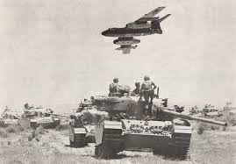
1967
Arab-Israeli 6 Day War. Israel wins and takes territory from Arab countries.

Slide 28
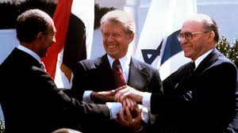
1970’s-1990’s
Peace efforts, helped by the USA, bring some stability to the region.

Slide 29
1970’s-1980’s
Conflict and terrorism in Lebanon due to Christian/Muslim conflict. US embassy is bombed in 1983.

Slide 30
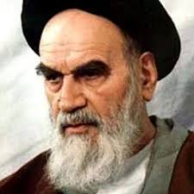
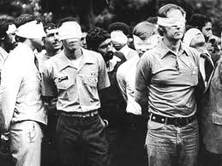
1979
Iranian Hostage Crisis

Slide 31
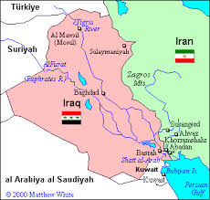
1980-1988
Iran-Iraq War

Slide 32
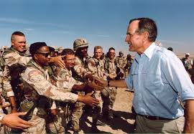
1991
Persian Gulf War US and Allies vs. Iraq

Slide 33
1993
First World Trade Center bombing

Slide 34
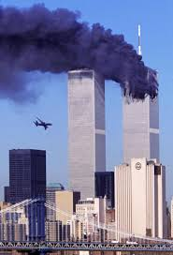
2001
9-11 Terrorist Attacks, WTC, Pentagon, Pennsylvania

Slide 35
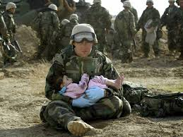
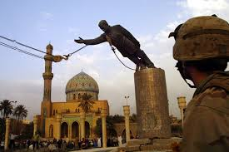
2003
Iraq War

Slide 36
Traditional Motives for Terrorism
Gaining independence
Expelling foreigners
Changing society

Slide 37
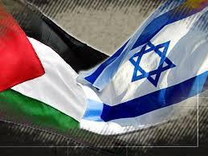
Israeli-Palestinian Conflict
Terrorism resulting from Arab anger at Israel and at the USA for supporting Israel.

Slide 38
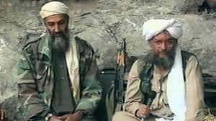
Al-Qaeda
Global network of Muslim terrorists—was led by Osama Bin Laden—opposes American influence in Muslim lands

Slide 39
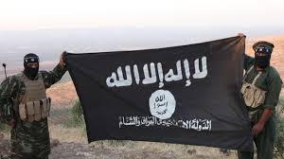
2014…..2015…..?
ISIS Islamic State of Iraq and Syra, sometimes called ISIL (Islamic State of Iraq and the Levant)

