Slide 1
Oil/Water Crisis in Southwest Asia (Middle East)

Slide 2
Essential Questions
How do humans interact and adapt to their environment?
What makes a country “rich”?

Slide 3
Where is Oil Found?
A huge amount of the world’s oil is found in Southwest Asia, or the Middle East.
This area was once under water, creating the perfect conditions (plants and animals) to begin the oil-making process
Plate Tectonics- Iranian plate and the Arabian plate collided, therefore trapping oil and gas.

Slide 4
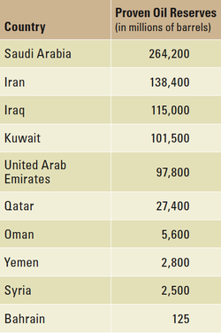
Uneven Distribution
Saudi Arabia, the largest country in Southwest Asia has the most oil.
¼ of the world’s oil can be found under the Saudi Arabian deserts.

Slide 5
The Price and Flow of Oil
OPEC- Organization of the Petroleum Exporting Countries
Most oil-exporting countries rely on oil sales to support their economies.
Exporting countries primary source of income
Oil-importing countries depend on oil from Southwest Asia
What do we use oil for?
What would life be like without oil?

Slide 6
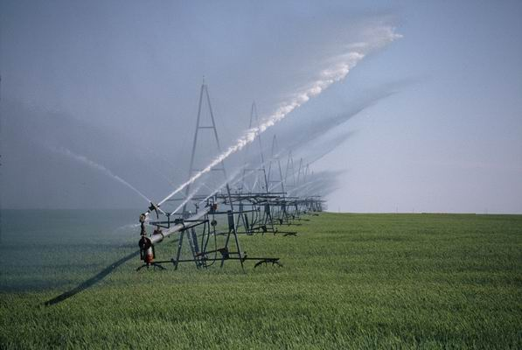
Water Crisis!!!!!
The climate in Southwest Asia is mostly desert.
Because of this, there is very little precipitation and ground water.
Since precipitation is so scarce, farmers have to water or irrigate their crops.

Slide 7
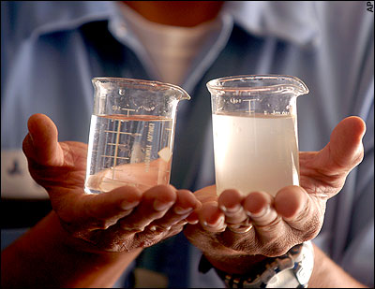
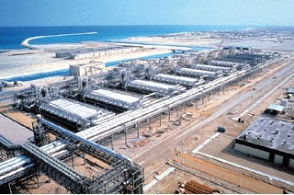
Desalinization
Though there is ample water supply in the region (lakes, rivers, ocean) there is a shortage of drinking water.
Desalinization- a process that removes salt from sea water

Slide 8
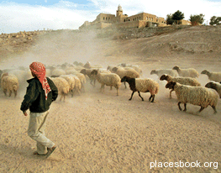
Land Usage
Because farming is possible mostly through irrigation, much of the land is used raising limited livestock through herding or ranching.

