Slide 1
Europe: The Effects of USSR’s Fall

Slide 2
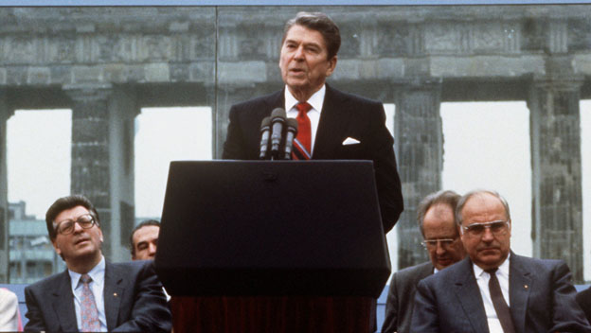
Our Story Continues…

Slide 3
Essential Questions
How did the collapse of the USSR lead to the creation of the modern political make-up of Europe?
Collapse: The inability of the Communist Party in Russia to continue its regime; the dissolving of the Russia’s communist republic.
Political Make-Up: The interaction of governments in Europe.
What factors contribute to the success or failure of new nation-states?

Slide 4
Key Terms
Nation-State: a country whose people mostly share a common identity
NATO: North Atlantic Treaty Organization, a military alliance between Western countries (Canada, France, US, England, and Western Europe)
Standard of Living: the level of wealth, comfort, material goods and necessities available in a geographic area.
Balkanization: the separation of an area into smaller territories.

Slide 5
The Fall
Western Countries (Democratic countries, such as America, England, France) created a treaty during the Cold War that solidified (made official) their alliance.
If one country in NATO was attacked, all the countries in the alliance would react.
There are 23 countries in NATO today.
NATO membership is open to “any other European state in a position to further the principles of this Treaty and to contribute to the security of the North Atlantic area.”

Slide 6
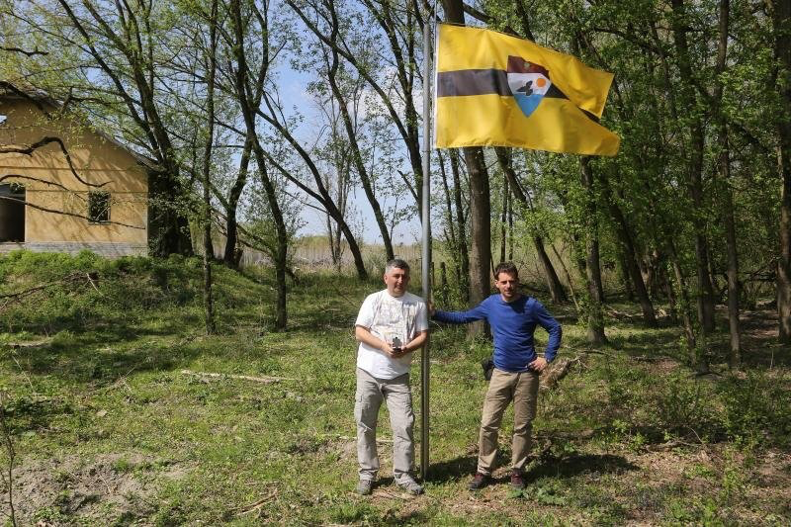
The Fall
The big question on everyone’s mind:
WILL LIBERLAND BECOME PART OF NATO?
Classy →

Slide 7
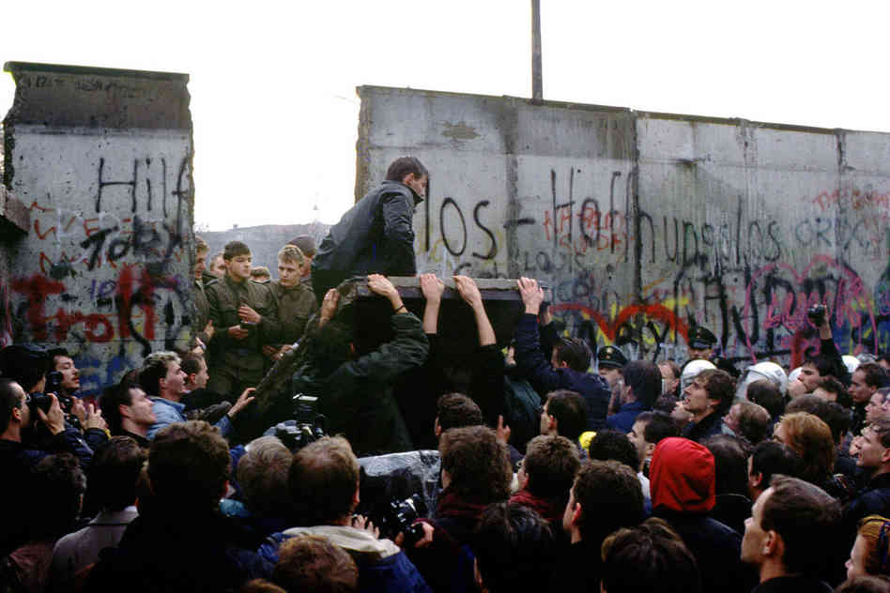
The Fall
The beginning of the end was marked by the fall of the Berlin Wall in 1989, which was attended by President Ronald Regan.
East and West Berlin were reunited.

Slide 8
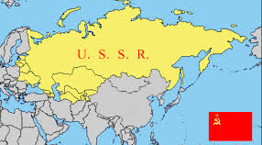
The Fall
The USSR - #big #REALLYbig

Slide 9
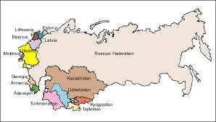
New Beginnings
The Former Soviet Union Today—15 New Nation States
#NewCountries

Slide 10
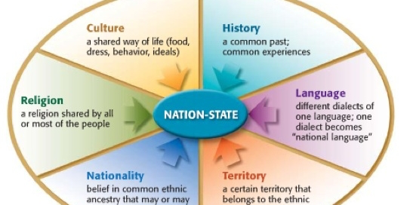
New Beginnings
The former Soviet Union is now a group of 15 separate nation-states.

Slide 11
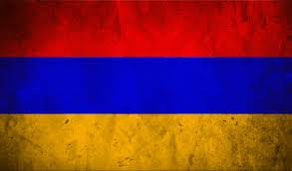
New Beginnings
Nation—group of people who share a common history and culture
State—political unit that controls a fixed territory
So a NATION-STATE is a country whose people mostly share a common identity
What country does this flag belong to?

Slide 12
Question
What famous politician is this? Hint: Her goal is to bring awareness to the many forms of genocide around the world.

Slide 13
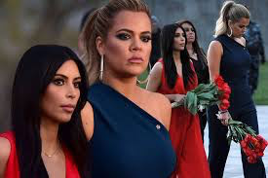
Answer
Kim Kardashian, who is of Armenian decent!
Like many other nation-states, Armenia became an independent country after the dissolution of the USSR. This happened in the early 1990s.

Slide 14
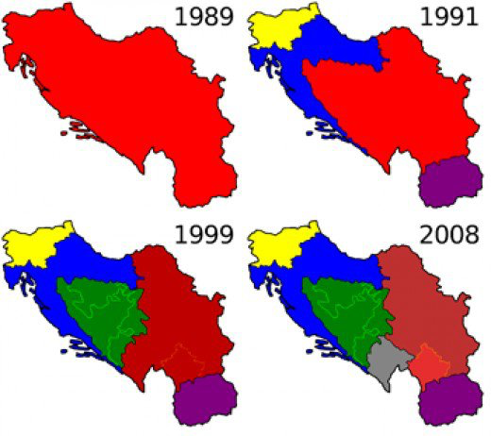
New Beginnings
Ethnic Tension: Conflict between different ethnic groups.
Balkanization: In the early 1990s the disintegration of Yugoslavia and the collapse of the Soviet Union led to the emergence of several new states—many of which were unstable and ethnically mixed—and then to violence between them. – britannica.com

Slide 15
New Beginnings
In short:
The fall of the Soviet Union created an unstable and unpredictable atmosphere in Eastern Europe, since most countries had been under communist rule for decades.
How are they doing??

Slide 16
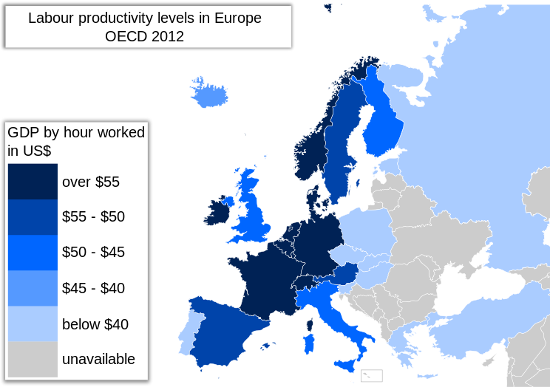
New Beginnings
What part of Europe makes the least amount of money?

Slide 17
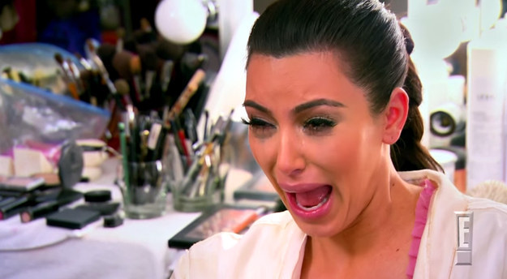
New Beginnings
Has Eastern Europe really been affected by the Cold War?
KimmyK is crying for Eastern Europe

