Slide 1
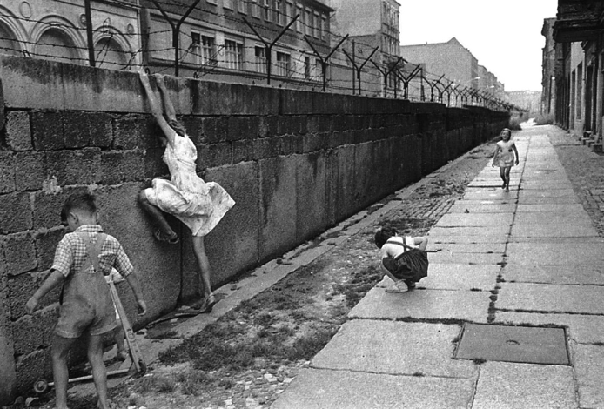
Road to Modern Europe 1950-1990

Slide 2
Objectives
Political boundaries formed after the fall of the USSR (Union of Soviet Socialist Republics).
Transboundary Pollution: Pollution that crosses political borders.
Regional Cooperation: Neighboring countries working together to achieve a common goal.

Slide 3
Essential Questions
How can population impact the political situation of a country?
How can a government fail?
Terms to Know:
Population: The people who inhabit (live in) a certain area.
Political Situation: The government and its relationship with other countries and the people living within its control (the population).

Slide 4
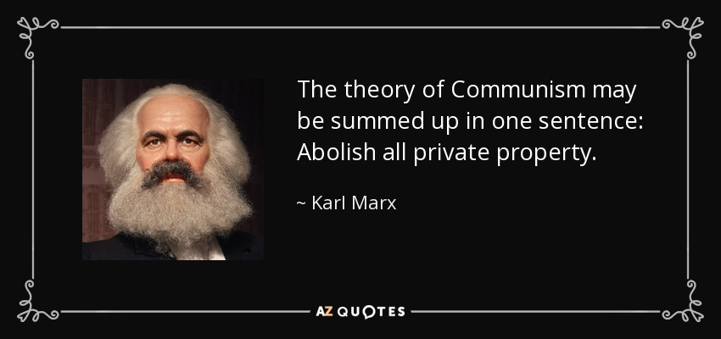
The War Rages
Communism in Russia: The Beginning

Slide 5
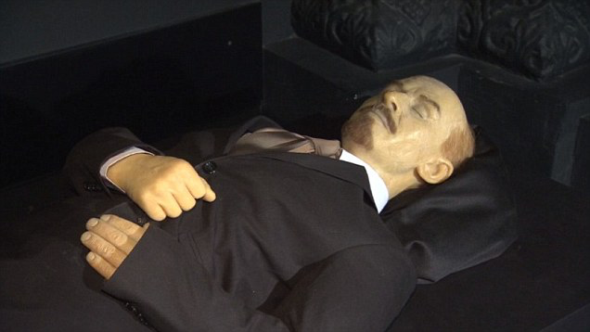
The War Rages
Embalmed body of Vladimir Lenin, who died in 1924. You can see him for free at the Lenin Mausoleum in Russia!
Why is this guy important??

Slide 6
The War Rages
Communism in Russia, a brief history:
1917: Russia withdraws from WWI due to an emerging civil war, a conflict between the monarchs (Tsarists) and communists (Bolsheviks).
1917: Czar Nicholas was forced to abdicate his throne by communists who had taken control of the government, led by Vladimir Lenin.
1918: The Czar and his family were executed. The new Russian government adopts Communist policies.
1933: USSR is admitted to the League of Nations
1941: Nazi Germany invades the western USSR. Russia joins the Allies.

Slide 7
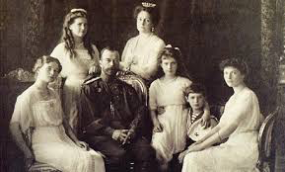
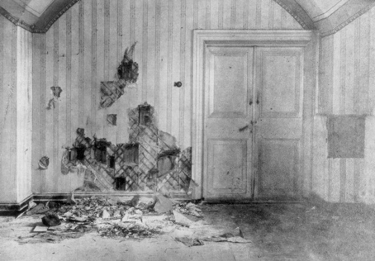
The War Rages

Slide 8
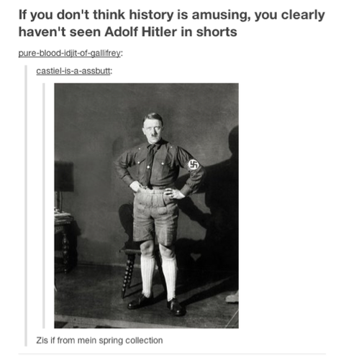
The War Rages
Dear Future Dictators,
If you want to take over the world, do not invade Russia until you have plenty of
time and money.
Sincerely,
Adolf Hitler and Napoleon Bonaparte

Slide 9
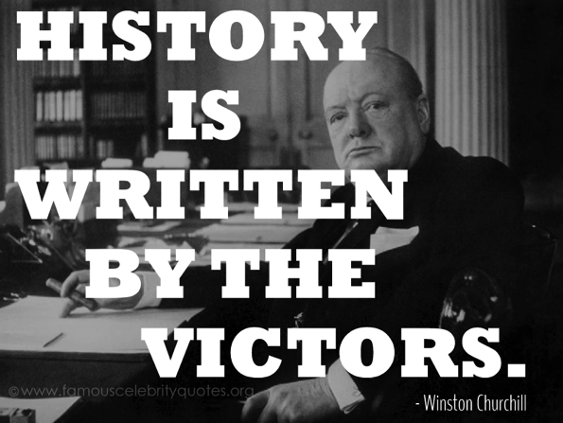
The War Rages
Because the Allies (US, England, France, and Russia) won WWII, the losing country (Germany and its territories) were divided between them.

Slide 10
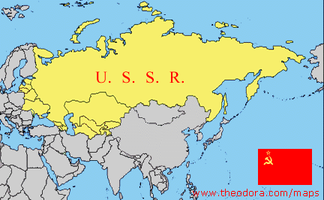
The War Rages
After the end of WWII, Europe was divided between the democratic West (England, America and France) and the communist East (the USSR and its countries).
The USSR was #big
#REALLYbig

Slide 11
The War Rages
Due to heightened tensions, the world’s two superpowers (United States and Soviet Russia) began to compete to be the best. This lead to an increase in weapons, technology, armies, and nuclear bombs.
The Cold War: Rivalry between the US and USSR for control over the postwar world.
Arms Race: Build up of weapons, bombs, and armies.
Space Race: Race to see who could put a man on the moon first.

Slide 12
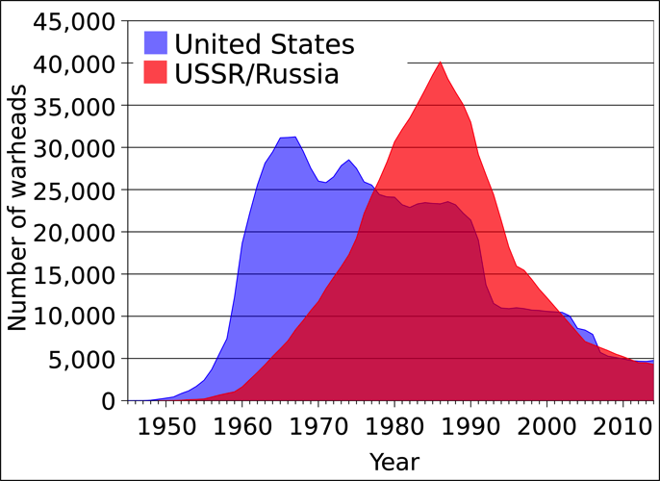
The War Rages

Slide 13
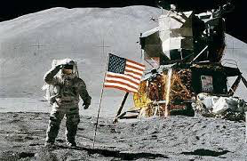
The War Rages
“Fate has ordained that the men who went to the moon to explore in peace will stay on the moon to rest in peace.”
Exert from President Nixon’s Apollo 11 Failure Speech, if it had been needed.

Slide 14
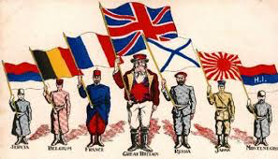
The War Rages
While tensions escalated (grew), nationalism began to grow amongst countries that were involved.
Nationalism: A deep sense of pride for one’s country. War and moments of distress can unite people.

Slide 15
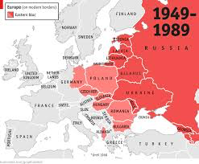
The War Rages
During the late years of the 1980s, communism in the USSR began to fail.
Remember, Communism in Russia began about 1917, so that’s about a 70 year time period.
WHY??

Slide 16
The Fall of USSR
After about seven decades of communist rule, the government was not able to provide for the people under its control.
People were not motivated to work, since hard work usually did not lead to fortune. This lead to less manufacture (aka, less money $$$).
Under Joseph Stalin, 48 million people were killed for various reasons, typically being an “enemy of the state.”

Slide 17
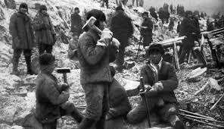
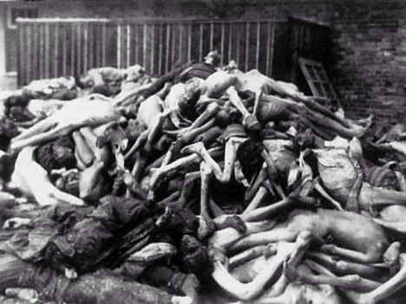
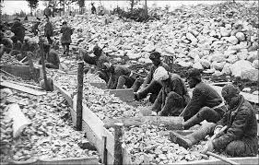
The Fall of the USSR
Soviet Guglags (Work Camps)

Slide 18
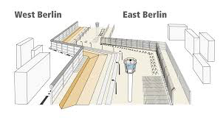
The Fall of the USSR
Due to the poor economic environment in Eastern Berlin (the communist controlled section), people began to migrate to the western side….
The USSR was concerned that too many people were leaving, so they created a wall to cage the Berliners in.

Slide 19
Question
People are leaving Ms. Smith’s class in large numbers. Students claim the sorry jokes and long lectures are just too awful to stand. This looks bad on Ms. Smith, who refuses to change her ways. How can this problem be solved?
Allow for 30 minutes of free time
Create more exciting lessons that are free from corny jokes and long lectures.
Not allow students to go to the counselor and force them to say nice things, or else their grade will suffer.

Slide 20
Answer
Not allow students to go to the counselor and force them to say nice things, or else their grade will suffer.
It’s all about appearances!!! It could be total chaos in Ms. Smith’s room, but as long as no ones knows, it’s all good…
But for real, this was the USSR’s solution for major issues.
Fear and intimidation plus lots of denying = good international reputation.

Slide 21
The Fall of the USSR
Case and Point: Chernobyl
In 1986, the Chernobyl Nuclear Power Plant in the Ukraine experienced a massive accident that led to a meltdown of the core.
Radiation went EVERYWHERE.
The USSR refused to acknowledge that anything was wrong until other countries began to detect large amount of radiation.
At that point, the Soviet Union had to admit that Chernobyl had an accident.

Slide 22
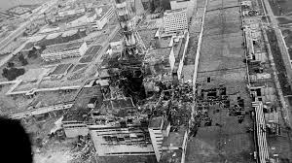
The Fall of the USSR

Slide 23
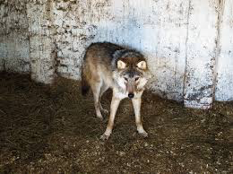
The Fall of the USSR
Chernobyl Today
The radiation at Chernobyl is still so high, that the plant and the neighboring town cannot be occupied by humans.
Giant wolves are rumored to have grown from the radioactive environment around Chernobyl.

Slide 24
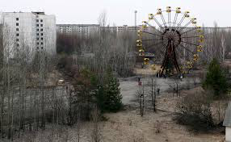
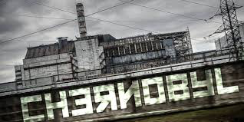
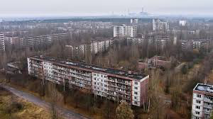
The Fall of the USSR

Slide 25
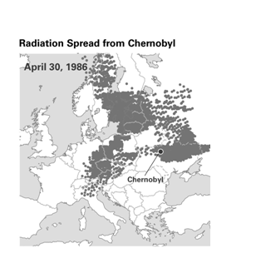
The Fall of the USSR
Radiation, and other forms of pollution, is not contained by political boundaries; therefore, it becomes everybody’s problem.
This is known as transboundary pollution, and is still a problem today.

Slide 26
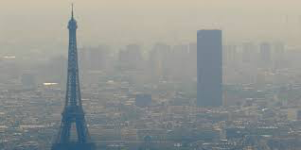
Question
How can regional cooperation help the world obtain (get) a cleaner environment? Answer on your sheet.
Smoggy haze created by pollution in Paris, France (not Paris, Texas).

Slide 27
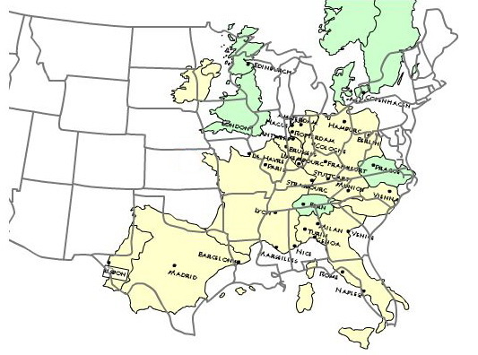
Answer

Slide 28
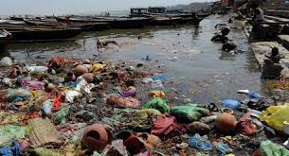
Answer
Ms. Smith’s Answer: Since pollution affects everyone, regardless of who created it, countries must work together and have similar policies in order to combat its negatives effects, which are, but not limited to, dirty water and dangerous air.
Not clean →

Slide 29
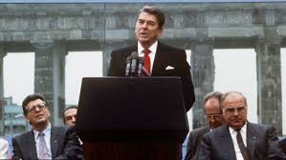
The Fall of the USSR
The deteriorating (worsening) conditions in Eastern Europe (controlled by the USSR) and the inability of the Soviet government to take care of its people hastened (quickened) the end of the USSR and the Cold War. This came to an end with the fall of communism in Russia.

Slide 30
Modern Europe

