Slide 1
Spatial inequality

Slide 2
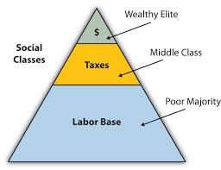
Beginning in colonial period
Majority of the wealth was owned by the top ruling class, the Wealthy Elite. They taxed the middle class, also a small group.
Majority of the people fell in the Labor Base category. Typically, these people were not given good access to resources such as education and good medicine.

Slide 3
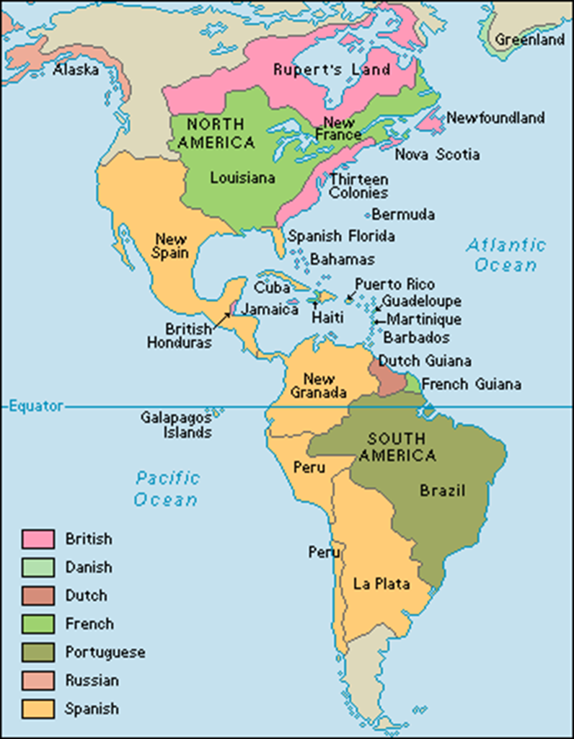
Colonialism
A practice of acquiring (gaining) full or partial political control over another country, occupying it with settlers and exploiting it economically.
North America- colonized by Britain, Spain and France
South America- colonized by Spain and Portugal

Slide 4
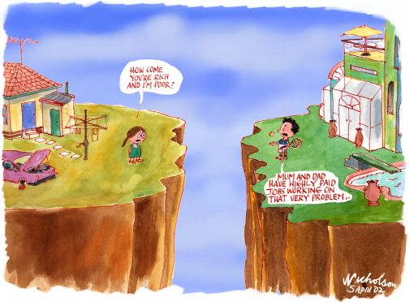
Income Gap
The economic divide between the rich and the poor. (uneven distribution of wealth)
In Latin America (S. America) it is classified as a 85/15 split of wealth between the rich and poor.

Slide 5
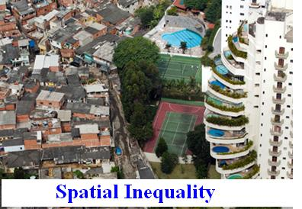
Spatial Inequality
Unequal amounts of resources and services.

Slide 6
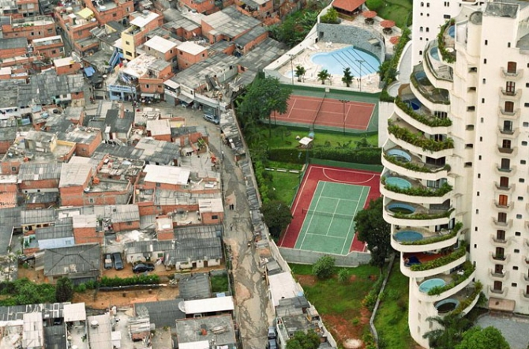
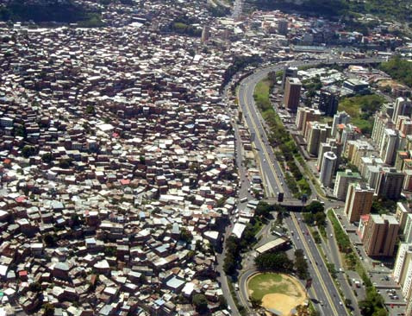
Even though the Spanish and Portuguese lost control of South America (Latin America), their descendants still had all the power and held most of the resources, creating an uneven distribution of wealth and resources. Only the very wealthy have enough money for creature comforts such as the apartments located on the top of the screen.
Many people live without electricity, wifi, concrete roads, running water, and access to medical care and education.

Slide 7
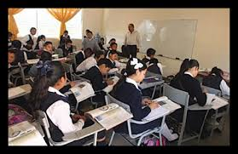
Lack of Education
The poor lack the basic skills that would make taking part in the formal economy possible.
Little education = low paying jobs
What has caused this lack of Education?
Who is responsible for a country’s education?

Slide 8
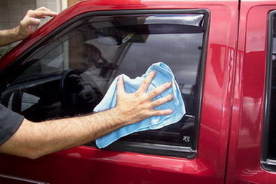
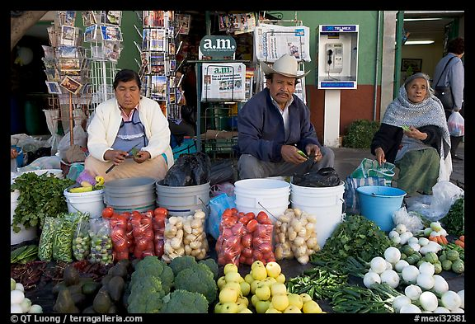
Informal Economy
Jobs that take place outside official channels, without benefits or protection for workers.
For millions of people in Latin America this is the only type of work they have.
Why Only These Jobs?
Examples:
-Subsistence Farmers
-Street Vendors
-Illegal Activity

Slide 9
Income Gap Numbers
15% of people own 85% of wealth
85% of people only own 15% of wealth
How could this lead to the Drug wars and drug trafficking?

