Slide 1
Trade in the Americas

Slide 2
The Beginning: Columbian Exchange
DURING THE COLONIAL PERIOD:
Columbian Exchange: During the period of European colonialism, there was an exchange of plants, animals, and diseases.
Question: What animal was introduced to the Americas by the Europeans?
A) Cows
B) Horses
c) Sheep

Slide 3
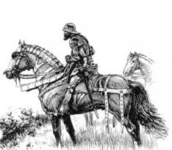
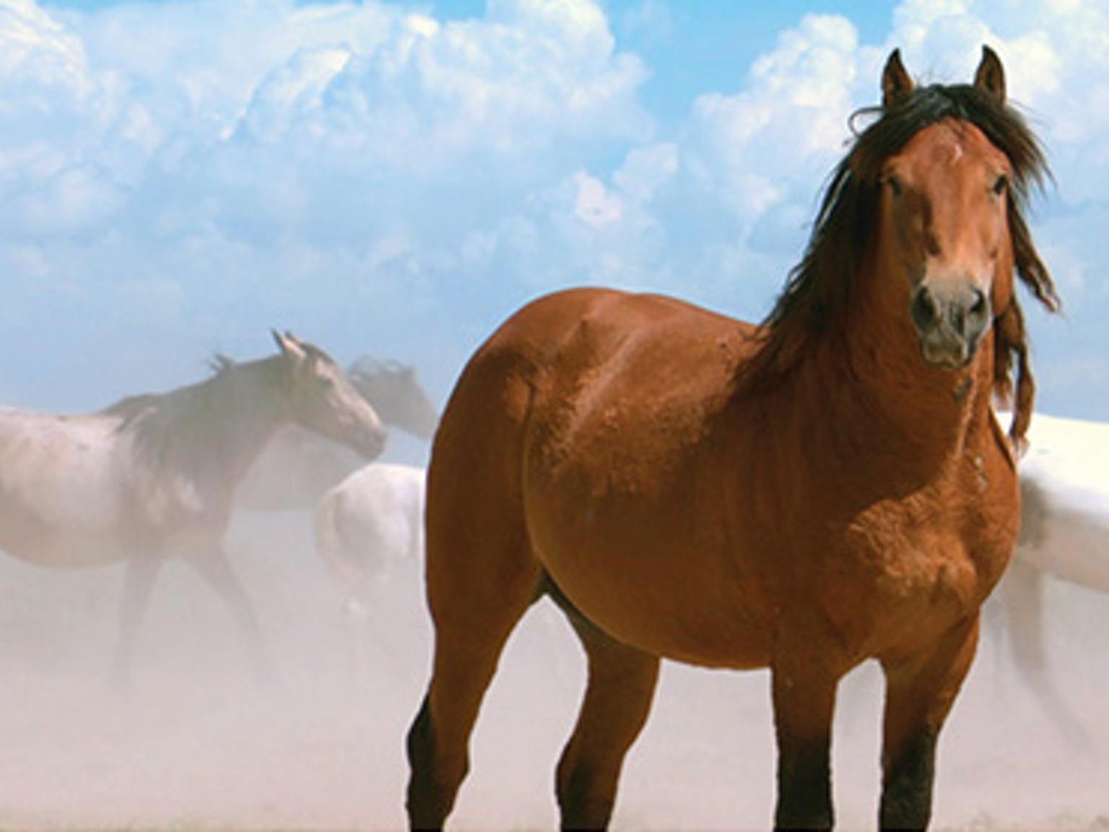
The Beginning: The Columbian Exchange
Answer: All three animals were brought over to the Americas because of the colonial exchange.
American Mustang: Heavy Spanish Influence
Spanish Conquistador

Slide 4
The Beginning: The Columbian Exchange
What percentage of Native Americans were killed by European diseases?
A) 35%
B) 55%
C) 90%

Slide 5
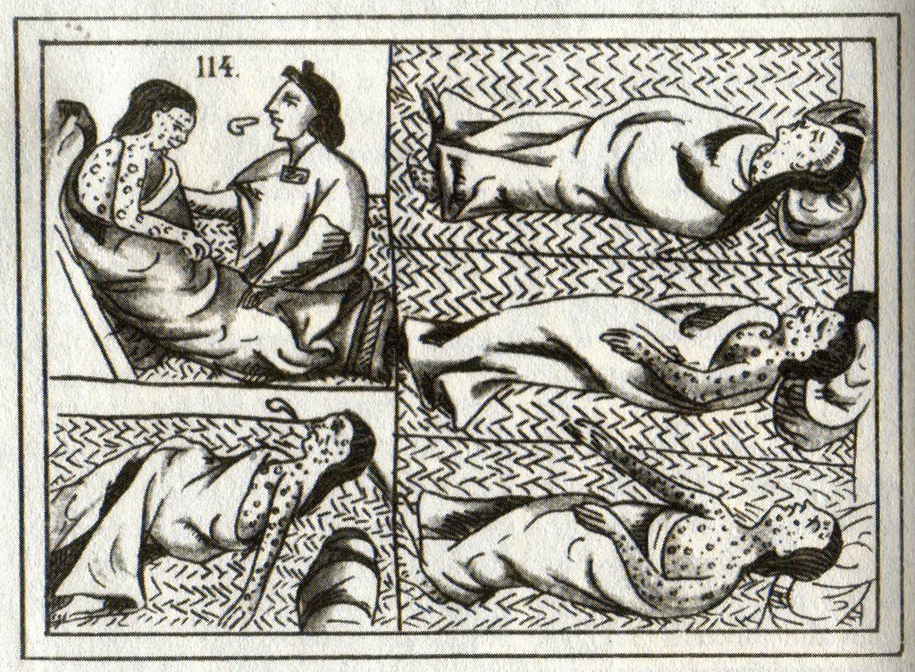
The Beginning: The Columbian Exchange
Correct Answer: C
“Within just a few generations, the continents of the Americas were virtually emptied of their native inhabitants – some academics estimate that approximately 20 million people may have died in the years following the European invasion – up to 95% of the population of the Americas.”
-- Jared Diamond, Guns, Germs, and Steel

Slide 6
The Beginning: The Columbian Exchange

Slide 7
The Beginning: The Columbian Exchange

Slide 8
Trade Today: NAFTA
North American Free Trade Agreement:
Countries involved: Canada, USA, and Mexico
A free trade agreement is an agreement between countries to reduce restrictions on imports and tariffs.
Tariff: Tax on imported goods
Import: Good brought into the country (buying)
Export: Good that is being shipped out (selling)

Slide 9
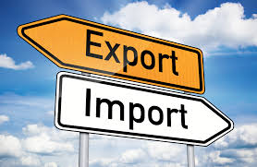
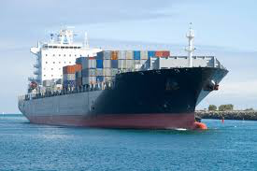
Trade Today: NAFTA
Why would countries want to place a tax on imported goods?

Slide 10
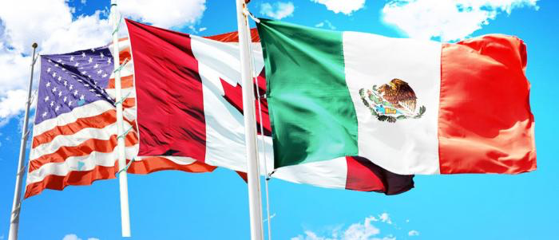
Trade Today: NAFTA
Benefits from NAFTA:
Unemployment decreased
Manufacturing and trade increased (making money)
Wages in Mexico and America grew.

Slide 11
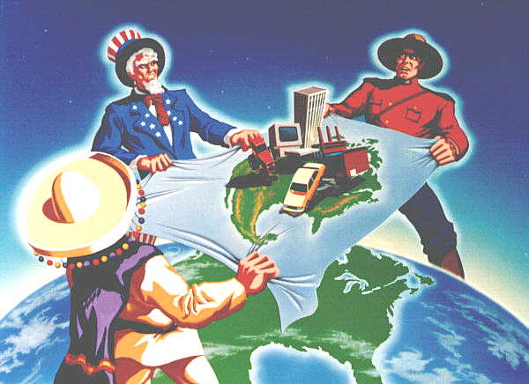
Trade Today: NAFTA
Disadvantages of NAFTA
Canadian social programs were negatively affected.
Illegal immigrations was not “curbed,” as was the theory.

Slide 12
Trade Today: NAFTA and CAFTA
CAFTA
The Central American Free Trade Agreement: a free trade agreement that includes the US, El Salvador, Nicaragua, Guatemala, Honduras, and Costa Rica.
While the free trade helped increased exports from Latin America, the economic growth was not fast enough to help.

Slide 13
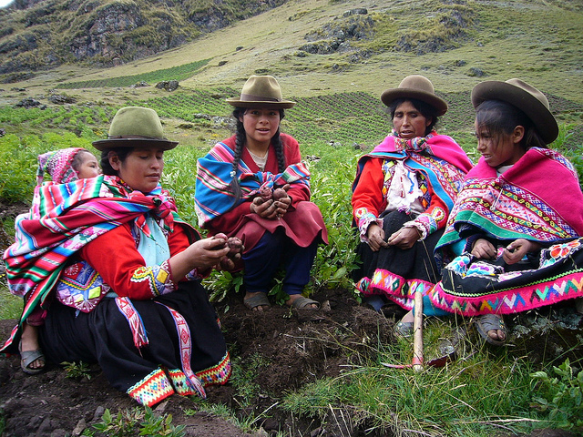
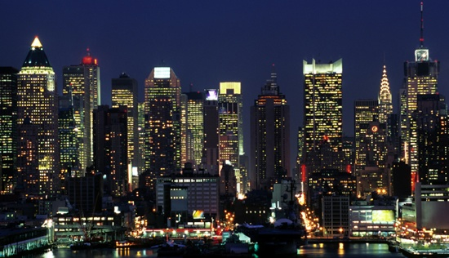
Trade Today: The Future
Why are Latin American Countries less developed and the U.S. and Canada More Developed?

Slide 14
Trade: The Future
Lack of Education:
The poor lack of basic skills that would make taking part in the formal economy possible.
Little education = low paying jobs
What contributed to the lack of education in Latin America?
Who should be responsible for education?

Slide 15
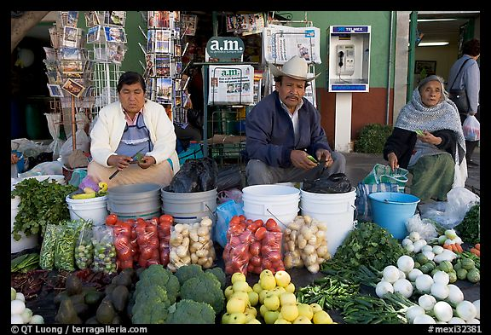
Trade: The Future
Informal Economy:
Jobs that take place outside official channels, without the benefits of protection for workers.
Subsistence Farming
Street Vendors
Illegal Activity
Why is the informal economy the only way millions in Latin Americans can find work?

Slide 16
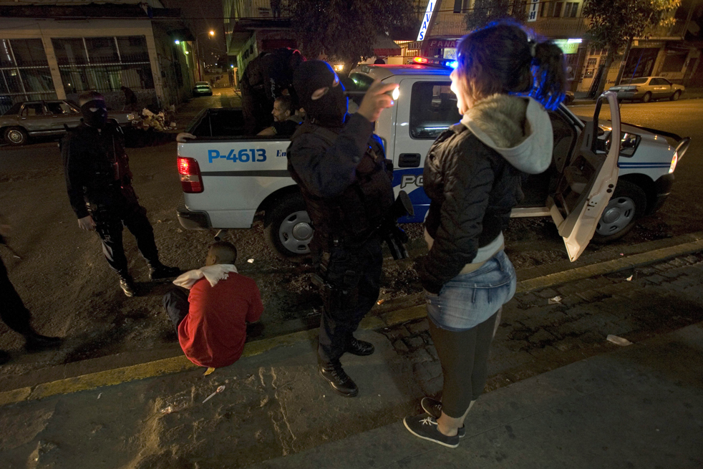
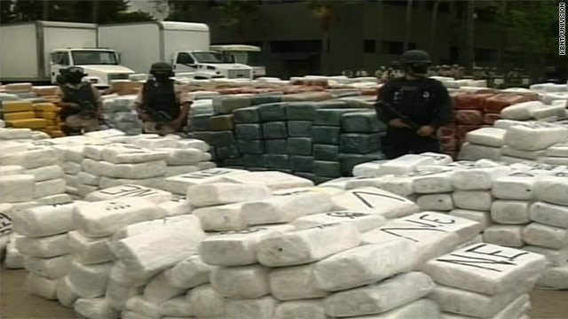
Trade: The Future
Drug Trafficking

Slide 17
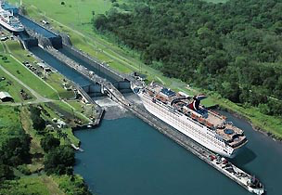
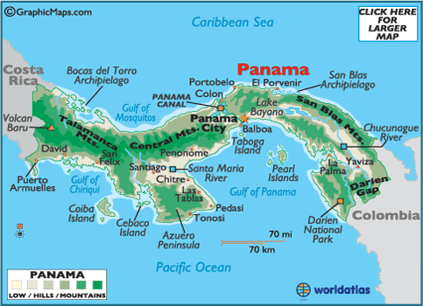
Trade: The Future
The Panama Canal, located in Panama, was created to help international trade. The canal connects the Pacific and Atlantic oceans.

