Slide 1
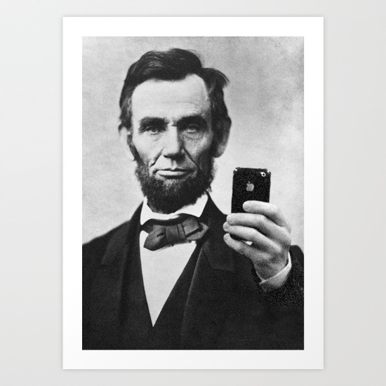
The United States of America
A brief guide

Slide 2
True or False
America has 50 states.

Slide 3
True or False
America is the third largest population in the world.

Slide 4
True or False
America has had 150 presidents.

Slide 5
True or False
The Constitution is the second constitution of the USA.

Slide 6
True or False
Mt. Everest is in America.

Slide 7
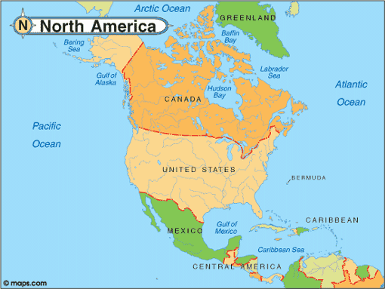
North America

Slide 8
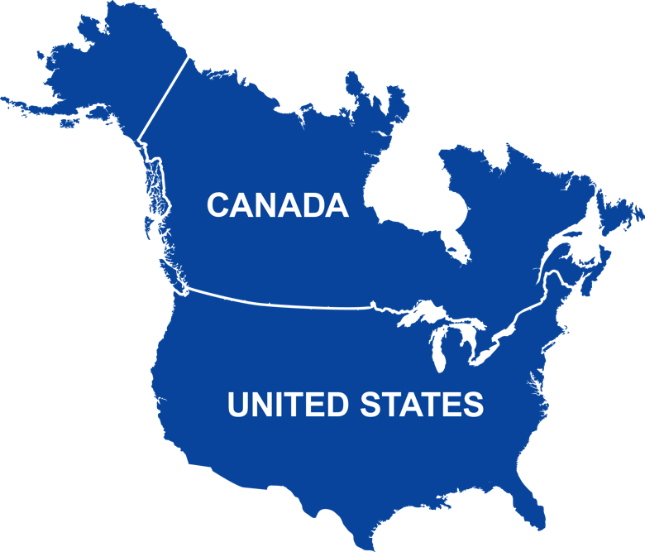
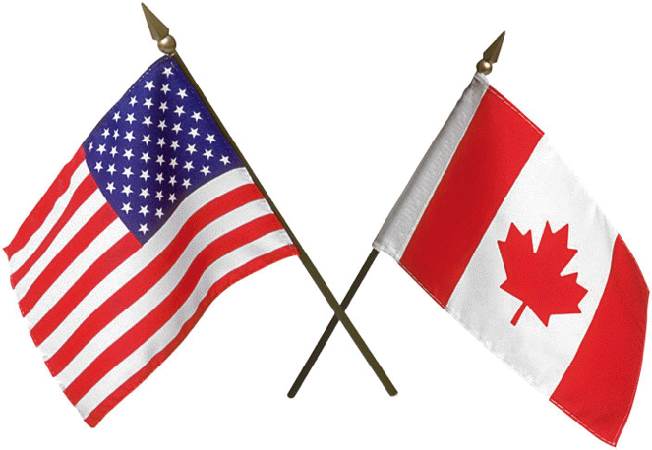
US and Canada
Have similar cultures because they have similar colonization stories.

Slide 9
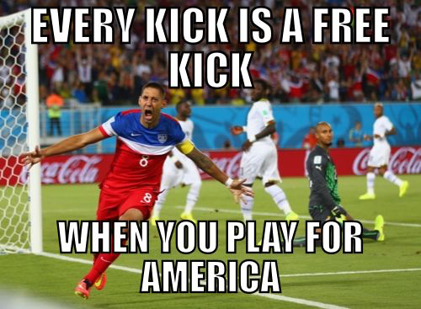
The United States of America

Slide 10
Parts
Essential Questions
Vocabulary
Ancient America
Colonization
Landforms
Political Process

Slide 11
Essential Questions
What traditions did European colonizers leave behind?
How does the American political system work?

Slide 12
Vocabulary
Colonization: the process of creating a settlement away from the country of origin.
Federal Government: a government based upon power being broken up (i.e. checks and balances, different tiers of government)
Presidential System: political structure that has three branches of government and a president as the head of the Executive branch.

Slide 13
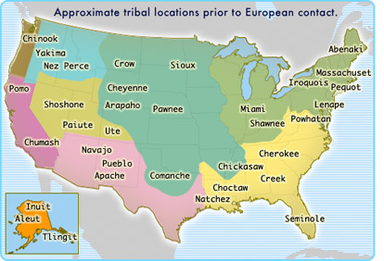
Ancient America
First inhabited by a group the Native Americans, who came to the North American continent somewhere between 10,000-30,000 years ago.

Slide 14
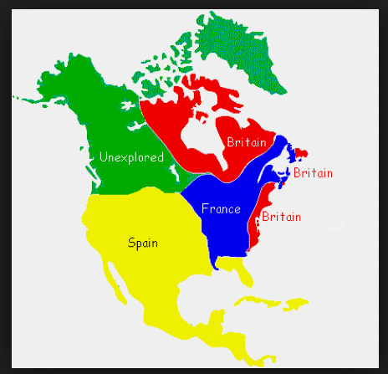
Colonization
After Columbus’ discovery of the “New World,” many European countries moved men, animals, and weapons to America.

Slide 15
Question
What were the main colonizing forces (or countries) of the country now known as the USA?
Portugal and England
England and France
Mexico and England

Slide 16
Answer
B) England and France

Slide 17
America Today
After receiving it’s independence upon winning the Revolutionary War, the USA became the world’s first modern democratic country.
At the time, countries did not allow people to fully decide how government was going to be run. (It was pretty stellar!)

Slide 18
America Today
America is home to roughly 321 million people.
27 million Texans.
There are three branches of government, the Judicial (the courts), the Legislative (Congress), and the Executive (President and police force).
The US government is also divided into tiers: Local, State, and Federal (national).

Slide 19
America Today
Major Landforms
Rocky Mountains
Appalachian Mountains
Redwood Forest
Mississippi River
Gulf of Mexico
Great Lakes

Slide 20
Rocky Mountains

Slide 21
Appalachian Mountains

Slide 22
Redwood Forest

Slide 23
Mississippi River

Slide 24
Gulf of Mexico

Slide 25
Great Lakes

Slide 26
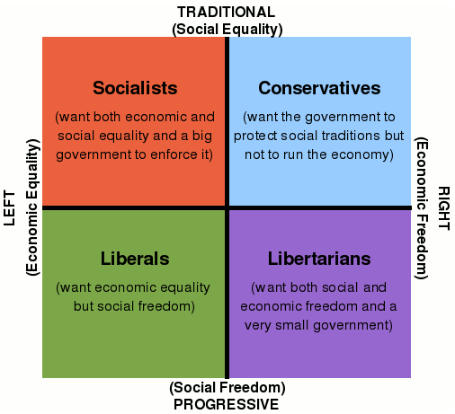
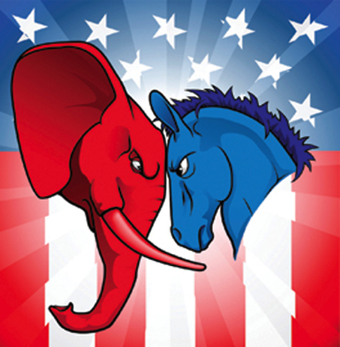
Political Process
America has to major political parties:
Democrats: Donkey
Republicans: Elephant

Slide 27
Political Process
America is a democratic republic, meaning that people vote for elected officials.
Representatives, Presidents, governors, railroad commissioners, pretty much everyone in government (except for Justices of the Supreme Court)
The President is NOT elected by the people; rather, he is elected by the Electoral College, who is elected by the people

Slide 28
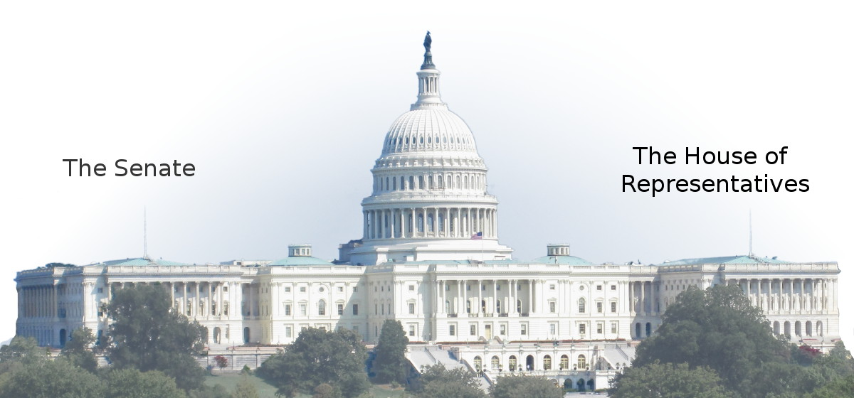
Political Process
Who makes the laws? Congress (House of Representatives and the Senate) makes the laws. In order for a bill to become a law, it must be approved by both houses. (Bicameral system).

Slide 29
Political Process
Electoral College, essentially a point based system
A presidential candidate (this time Hillary Clinton and Donald Trump) and his/her party have to win 51% of a state’s popular vote in order to win all the electoral votes (or points) of that state.
Texas has 38 electoral votes, which is determined by the number of Representatives (subject to change) + Senators (always 2) a state has.
The party that wins the 51% of the popular vote in the state gets to send all its electors to the Electoral College.
The candidate that receives 270 (51% of the overall electoral votes)

Slide 30
Political Process
Electoral College continued
It is possible to win the popular vote but not become president.
The Founding Fathers structured the presidential election process this way in order to prevent people abusing their right to vote. They wanted to make sure there was a way to weed out “celebrity like” candidates.
Also, this system requires presidential candidates to have a broad geographical support.
Because a candidate needs to win at least 51% of the vote, it makes it difficult to have more than two parties.

Slide 31
Our Political Process
Two Parties – One Candidate
Will have electors that decide who becomes president.

Slide 32
Liberal vs Conservative
https://www.isidewith.com/political-quiz

